Slide 1
Psychotherapy 101
Zhanna Elberg M.D.
Assistant Professor of Clinical Psychiatry
Director of Psychotherapy Training
University at Buffalo
Department of Psychiatry

Slide 2
Disclosures
NO FINANCIAL, GENERAL, OR OBLIGATION INTERESTS TO REPORT

Slide 3
Learning Objectives
Define Psychotherapy
Describe indications for psychotherapy
Distinguish between Psychodynamic Supportive and Cognitive Behavioral (CBT) Psychotherapies
Describe theories of therapeutic action for each psychotherapeutic modality

Slide 4
What is Psychotherapy?
“The Talking Cure” – a treatment
The therapist - trained professional
Help seeker –patient
Framework
Goal: to improve the mental and emotional health of a patient

Slide 5
Is Psychotherapy Effective?
Large and growing evidence base
Improving Mood with Psychoanalytic and Cognitive Therapies (IMPACT)
Improving mood with psychoanalytic and cognitive therapies (IMPACT) is a randomized controlled, relapse prevention trial. The aims of IMPACT are to explore the effectiveness of three therapeutic interventions in the treatment and relapse prevention of depression in young people:
cognitive behavioral therapy
short-term psychoanalytic psychotherapy
specialist clinical care.
MR-IMPACT - using MRI to explore brain function and intervention effects amongst depressed adolescents.

Slide 6
Indications for Psychotherapy
The patient has a chronic psychiatric disorder, i.e. personality d/o, MDD, anxiety, psychosis, etc
Significant evidence base supporting that psychotherapy has efficacy equal to medication
Psychosocial stressors are important aspects of the clinical condition
The patient remains symptomatic despite an adequate course of medication
The patient has benefited from psychotherapy in the past
The patient requests psychotherapy

Slide 7
The Focus on the Subjective Experience
As compared to most other diagnostic and treatment protocols in medicine that ask, “how is this person similar to others,” psychotherapy asks,” how is this person different from others?” How has this person’s unique history and temperament influenced their clinical condition.

Slide 8
Y Model of Psychotherapy
Y
Branches – Psychodynamic/
CBT Techniques
Stem – Core common feature: therapeutic alliance, empathy

Slide 9
The Stem: Common Features Across All Psychotherapies
Therapeutic Alliance – best predictor of outcomes
Empathic Listening
Setting and Maintaining Boundaries
Combined Medication and Psychotherapy

Slide 10
The Branches: Psychotherapy Differs Based on Technique and Goals of Treatment
Psychodynamic
Supportive
Cognitive Behavioral
Interpersonal
Group
Dialectical Behavioral

Slide 11
Psychodynamic = Mind in Motion
Unconscious
Conscious
Unconscious Mental Activity Affects Conscious
Thoughts, Feelings and Behaviors

Slide 12
Psychodynamic Psychotherapy: Any therapy based on a psychodynamic frame of reference
GOAL of PSYCHOTHERAPY
To understand the origins of dysfunctional behaviors whose motivations are outside of conscious awareness and are derived from experiences and beliefs from the past

Slide 13
The Developmental Perspective
Temperament/inherited traits
Interactions with parents – “goodness of fit”
Parents’ psychological characteristics

Slide 14
Early experiences of the self with others and and their associated affect states are internalized to produce representations of these interpersonal interactions

Slide 15
Psychodynamic Psychotherapist’s mission…
should we choose to accept it…
is to understand what’s going on in the patient’s unconscious

Slide 16
OK…once we understand what’s going on in the unconscious, how do we help the patient?
Uncovering – making patient aware of what’s going in in the unconscious
Supporting – uncovering may be overwhelming and unhelpful, so we support mental activity

Slide 17
Techniques of Psychodynamic Psychotherapy
Access to the unconscious is provided by attention to the patient’s:
Associations
Defenses
Transferences
Dreams/fantasies
Resistance

Slide 18
Techniques of Psychodynamic Psychotherapy
Unconscious connections are presented through a process of
Confrontation: drawing a patient’s attention to something
Clarification: noting a pattern without offering a hypothesis
Interpretation: noting patterns with hypothesis and link to the past

Slide 19
Techniques of Psychodynamic Psychotherapy
Unconscious conflicts and derivatives are presented and discussed many, many times; this is called “working through.”

Slide 20
The Therapeutic Relationship
Agent of Change
Patients learn about themselves and their relationships with others through their interaction with the therapist
TRANSFERENCE – patient’s feelings about the therapist which affect how they will interact with the therapist
COUNTERTRANSFERENCE – the therapist’s feelings/reaction/response to the patient

Slide 21
How Does Psychodynamic Psychotherapy Work
Theory of Therapeutic Action

Slide 22
Making the Unconscious Conscious
Thoughts and feelings that are out of awareness affect the patient’s conscious functioning (maladaptive thoughts and behaviors)
Bringing them into awareness can be therapeutic
“Avoid Proliferation in the dark”
Patients can have more conscious control of their lives

Slide 23
Supporting/Strengthening Weakened Ego Functions
ID
Ego
Super-Ego
Conscience/
personal ideals/guilt regulation
Wishes/desires
Manages inner mental life and relationships to the world

Slide 24
External World
Reality Testing/Sense of Reality
Sensory Stimulus Regulation
Relationships with others
Judgment

Slide 25
Internal World
Affect/Anxiety Tolerance
Impulse Control
Defenses
Capacity for play
Self Awareness
Self-esteem regulation
Cognitive function

Slide 26
Supporting/Strengthening Weakened Ego Functions
Patients “borrow” ego function from the therapist in times of crisis
and
Patients internalize new ways of thinking and behaving in order to strengthen ego function

Slide 27
Reactivation of Development to Promote Healthier Function and Growth
New ways of regulating self esteem
New ways of relating to others
Learning more flexible and adaptive coping skills

Slide 28
Psychodynamic Psychotherapy Can Help Improve:
Self- perceptions and self- esteem management
Relationships with others
Characteristic ways of adapting to external and internal situations
Ego Functioning

Slide 29
Indications for Psychodynamic Psychotherapy
People who are suffering and recognize patterns that recur without conscious control
People who have failed at other forms of individual psychotherapy
People with personality disorders, multiple mental disorders, and chronic mental disorders
People must be introspective, experience psychological conflict as internal, and tolerate strong affects without acting out.

Slide 30
Miss A is a 23 yo female who initially presented to
treatment after a break up with her boyfriend. She
describes feeling “unsettled” her whole life and would
like to feel content with herself and with what she is
doing in her life. She does not have a good sense of
who she is and although she has many friends she feels
they do not really know her either. Her mother was
mentally ill and Miss A spent much of her childhood
living with various family members while her mother
was in psychiatric hospitals. The therapist has noticed
that Miss A tends to miss appointments after more
emotionally charged sessions.

Slide 31
Supportive Psychotherapy Goals
To help patient maintain or re-establish best possible level of function
Achievement may take a short time for patients in crisis, or may be life-long for patients with chronic, severe mental illness

Slide 32
What kinds of patients benefit from supportive psychotherapy?
People compromised or impaired by crisis or trauma who are generally psychologically healthy and well-adapted
People with chronic psychological deficits and impaired functioning, such as impaired reality testing, difficulty with impulses, limited interpersonal skills or experience
People with psychotic disorders and severe mood disorders
People with severe personality disorders
People with cognitive impairments

Slide 33
Techniques of Supportive Psychotherapy
Foster good working relationship with patient- first priority
Use therapeutic relationship for stability, consistency, containment
Psychotherapy substitutes for capacities the patient lacks – EGO FUNCTIONS
Problem solving, role-playing and education are important aspects of treatment

Slide 34
Case Example
A 26 year old student comes for continuation of treatment upon matriculation into graduate school. The patient was hospitalized elsewhere during college and given the diagnosis of schizoaffective disorder. He has remained on medication and feels he has benefited from psychotherapy. A major goal for him is to become comfortable about dating. He feels insecure and shy and “doesn’t know how to make small talk.”

Slide 35
Cognitive Behavioral Therapy
GOAL
Identifying maladaptive patterns of thinking and behaving and challenging them in order to change the way a person thinks and behaves, thus improving overall function

Slide 36
Cognitive Behavioral Therapy
Highly structured sessions with set-agenda,
Manualized, Evidence-based treatment
Time Limited, focused on the present
Used to treat a variety of psychiatric disorders – customized to each disorder
Therapy of Choice for Anxiety Disorders
Therapist as Collaborator - gives on-going feedback to direct the course of treatment.
Strong Therapeutic Alliance is critical

Slide 37
Cognitive Triad
Thoughts
Behaviors
Feelings

Slide 38
Core Beliefs
Intermediate Beliefs (Rules, Assumptions)
Automatic Thoughts

Slide 39
Cognitive therapy uses a hypothesis testing approach
Automatic thoughts are identified and the evidence for them is examined.
Alternatives are generated and tested.
Core beliefs are similarly identified, tested and modified
Homework is assigned to link sessions together:
evaluation of thoughts (thought record)
collection of evidence to test beliefs
behavioral activities i.e. relaxation exercises, exposures

Slide 40
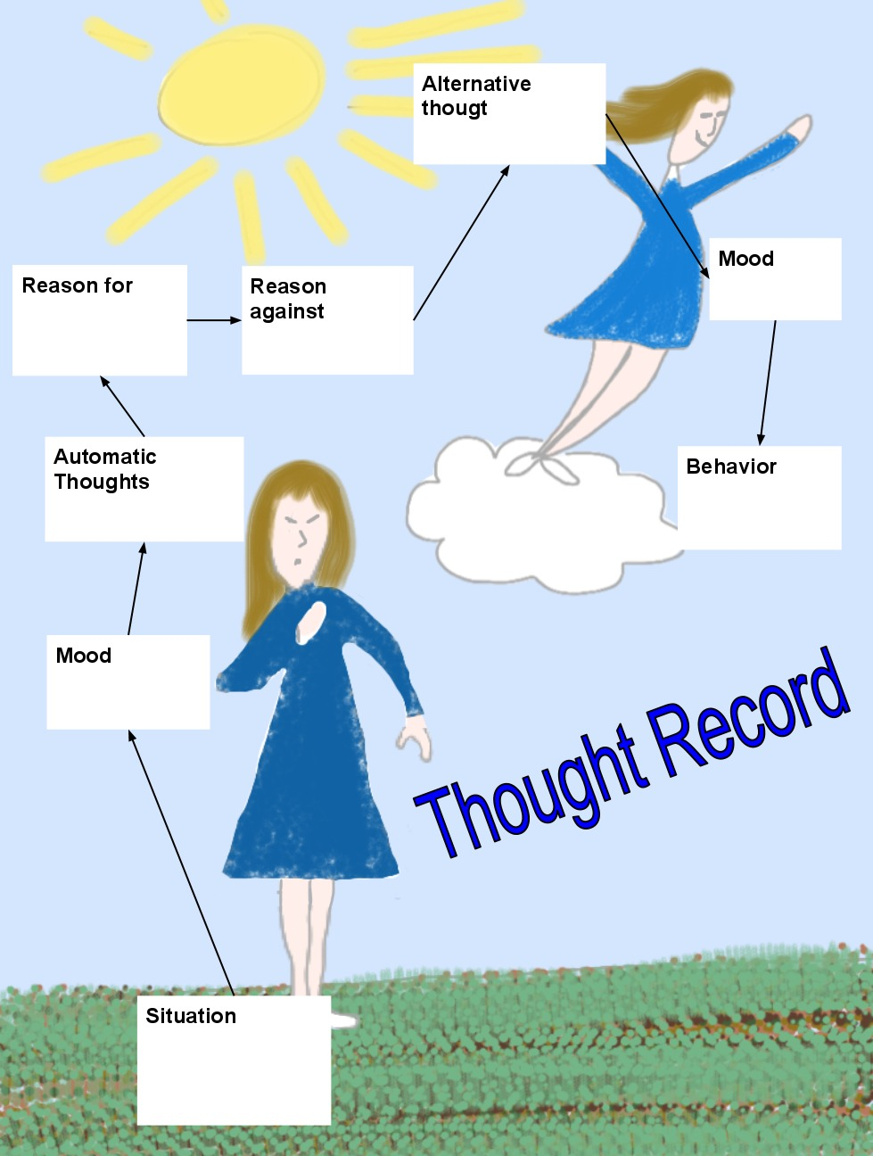

Slide 41
Exposure and Response Prevention
Widely used with anxiety disorders
Constructing a Hierarchy
Gradual exposure to anxiety provoking stimuli
Concomitant use of relaxation techniques
Goal: Extinction of unwanted behavior

Slide 42
Case Example
An 11 y/o girl is brought to see you because she has been progressively more anxious. She has been experiencing “sticky thoughts” – explaining that she obsesses about worries that she will “get sick from touching things”. She spends hours obsessing and has to constantly wash her hands or use hand sanitizer. Parents report that she is not able to go to school because of these fears and is having trouble doing routine things around the house. She is very distressed by these symptoms.

Slide 43
CBT
Intrapersonal cognitive focus
Homework as part of treatment
Psychodynamic
Focus on affect and expression of emotion
Therapists direct session activity
Teach skills to cope with sx
Focus on patients' future experiences
The patient's interpersonal experiences are a central focus
Goal to uncover unconscious material
Emphasis on past experiences
Transference Key Feature
Supportive
Focus on here and now
All diagnoses treated
Focus to strengthen ego functions
Therapist/collaborative
Problem solving/psychoeducation

Slide 44
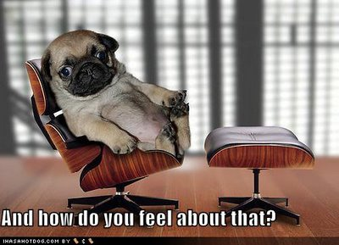
Questions?

