Slide 1
Psychiatry
Review Session #2
Greg Raczkowski, MS-IV
John DiMeglio, MS-IV
Jacobs School of Medicine & Biomedical Sciences
2/6/2020
Notes:
Depression (GREG)
Bipolar Disorders (JOHN)
Suicide (GREG)
Eating Disorders (JOHN)
PTSD (GREG)
LGBT Issues (JOHN)
Anxiety Disorders (JOHN)
Defense Mechanisms (GREG)
Somatic Symptom Disorders (JOHN)

Slide 2
Our Goals
Brief overview of material since last review
Highlight relevant exam/board material
Answer any lingering questions
Topics: Depression, Bipolar disorder, Suicidality, Eating disorders, PTSD, Anxiety disorders, Defense Mechanisms
Practice Questions!
Review sessions should guide your studying

Slide 3
Differential Diagnosis of Depression
Major Depressive Disorder (unipolar depression)
Persistent Depressive Disorder
Cyclothymia
Bipolar II disorder
Bipolar I disorder
Borderline Personality Disorder
Substance/Medications Induced or Due to Medical Condition

Slide 4
Major Depressive Disorder
Depressed Mood
Sleep
Interest
Guilt/hopelessness/worthlessness
Energy
Concentration
Appetite/weight loss
Psychomotor retardation/agitation
Suicidal ideation
-Need 5 for DSM def’n of Major Depressive Episode
-One of them must be either depressed mood or anhedonia
-Count ‘em up
-symptoms must be present for at least 2 weeks

Slide 5
Depression
Etiology
-Genetic: 50% MZ vs 20% DZ -> oligogenic
-Environmental factors: loss, illness, substances, etc.
Neurobiology
-Dysregulated stress response, increase cortisol
-neuronal atropy, neurotransmitter imbalances
-Sleep: decreased REM latency, decreased slow wave sleep (restorative)
-more likely to be asked about mechanism of the drugs
Course
-50% recurrence after 1 episode
-increase risk of recurrence with more severe MDE
Children
-irritability, apathy, behavioral change (less depressed mood)
-decreased response to antidepressants (can use them in kids)
-more likely to have bipolar outcome

Slide 6
MDD Specifiers
w/ Atypical Features
-mood reactivity: mood brightens in response to actual or potential positive events
-hypersomnia
-leaden paralysis: heavy leaden feeling in arms and legs
-rejection sensitivity
Important to know because treatment can be different: MAO inhibitors more effective for this

Slide 7
MDD Specifiers
w/ Psychotic Features
-meets criteria for major depressive episode and also presence of delusions/hallucinations
-psychosis will often take ‘flavor’ of depression, e.g. depressed individual believing his body is rotting away
-add antipsychotic to antidepressant
-adequate reason to try ECT
w/ Seasonal Pattern
-meets criteria for major depressive episode during specific time of year (i.e. winter months)
-can treat with special light

Slide 8
Depression
Persistent Depressive Disorder
-symptoms for 2 years, never went more than 2 months w/o sx
-Depressed mood + 2 or more: appetite, sleep, energy, self-esteem, concentration, hopelessness
Medications/Substances: alcohol, steroids
Medical Conditions: Hypothyroidism, pancreatic cancer, l. Hemisphere stroke, Parkinsons, HIV, autoimmune (inflammatory), B12, syphilis

Slide 9
Antidepressants
-for mild to moderate depression, psychotherapy is effective (psychodynamic, CBT)
-SSRIs = first line: fluoxetine, paroxetine, fluvoxamine, sertraline, citalopram, escitalopram
-inhibit serotonin reuptake, increasing levels
-side effects: sexual dysfunction, GI disturbance, headaches, sedation/activation
-fluoxetine longest half-life, paroxetine shortest
-paroxetine - cardiac defects in fetus (contraindicated in pregnancy), more anticholinergic
-citalopram - lots of evidence in elderly
-ecstasy + SSRI/MAOI + SSRI -> serotonin syndrome
-SSRI discontinuation syndrome
-withdrawal effects from stopping -> ‘electric shock’, headache, GI
-worse with short half life medications (paroxetine)
-taper to d/c

Slide 10
Antidepressants
SNRIs: venlafaxine, duloxetine
-second-line
-venlafaxine: dose-related hypertension
-duloxetine: neuropathic pain
TCAs: amitriptyline, nortriptyline, clomipramine, imipramine, desipramine, doxepin
-NE and 5HT reuptake inhibitors
-overdose potential -> arrhythmias, treat with NaHCO3
-anticholinergic side effects, orthostatic hypotension
-amitriptyline - migraine prophylaxis
-clomipramine - OCD (not first line)
-imipramine - bed-wetting (not first line)

Slide 11
Antidepressants
MAOIs: phenelzine, isocarboxazid, tranylcypromine, hydracarbazine, selegiline, rasagiline
-inhibit breakdown of catecholamines - NE, 5HT, DA, tyramine
-MUST avoid tyramine containing foods (cheese, wine, chocolate, fava beans), otherwise at risk for hypertensive crisis
-effective in atypical depression, refractory cases (not used often)
-when combined with SSRIs, can cause serotonin syndrome -> d/c and start 2 weeks later if switching

Slide 12
Antidepressants
Trazodone: serotonin antagonist
-trazzzoBONE: sedation, priapism
Bupropion: DA and NE reuptake inhibitor
-more activating
-increase risk for seizure -> cannot use in eating disorders
-can use instead of SSRIs if experiencing sexual dysfunction
-DA reuptake inhibition -> first line for Parkinson’s
Mirtazapine: 5HT and alpha2 antagonist
-sedation and weight gain -> good for chronically ill/cancer pts

Slide 13
Depression
ECT
-most effective therapy
-severe depression (psychosis), elderly, pregnancy, refractory, severe suicidality
-only side effect is amnesia that usually resolves

Slide 14
Depression
Principles of Treatment
-adequate trial of antidepressant = 4-6 weeks, must wait this long before switch is justified
-suicidality may be increased in the short term -> improve vegetative sx before mood
-be wary of mania
-continue antidepressants for 8-12 months, indefinitely if recurrent or severe episode

Slide 15
LGBT+ Mental Health

Slide 16
Some important takeaways...
Difference between sexuality and gender (other terminology helpful as well)
Change from binary thinking (male OR female; gay OR straight) to spectrums of gender and sexuality.
LGBT population at significantly higher risk for depression, anxiety disorders, and suicide.
Plethora of healthcare disparities- less likely to have insurance, fill medications. More likely to delay care, be refused care, or be harassed by healthcare providers.
Help to offset this by creating welcoming, inclusive environments; don’t make assumptions; be conscious of “felt stigma”

Slide 17

Bipolar disorders
Notes:
Benjavisa / Getty Images

Slide 18

Bipolar Disorder
Mania – elevated/expansive/irritable mood with 3-4+ symptoms for ≥ 1 week:
Distractibility
Indiscretion
Grandiosity
Flight of Ideas
Activity ↑
Sleep ↓
Talkative (pressured speech)
Hypomania – same symptom criteria as above EXCEPT:
≥ 4 days duration
No marked functional impairment
Hospitalization not required
No psychotic features

Slide 19
Mania/Hypomania ….continued
Additional Characteristics of Mania:
Severe impairment in function
May present with psychotic features
Frequently necessitates hospitalization** (this confirms diagnosis, time-frame becomes irrelevant)

Slide 20
Diagnoses
Bipolar Diagnoses:
[1] Bipolar I – 1 manic episode (only requirement)
(+/- major depressive episodes, may include hypomania)
[2] Bipolar II – at least 1 hypomanic episode AND at least 1 major depressive episode

Slide 21
Cyclothymia
Criterion A from the Diagnostic and Statistical Handbook of Mental Disorders, Fifth Edition (DSM-5) defines cyclomania as: “For at least two years there have been numerous periods with hypomanic symptoms that do not meet criteria for a hypomanic episode and numerous periods with depressive symptoms that do not meet criteria for a major depressive episode."
Additional criteria for cyclothymic disorder in the DSM-5 are:
B. During the above two-year period**, the hypomanic and depressive periods have been present for at least half the time and the individual has not been without the symptoms for more than two months at a time.
C. Criteria for a major depressive, manic, or hypomanic episode have never been met. [If such episodes appear later, the diagnosis would be changed to bipolar I or bipolar II disorder, as appropriate.]
D. The symptoms aren’t better explained by another mental disorder.
E. The symptoms aren’t caused by a substance (i.e., medication or drug of abuse) or another medical condition.
F. The symptoms cause clinically significant distress or impairment in social, occupational, or other important areas of functioning.
The specifier “with anxious distress” may be added to a diagnosis of cyclothymic disorder where anxiety is a significant factor.

Slide 22
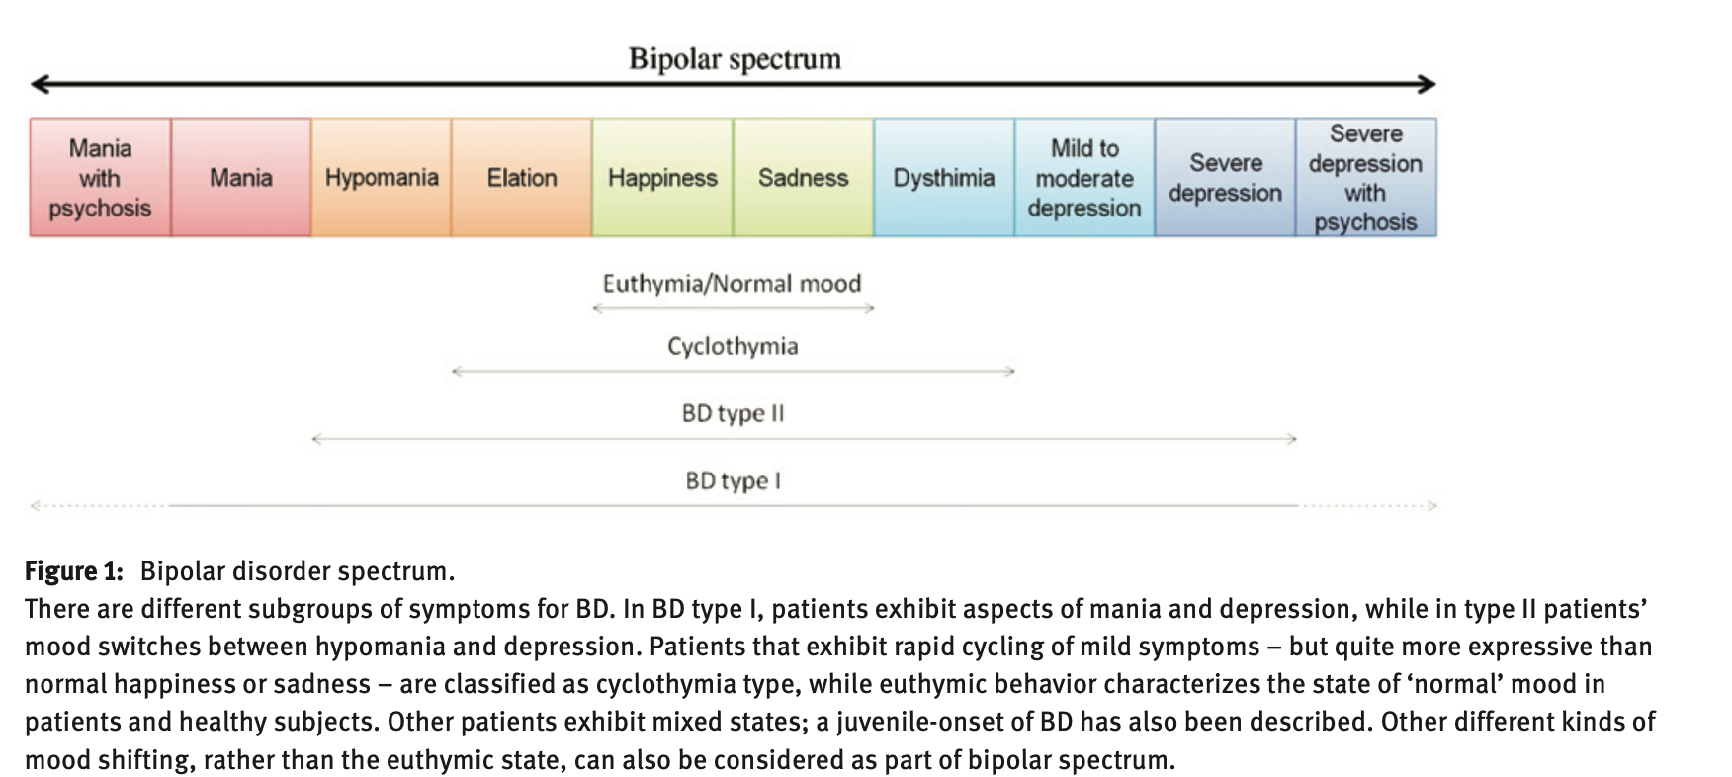
Notes:
Naaldijk, Y. M., Bittencourt, M. C., Sack, U., & Ulrich, H. (2016). Kinins and microglial responses in bipolar disorder: a neuroinflammation hypothesis. Biological chemistry, 397(4), 283-296.

Slide 23
Contrasting this with Schizoaffective d/o
Schizoaffective Disorder – concurrent symptoms of schizophrenia and mood disorder but with at least 2 weeks of psychotic symptoms in the absence of mood symptoms
In mood disorders with psychotic features, psychosis never occurs outside of the context of the mood symptoms (since the mood symptoms are causing the psychosis)
If mood symptoms disappear but psychotic symptoms persist for at least 2 weeks on their own = Schizoaffective Disorder

Slide 24
Mood Stabilizers:
Lithium
Narrow therapeutic index, can improve depression, helps suicidality
Side effects – cognitive impairment, weight gain, renal/thyroid dysfunction
Carbamazepine
Better tolerated than Li, useful for rapid cycling, can improve depression
Side effects – sedation, neurotoxicity, SIADH, agranulocytosis (rare)
Valproic Acid/Divalproex
Good for anxiety and anti-aggression, but no antidepressant effect
Side effects – sedation, weight gain, cognitive impairment, pancreatitis
Atypical antipsychotics
Treat acute mania, possible adjunct to maintenance therapy
Notes:
Mention how the first three are teratogens, and in general you don’t give antidepressants because it can precipitate mania/hypomania!!!

Slide 25
Suicide
-Native American > White > Asian, Hispanic, Black
-females attempt more (3:1), males complete more (4:1)
-firearms = most common in U.S. and most lethal
-hospitalize! Start antidepressant, ECT
-SSRIs may increase suicidality in short term
-more likely in bipolar than depression
-people don’t want to be dead, they want symptoms to be over

Slide 26
Suicide
Sex (male)
Age (<19 or >45)
Depression
Previous Attempt!
Ethanol (or other substances)
Rational thinking loss (psychosis)
Social supports lacking
Organized plan
No spouse
Sickness

Slide 27

Eating Disorders

Slide 28

Anorexia Nervosa
Anorexia Nervosa
Persistent energy intake restriction
Intense fear of gaining weight
Disturbance of body image
Underweight – BMI < 18.5
Tend to be controlling, perfectionistic, inflexible. Generally ego-syntonic – less likely to present themselves for treatment
↓ HR/BP/Temp, ECG changes, electrolyte abnormalities, osteopenia, lanugo**
Types: restricting, binge-eating/purging
Treatment? Psychotherapy and nutritional rehabilitation are first line; pharmacotherapy includes SSRIs for comorbid anxiety and/or depression.
Refeeding syndrome—insulin increase leading to hypophosphatemia, hypokalemia, hypomagnesemia cardiac complications, rhabdomyolysis, seizures.

Slide 29
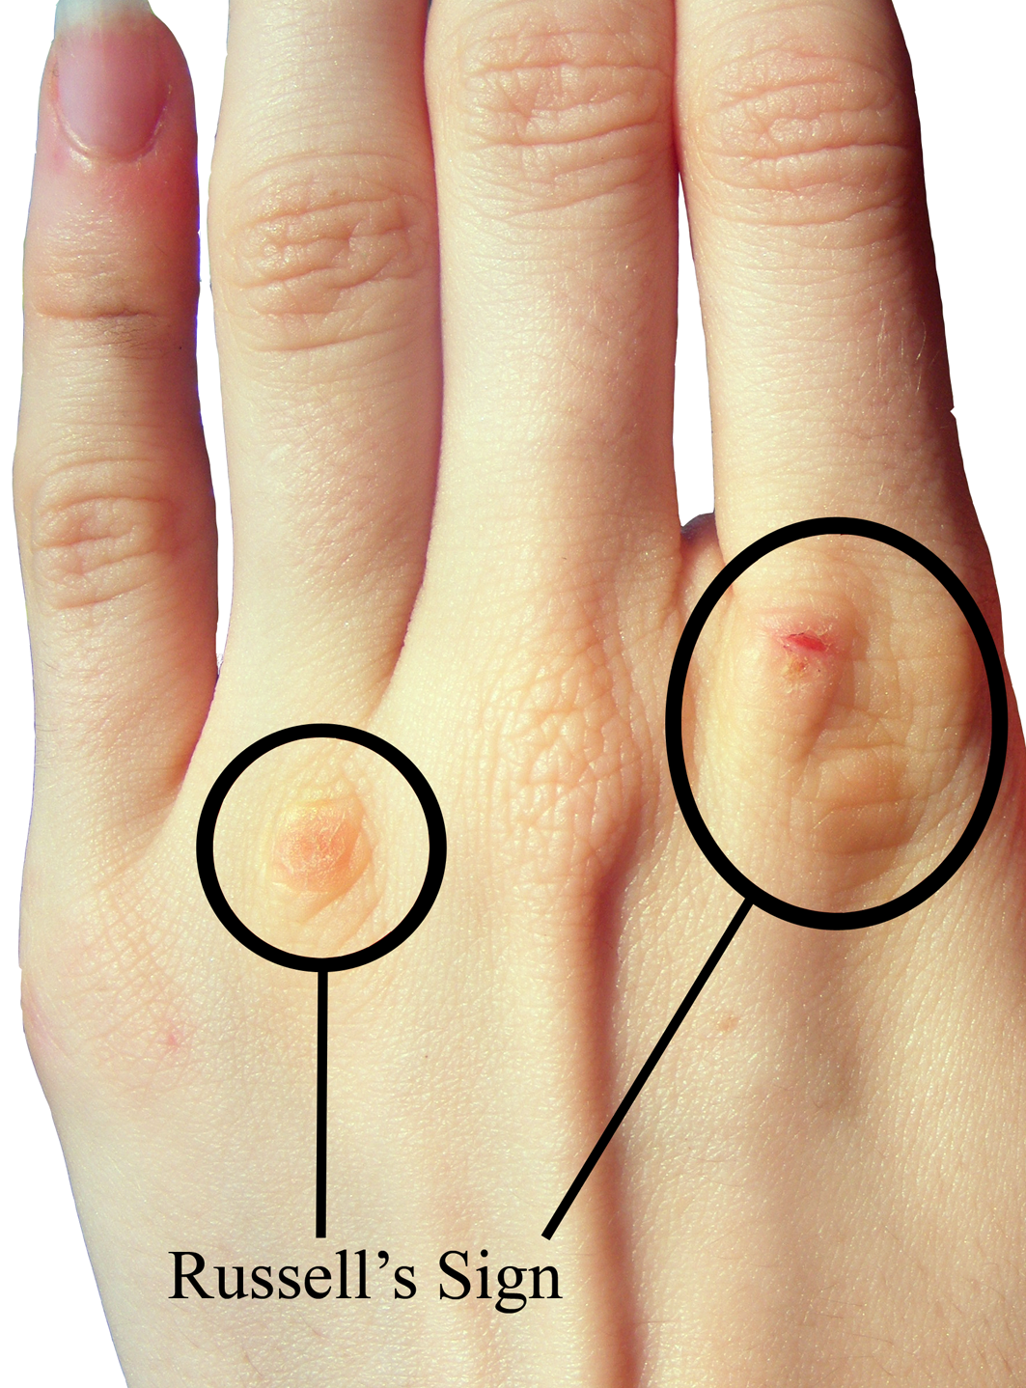
Bulimia Nervosa
•Recurrent episodes of binge eating
•Compensatory behaviors – vomiting, laxatives
•Disturbance of body image
•Normal or overweight
•Sense of lack of control
•Feelings shame/embarrassment during/after binge
•Ego-dystonic – more likely to present for treatment
•Parotitis, enamel erosion, dorsal hand calluses**, hypokalemic hypochloremic metabolic alkalosis
•Treatment – psychotherapy, nutritional rehabilitation, antidepressants (eg, SSRIs). Bupropion is contraindicated due to seizure risk**.

Slide 30
Binge Eating Disorder
Regular episodes of excessive, uncontrollable eating with no inappropriate compensatory behavior**
•Normal or overweight; increased risk of diabetes
Treatment: psychotherapy, such as CBT, is first line; SSRIs, lisdexamfetamine.
Notes:
Binge-eating – excessive food intake within a 2-hour period, eating more rapidly, eating until uncomfortably full, eating when not hungry, eating alone, feeling disgusted about eating habits

Slide 31
Posttraumatic Stress Disorder
Exposure to actual or threatened death, serious injury, or sexual violence in one (or more) of the following ways:
  Directly experiencing the traumatic event
  Witnessing the event as it occurred to others
  Learning that the traumatic event happened to a close friend or family member
  Experiencing repeated or extreme exposure to aversive details of the traumatic event (e.g. police officers exposed to repeated instances of child abuse)

Slide 32
Posttraumatic Stress Disorder
B. Intrusion symptoms (1 or more):
-flashbacks (distressing, intrusive memories)
-recurrent nightmares
-dissociative reactions in which the patient feels or acts as if the traumatic event is recurring
-intense or prolonged psychological distress to internal or external cues that symbolize or resemble an aspect of the traumatic events
-marked physiological reaction to cues

Slide 33
Posttraumatic Stress Disorder
C. Avoidance symptoms:
-avoidance of distressing thoughts, feelings, or memories
-avoidance of external reminders (locations, objects, etc.)
D. Negative symptoms (cognition/mood):
-loss of memory (dissociative amnesia)
-persistent negative beliefs of oneself, others, world
-self-blame
-persistent negative mood
-anhedonia
-feelings of detachment from others
-inability to experience positive emotions

Slide 34
Posttraumatic Stress Disorder
E. Arousal symptoms
-irritable behavior/angry outbursts
-reckless/self-destructive behavior
-hypervigilance
-exaggerated startle response
-problems with concentration
-sleep disturbance

Slide 35
PTSD
Risk Factors: female gender, younger age, low SES, education, IQ, intentional act towards you, trauma severity, continued environmental exposures
Functional Consequences: substance abuse, aggression/violence, SI/attempts, work/relationship issues
Treatment:
-SSRIs = first-line
-CBT, EMDR also first-line
-prazosin - nightmares
-Benzos - short term anxiety only

Slide 36
Acute Stress Disorder
-similar symptoms as PTSD
-timeframe is important (in questions): >3 days to <1 month
-PTSD must be > 1 month

Slide 37

Anxiety Disorders
Inappropriate experience of fear/worry and its physical manifestations (anxiety) incongruent with magnitude of perceived stressors. Symptoms interfere with daily functioning and are not attributable to another mental disorder, medical condition, or substance abuse.

Slide 38
Generalized Anxiety Disorder
Excessive worry about multiple, everyday events for > 6 months
Unrelated to a specific person, situation, or event.
Restlessness, easily fatigability, ↓ concentration, irritability, muscle tension, sleep disturbance
Treatment: CBT and SSRIs/SNRIs are first line. Buspirone, TCAs and benzos are second line.

Slide 39
Panic Disorder
Recurrent, unprovoked episodes of intense fear (panic attacks)
Strong genetic component.
Diagnosis requires attack followed by one or more months of one or more of: persistent concern of additional panic attacks, worrying about consequences of attack, behavioral change related to attacks.
Attacks peak ~10 min. May include Palpitations, Paresthesias, dePersonalization/derealization, Abdominal distress, nausea, intense fear of dying or “going crazy”. Chest pain, chills, choking, sweating, shaking, SOB.
Treatment: CBT, SSRIs and venlafaxine are first line. Benzos used acutely/bridge SSRI initiation

Slide 40
Agoraphobia – fear of being in situations from which escape may be difficult. Associated with panic disorder. Tx w/ CBT and SSRIs
Specific Phobia – persistent, irrational fear of an bject, creature or situation. Tx with systematic desensitization.
Social Phobia (Social Anxiety Disorder) – anxiety about humiliating oneself in both social and performance situations. Treatment: CBT, SSRIs/SNRIs. For performance type, may use beta blockers or benzos as needed.

Slide 41
Other causes of anxiety disorders
Other Psychiatry Causes:
Depression
Bipolar
Schizophrenia
Substances:
Stimulants
Caffeine
Nicotine
Alcohol
Antidepressants
Medical Causes:
PE
Arrhythmia
CHF
Delirium
Dementia

Slide 42
Anxiolytic Medications
Benzodiazepines (diazepam, alprazolam, etc.) – treatment for acute anxiety
Potentiate GABA -> neuron hyperpolarization -> reduces anxiety
Side effects – sedation, impaired coordination, life-threatening withdrawal
Antidepressants (SSRI/SNRI’s) – 1st line for all anxiety disorders (for board exams at least)
Buspirone – used for GAD only, efficacy is meh
5HT partial agonist
Non-sedating, no withdrawal, no impairment of driving
Propranolol – performance anxiety
Ramelteon – melatonin receptor agonist à sleep initiation but not maintenance for insomnia
Prazosin – alpha blocker that ↓ BP and improves sleep (↓ arousal due to nightmares)
Non-pharmacologic treatments – relaxation training, desensitization, CBT
Notes:
AVOID THE LOT ONES IN LIVER FAILURE!

Slide 43
Defense Mechanisms - Maladaptive (Immature)
Acting out: performing extreme behavior in order to express thoughts or feelings the person is otherwise incapable of expressing (e.g. toddler breaking sibling’s toys)
Repression: involuntary removal of threatening or unacceptable memories/impulses/thoughts from awareness; UNABLE to recall (e.g. unable to recall childhood abuse)
Denial: Refusal to perceive an unpleasant reality (e.g. “I don’t have a gambling problem”)
Displacement: transferring emotions/ideas/desires from original subject to more acceptable one (e.g. boss gets angry at father, father to mother, mother to child, child to dog, dog to cat, cat to bird, bird to worm, worm to ???)

Slide 44
Defense Mechanisms - Maladaptive (Immature)
Reaction Formation: behaving opposite to one’s true unacceptable emotions/feelings (e.g. angry at dying parent, so you give them extra care)
Projection: attributing one’s own unacceptable feelings/ideas/thoughts to another (e.g. accusing partner of being unhappy in relationship)
Rationalization: controversial thoughts or feelings are justified in a seemingly logical way to avoid the true explanation (e.g. racism)
Intellectualization: avoid distressing emotions by focusing on facts and logic (e.g. doctor looking up all the statistics of new cancer diagnosis)

Slide 45
Defense Mechanisms - Maladaptive (Immature)
Isolation: repression of either the emotion or experiential details of an event (e.g. watching movie and character gives you strong emotional response, reminds you of someone in your past)
Splitting: viewing people/self/groups/the world as either all good or all bad
Projective Identification: experience the emotion that another person is projecting onto you

Slide 46
Defense Mechanisms - Adaptive (Mature)
Suppression: voluntary and deliberate effort to control/conceal disturbing thoughts/emotions until able to address them at a later point (e.g. need to study for exam so ‘deal with’ break-up afterwards)
Sublimation: diverting basic drives/impulses into socially appropriate channels (e.g. channel anger/aggression into boxing)
Humor: using humor to diffuse anxiety/negative emotions
Altruism: taking negative emotions/experiences and channel these into socially positive ones. (e.g. starting a group for traffic rule awareness after one’s parents were killed in a traffic accident)

Slide 47
Somatic Symptom & Related Disorders

Slide 48
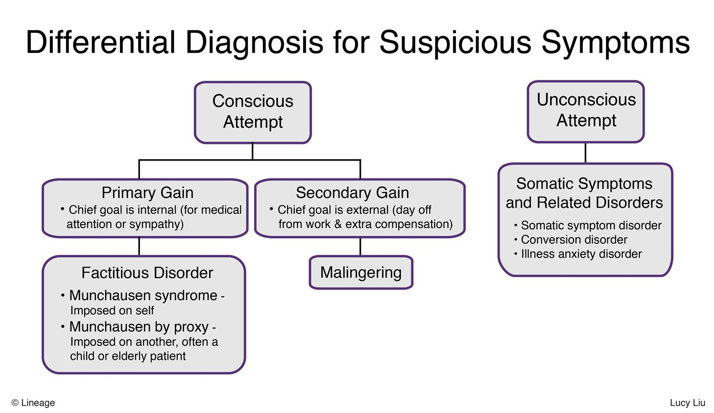
ABUSE!!!

Slide 49
Somatic Symptom Disorder
1+ somatic symptoms that are distressing
Excessive thoughts/feelings/behaviors related to the symptoms
Disproportionate/persistent thoughts about seriousness of symptoms
Persistently high anxiety level
Excessive time/energy devoted to symptoms or health concerns
Symptom duration ≥ 6 months
Treatment – regular office visits with same physician, psychotherapy. Minimize polypharmacy, set limits with office visits.

Slide 50

Illness Anxiety Disorder
Formerly known as hypochondriasis.
Excessive/disproportionate preoccupation with having/acquiring a serious illness, often despite medical evaluation and reassurance.
High anxiety level about health, illness becomes central to identity.
Minimal to no somatic symptoms
Illness preoccupation present for ≥ 6 months
Treatment: Similar to Somatic Symptom Disorder. Primary goal in managing illness anxiety disorder is to improve coping with health fears rather than eliminate them, and to prevent patients from adopting the sick role

Slide 51
Conversion Disorder
Also known as functional neurological symptom disorder.
One or more neurologic (sensory or motor) symptoms which cannot be explained by a known neurological/medical condition
Weakness/paralysis, reduced sensation, dysarthria, limb shaking/pseudoseizures
Abrupt onset, short duration
More likely in women, adolescents, and young adults.
“La Belle Indifference” - awareness of, but indifference towards, symptoms
Treatment focuses on education regarding the diagnosis, as well as strengthening the patient-physician alliance. May consider physical therapy and/or CBT.

Slide 52
Practice Question Time

Slide 53
A 39-year-old man was evaluated by a psychiatrist 1 month ago after reports that he was locking himself in his apartment because the devil was trying to put thoughts into his head. He initially responded well to pharmacologic treatment and was able to resume normal daily activities. However, 3 weeks after initiation of treatment, he presents to the hospital with muscular rigidity and mental status changes. His temperature is 39.7°C (103.5°F), blood pressure is 173/91 mm Hg, pulse is 116/min, and respiratory rate is 22/min.
Which of the following best describes the mechanism of action of the drug used to treat this patient's acute medical condition?
Blocks gamma-aminobutyric acid receptor
Blocks dopamine D2 receptor
Competitively inhibits alcohol dehydrogenase
Inhibits calcium release from the sarcoplasmic reticulum of skeletal muscle
Potentiates gamma-aminobutyric acid effects by increasing the duration of Cl- channel opening
Notes:
D

Slide 54
A 19-year-old boy is brought to the emergency department by his parents after he attempted to jump off the balcony of their 23rd story condominium. Three months ago, he began to hear voices telling him “use your superpowers to save the world.” Additionally, he is paranoid that the Russian government is trying to “hack his brain for intel.” He used to be a full-time student at the local community college; however, after he failed all of his classes, his parents demanded he that take a semester off. On physical examination, he appears disheveled and disinterested. When the physician attempts question him directly, the patient ignores the questions entirely and jumps to unrelated topics that are difficult to follow. A consulting psychiatrist admits the patient to the psychiatry ward and low-dose olanzapine is initiated immediately.
Which of the following is the most likely diagnosis?
Brief Psychotic Disorder
Delusional Disorder
Schizoaffective Disorder
Schizoid Personality Disorder
Schizophrenia
Schizophreniform Disorder
Schizotypal Personality Disorder
Notes:
F

Slide 55
A 21-year-old college student is brought to the local emergency department by her roommate after she collapsed at a party. Physical examination reveals a severe tremor and muscle rigidity. Her pulse is 120/min, temperature is 38°C (100.4°F), and respiratory rate is 15/min. The patient does not respond to questioning, but her roommate states that she was with her all night and she is fairly certain the patient did not consume any alcohol or drugs. A urine drug screen is negative for illicit substances. The patient is on sumatriptan for migraines, and has also been on a first-line medication for depression.
Which of the following is an appropriate pharmacologic intervention for her acute condition?
Amitriptyline
Cyproheptadine
Dantrolene
Flumazenil
Naloxone
Notes:
B serotonin syndrome with triptan and ssri

Slide 56
A 17-year-old girl is brought to the physician by her mother who is concerned that her daughter is losing weight. The daughter does not share this concern and says, “I just exercise a lot because I want to look my best.” The girl is 165 cm (5’5”) tall and weighs 44.5 kg (98 lb). Her BMI is 16.3 kg/m². She is wearing multiple layers of clothing and yet still complains that the office is cold. Physical examination reveals her body is covered by soft, fine hair.
Which of the following additional findings would most likely be associated with this patent’s likely diagnosis?
Diarrhea
Enlarged thyroid gland
Increased bone density
Menorrhagia
Stress fractures
Notes:
E - anorexia, decreased bone density

Slide 57
A 45-year-old woman comes to her psychiatrist for follow-up evaluation of mood swings and problems sleeping. She was diagnosed with bipolar I disorder 9 months ago after experiencing a manic episode and has been taking lithium ever since. She reports a reduction in mood swings and has not had a manic episode since she started therapy. She feels well but has lost 2.27 kg (5 lb) during that time. Pulse is 105/min; blood pressure is 115/75 mm Hg. Physical examination shows no palpable masses around the neck. A fine tremor of the hands is observed when the patient’s hands are outstretched.
Which of the following studies is the most appropriate for the long-term safety of this patient?
Complete blood cell count
Fasting glucose and lipid panel
Liver function tests
Serum cortisol test
Thyroid function tests
Notes:
E thyroid obv. Tremor. Also renal - nephrogenic DI, hypothyroidism, pregnancy (ebstein anomaly)

Slide 58
A 35-year-old woman presents to the urgent care clinic because she is concerned about her trembling hands and a facial tic. According to her mother, who accompanies her, the patient has been seeing a psychiatrist for the past several years. On examination, the patient exhibits repetitive facial grimaces with occasional protrusion of the tongue. She denies that she is purposefully producing these facial expressions.
What is the mechanism of action of the medication that this patient is most likely taking?
Antagonism at dopamine, serotonin, and adrenergic receptors
Antagonism of dopamine receptors
Antagonism of noradrenergic and serotonin receptors
Inhibition of serotonin reuptake
Inhibition of serotonin-norepinephrine reuptake
Interaction with cation transport
Notes:
B - typical antipsychotics
A - atypicals, c - mirtazapine, d - ssris, e - snris, f - Li

Slide 59
A 46-year-old woman comes to the emergency department because of fever and muscle spasms. She says that a few hours before the onset of her symptoms, she took the first dose of a new medication for her depression. She was diagnosed with major depression approximately 3 months ago, at which point she was started on a 6-week trial of sertraline. After that was unsuccessful, she tried fluoxetine for 6 weeks without much relief. Given her persistent symptoms, her physician decided to discontinue fluoxetine. She was instructed to cease medication for 1 week and then start taking the new medication. At the emergency department, she appears diaphoretic and agitated. Her temperature is 39°C (102°F), blood pressure 134/92 mm Hg, pulse is 95/min, and respiratory rate is 14/min. During the physical examination, brisk, passive dorsiflexion of each ankle produces sustained clonus.
Which of the following agents was she most likely prescribed after discontinuing fluoxetine?
Bupropion
Chlorpromazine
Diazepam
Mirtazapine
Propranolol
Tranylcypromine
Notes:
F- serotonin syndrome with maoi, need to wait 2 weeks

Slide 60
A 27-year-old woman with refractory depression for a duration of 1 year reports several symptoms after being switched to a new medication for her depression after trying other medications for it. She reports that her mood has improved, but she now feels that her face flushes more frequently and she is more sensitive to the hot weather outside. Additionally, she mentions that she has had a dry mouth despite drinking plenty of water. She occasionally has difficulty driving on the highway because signs appear blurry. She also reports pain in her lower abdomen because she has a hard time urinating. She is also worried that at times she feels like her heart is racing. On further questioning, she admits to some constipation. She denies any alcohol or drug use, reports no change in her diet, and states, "I really feel like none of these things happened prior to starting this new medication, but it helps so much with my mood that I don't want to stop it."
Which of the following drugs was most likely prescribed for this patient?
Amitriptyline
Clonazepam
Lithium
Sertraline
Venlafaxine
Notes:
A, anticholinergic effects

Slide 61
A 28-year-old man returns to his apartment after a heated argument with his girlfriend. A short time later, his roommate observes his obvious distress and asks whether he is okay. Immediately the man snaps at his roommate and tells him to “back off” and “stop barging into his personal life.”
Which defense mechanism is this man exhibiting?
Acting out
Displacement
Projection
Reaction Formation
Suppression
Transference
Notes:
b

Slide 62
A 65-year-old man presents to his family doctor for a regularly scheduled check-up. He is recently widowed and appears unkempt at this visit. He admits to feeling depressed since his wife’s death. He reports a 4.5-kg (10-lb) unintentional weight loss in the past few weeks. On further questioning, the patient admits that he plans to shoot himself in the head on the 3-month anniversary of his wife’s death.
Which of the following is the most appropriate next step?
Contact the patient’s children to remove the patient’s access to a firearm
Explore the patient’s concerns and schedule a follow-up visit
Hospitalization
Prescribe an antidepressant
Refer to a psychiatrist
Notes:
C - go over SADPERSONS

