Slide 1
Psychiatry
Review Session #3
Greg Raczkowski, MS-IV
John DiMeglio, MS-IV
Jacobs School of Medicine & Biomedical Sciences
2/12/2020
Notes:
OCD (John)
Conduct, ODD, DMDD (John)
Forensics (Greg)
Mass Shootings (John)
Resilience & Post Traumatic Growth (John)
Personality Disorders (Greg)
Child Psychiatry 1 - PTSD, Bipolar & Psychotic Disorders, Abuse, and ID (John)
Child Psychiatry 2 - Depression & Anxiety (Greg)
ASD (Greg)
ADHD (John)
Psychotherapy (Greg)

Slide 2
Our Goals
Brief overview of material since last review
Highlight relevant exam/board material
Answer any lingering questions before exam on Friday, 2/14 ❤️
Topics: OCD, Conduct disorder, ODD, DMDD, Forensics, Personality Disorders, Topics in Child Psych, ASD, ADHD, Psychotherapy
Practice Questions! (time permitting)
Review sessions should guide your studying

Slide 3
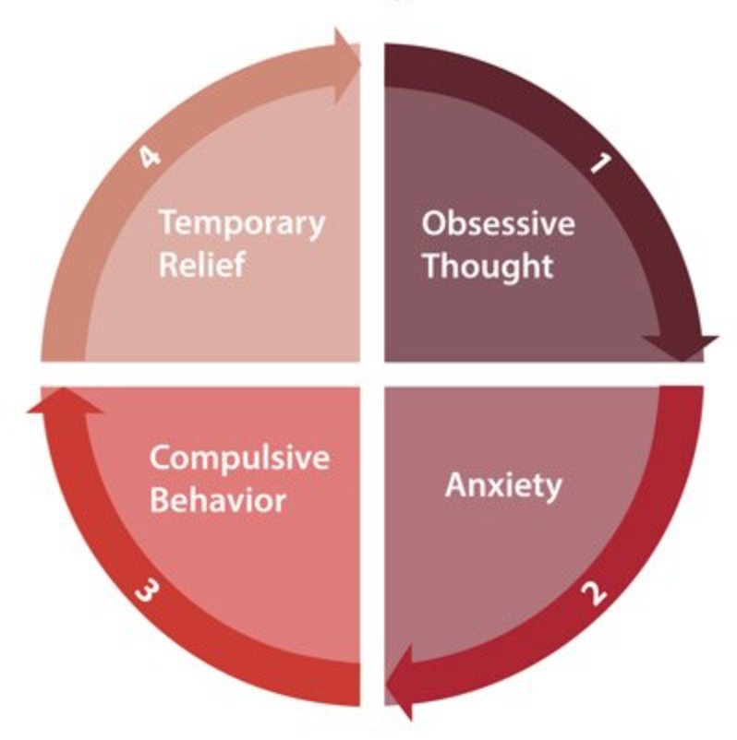
Obsessive-Compulsive Disorder

Slide 4
Important definitions...
Obsessions – recurrent and persistent thoughts/urges/images experienced as intrusive and unwanted; these cause anxiety/distress
Common themes include contamination, fear of harming, need for symmetry, checking for reassurance. Ego-dystonic ...unlike OCPD.
Compulsions – repetitive behaviors (washing, checking) or mental acts (counting, repeating) that the individual feels driven to perform to alleviate anxiety from obsessions or prevent a dreaded event

Slide 5
Obsessive-Compulsive Disorder
Recurring intrusive thoughts, feelings, or sensations (obsessions) that cause severe distress; relieved in part by the performance of repetitive actions (compulsions)
•MRI findings – increased metabolic activity in orbitofrontal cortex, limbic structures, caudate, and thalamus (regulate emotions, impulse inhibition and judgment)
•M=F, younger onset in males, 80-87% MZ concordance, childhood onset associated with comorbid Tourette’s Syndrome and/or ADHD
•Treatment – CBT (exposure and ritual prevention), SSRIs, clomipramine, (TCA). Refractory cases worth trying antipsychotics, surgery (gamma knife, deep brain stimulation)
Notes:
ERP (Exposure and Ritual Prevention) is a component of CBT used to treat OCD.

Slide 6
Lena Dunham’s character Hannah from Girls

Slide 7
Other disorders
Hoarding – acquisition of and/or failure to discard useless/valueless possessions
Cluttered living space, social isolation, impaired functioning or significant distress/shame, difficulty with decision making
Can be a symptom of OCD or a stand-alone diagnosis (70-80% meet OCD criteria)
Relative to OCD – earlier symptom onset, ↑ age at presentation, ↓ insight, more treatment-resistant
Treatment – similar to OCD (CBT, SSRIs)
Body Dysmorphic Disorder – preoccupation with perceived physical flaws that are slight/unobservable to others
Skin, hair, nose are common preoccupations
Repetitive behaviors (grooming, mirror checking) or mental acts (comparing to others)
Often have intrusive, obsessive thoughts
Clinically significant distress or impaired function
Ideas of reference common – falsely believe people are judging/mocking them
High rates of SI and attempts

Slide 8
Forensic Psychiatry
-intersection between psychiatry and the law
-treatment in correctional setting, legal assessments/reports, testimony
-violence risk assessment
-custody trials, decision-making capacity
-not always acting in ‘patient’ or ‘client’ interest

Slide 9
Forensic Psychiatry
Capacity: ability to make medical or treatment related decisions
-clinical term determined by (any) physician
Competency: ability to stand trial
-legal term determined by judge
Civil commitment: legal basis for involuntary hospitalization due to mental illness
-Danger to themselves or others
-not meeting basic needs
Right to Refuse Treatment: all patients have this right, with the exceptions:
-emergencies (biological or behavioral - risk to themselves or others)
-Medication Over Objection - procedures vary by state

Slide 10
Forensic Psychiatry
Violence Risk Assessment:
-Prior History of Violence - most predictive
-Younger age (late teens early 20’s) - prefrontal cortex finishes developing at 25
-Male
-lower SES
-lower IQ
-less education
-employment instability
-residential instability/homelessness
-history of substance abuse (Dr. Camp)
-mental illness: psychosis/schizophrenia (paranoid w/ persecutory delusions, command auditory hallucinations, disorganized thinking/behavior), depression (increased anger/irritability), bipolar (impulsive aggression, irritability, paranoia, grandiose delusions - omnipitence), antisocial, borderline, paranoid, intellectual disability, seizure disorders, CNS tumors, ADHD

Slide 11
Forensic Psychiatry
Exceptions to Patient Confidentiality
-Risk to another person - physician has duty to warn victim/alert authorities/arrange for hospitalization (Tarasoff v. Regents)
-Suicidal/Homicidal Ideation (e.g. “don’t tell my parents I’m suicidal”)
Informed Consent
-discussion of all pertinent information (facts about intervention, benefits, risks, alternatives), patient understands, patient agrees, free from coercion
-exception: patient lacking capacity, emergency, waived by patient
Malpractice - 4 D’s
-Duty to patient
-Dereliction: physician breached that duty
-Damage: patient suffered from harm
-Direct: harm was caused by the breach of duty

Slide 12
Mass Shootings,
Post-Traumatic Growth, Resilience

Slide 13
Mass Shootings: Important Takeaways
Indicators/Red Flags:
• Violent fantasies/writings
• Fascination with weapons
• Socially isolated
• Suicidal ideation or attempts
• Interest in other shootings
• Imitating murderers (dress/appearance)
• Drug use
• Mental illness (depression, psychosis, paranoia)
• History of violence
Cluster of indicators should raise suspicion and prompt evaluation/intervention
BUT
For every perpetrator with these factors, there are millions more who may fit but never commit

Slide 14
Conclusions
Mass shootings perpetuate the stigma of mental illness in our society
The media overemphasizes the role of mental illness in violent behavior and mass shootings, which colors public perception
Much of current gun legislation was passed reflexively after mass shootings, which are rare and lack any statistical predictability
Current legislation generalizes mental illness, affecting millions who will never go on to be violent
Psychiatrists are empowered to make decisions about gun ownership, despite limited risk assessment abilities
Still, mental illness is certainly a factor in violence and mass shootings – mental health care is a worthwhile target for improvement
Goal is for evidence-based policies/legislation that don’t unnecessarily infringe on the rights and privacy of the mentally ill at large

Slide 15
Cognitive Distortions
Cognitive distortions are ways that our mind convinces us of something that isn’t really true. These inaccurate thoughts are usually used to reinforce negative thinking or emotions — telling ourselves things that sound rational and accurate, but really only serve to keep us feeling bad about ourselves.
Mind Reading - also known as the “Jumping to Conclusions” distortion manifests as the inaccurate belief that we know what another person is thinking. While it is possible to have an idea of what other people are thinking, this distortion refers to the negative interpretations that we jump to.
Notes:
https://positivepsychology.com/cognitive-distortions/

Slide 16
Cognitive Distortions...continued
Catastrophizing - Catastrophizing is a cognitive distortion where we tend to blow circumstances out of proportion. In other words, we make things out to be a lot worse than they should be. The problem we face may in fact be quite an insignificant minor mishap. However, because we indulge in the habit of catastrophizing, we always make problems larger than life, which of course makes them incredibly difficult to overcome.
Taking Personally is where we consistently take the blame for absolutely everything that goes wrong with our life. Whenever anything doesn’t work out as expected, we immediately take the blame for this misfortune — irrelevant of whether or not we are responsible for the outcome.
Magnification and Minimization is a cognitive distortion where we tend to magnify the positive attributes of another person, while minimizing our own positive attributes. You talk-down all your positive attributes and accomplishments in order to lower people’s expectations. In other words, you are effectively devaluing yourself, while at the same time putting the other person on a pedestal.
Notes:
https://iqdoodle.com/cognitive-distortions/

Slide 17
Attachment - Strange Situation
Secure: calms down when mother returns
Insecure - ambivalent: remains upset when mom returns (continues to cry, is angry with mother)
Insecure - avoidant: despondent when mom returns, doesn’t engage
Insecure - disorganized: child is confused, doesn’t know how to react
Insecure attachment likely signifies inconsistencies in parenting, i.e. mother changes between responding with comfort or anger

Slide 18
Personality Disorders
Personality: assemblage of traits which characterize the self; stable, consistent
Personality traits: the enduring components of personality that manifest in social and personal contexts -> the building blocks of personality
Personality types: recognizable patterns of personality traits that tend to occur together
Personality Disorder: particular personality patterns that are inflexible, pervasive, maladaptive, and impair function/cause distress
-personality disorders cause problems: relationships, jobs, other functional areas
-you [probably] don’t have one

Slide 19
Cluster A - Weird
Paranoid: suspicious, consistently misinterpreting other’s actions as deliberately persecutory, demeaning, or threatening
-distrustful, easily slighted, aloof
Schizoid: detached, no interest in social relationships
-vs. Avoidant
-vs. Schizophrenia prodrome
Schizotypal: social deficits, magical thinking, eccentric, ideas of reference
-tend to have family hx of schizophrenia
-vs. Psychotic disorder

Slide 20
Cluster B - Wild
Histrionic: excessively emotional, attention-seeking, dramatic
-vs. borderline
Narcissistic: grandiose, entitled, arrogant, lacks empathy
-narcissistic injury
Borderline: unstable and reactive affect, intense interpersonal relationships, impulsivity, splitting, feelings of emptiness
Antisocial: violates basic rights of others, deceitful, manipulative, superficially charming, lacks empathy (age >18)
-requires conduct disorder diagnosis (age <18)

Slide 21
Cluster C - Worried
Avoidant: social inhibition, feeling inadequate, hypersensitive to rejection
-vs. Social anxiety disorder
-vs. Schizoid
Dependent: excessive need to be taken care of, submissive, clingy, can’t make decisions on own
Obsessive Compulsive: preoccupied with perfection, orderliness, control
-vs. OCD

Slide 22
Intro to Child/Adolescent Psychiatry
4 million children and adolescents with a serious mental disorder
Half of all lifetime cases of mental disorders begin by age 14

Slide 23
Development
Developmental approach important in this population- presenting symptoms for the same condition can differ based on where the patient is at developmentally
Many familiar diagnoses seen in adults, with different presentations. Important to note that children are NOT small adults.

Slide 24
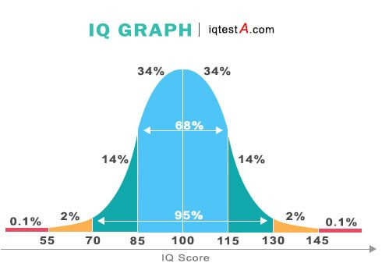
Intellectual Disability
Deficits in intellectual and adaptive functioning - formerly known as mental retardation (MR)
Low IQ categories
Notes:
Historical note - binet scale uses outdated and terms that have become offensive with time including moron, idiot, imbecile.

Slide 25
Learning Disabilities
Specific deficits in reading, writing, or mathematics.
These can occur in isolation or combinations.

Slide 26
Abuse and Neglect
Always ask about abuse and neglect. Must report suspicions to CPS.
Abuse - physical/sexual/psychological
Look out for bruises, burns, behavior changes - including acting out, detachment, nightmares.
Neglect - failure of a guardian to properly care for a child
Self-injurious behavior (sometimes called parasuicidal behavior, or non-suicidal self injury, NSSI) - symptom not a diagnosis. Intent is not suicide, but a coping mechanism for release. Seen in depression, anxiety, PTSD, substance abuse, some personality disorders. Treatment - therapy and identification of underlying diagnosis, treat accordingly

Slide 27
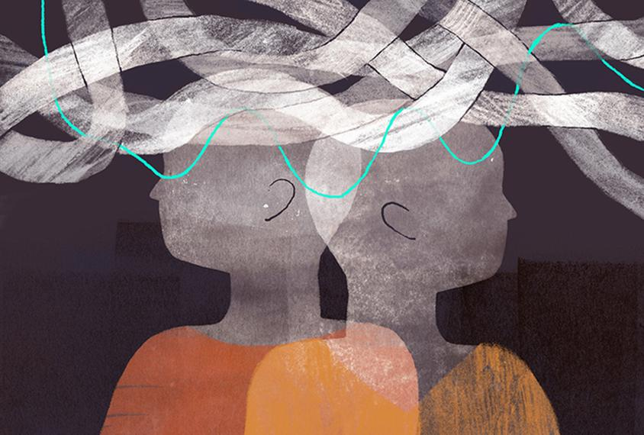
Psychotic Disorders in children and adolescents
Issues distinguishing normal childhood fantasies from frank delusions/psychosis
Schizophrenia CAN occur in childhood but is very rare.
If a child has depression and begins to have hallucinations, it is more likely to be the onset of bipolar disorder (vs. schizophrenia)

Slide 28
Pre-adolescents
Usually have 1st degree relative with schizophrenia. Often have minor neurological impairments, low average to borderline intelligence, high levels of anxiety, hyperactivity, impaired attention, delayed speech and language
Adolescents
Insidious symptoms (prodrome) including apathy, changes in personal hygiene, social withdrawal, anxiety, deteriorating school performance, depression, and suicidal ideation
Treatment with antipsychotics and therapy

Slide 29
Bipolar Disorder in Children & Adolescents
Risk factors: early onset MDD (especially those with psychotic features). Family history of bipolar disorder, depression w/ psychotic features or any mood disorder. Pharmacologically induced mania**
Mania in children RARELY presents with euphoria, more often irritability, anger, sexual preoccupation inconsistent with developmental level and emotional lability.
20-40 % of depressed children and adolescents will go on to develop Bipolar Disorder within five years after the onset of Major Depressive Disorder (MDD)
Treatment: mood stabilizers (lithium, valproic acid, lamotrigine, carbamazepine), antipsychotics (especially for mania)

Slide 30
Child & Adolescent Psychiatry
PTSD
Age >6 = need same 4 symptom clusters (intrusion, avoidance, cognition/mood, arousal/reactivity) as adults
Age <6 = need intrusion + arousal/reactivity + avoidance OR cognition/mood
• Re-enact trauma through play, often re-experience trauma while relaxed (vs. when stressed in adults), repetitive play/behaviors
• Treatment is psychotherapy, SSRIs, alpha agonists, atypical antipsychotics

Slide 31
Child & Adolescent Psychiatry
Major Depressive Disorder
-children (M=F): irritable, aggressive, disruptive, somatic complaints, poor self-esteem
-adolescents (M<F): depressed mood (still element of irritability), social isolation, hypersomnia, declining grades, hypersomnia, substance use, SI
-SIGECAPS
-20-40% go on to develop bipolar disorder within 5 years
-Tx: psychotherapy (CBT), antidepressants (SSRIs)

Slide 32
Child & Adolescent Psychiatry
Adjustment Disorder: clinically significant emotional/behavioral sx arising within 3 months of a stressor, in response to that stressor
-marked distress out of proportion to severity/intensity of stressor
-sx do not persist over 6 months (if anxious sx, then GAD)
-does not meet definition for any other disorder
-Tx: psychotherapy (first line), SSRIs

Slide 33
Child & Adolescent Psychiatry
Anxiety Disorders
-Selective Mutism: failure to speak in specific setting, can speak elsewhere (vs. normal behavior)
-Separation Anxiety Disorder: persistent, excessive distress when separated from home/major attachment figures
-school refusal, clinging, worried harm will come to parents
-somatic sx common (head/stomach aches)
-Tx: psychosocial interventions (CBT, family therapy, play therapy)
-vs. Normal behavior
-Learning disorder/Intellectual disability
-GAD, OCD, ASD, social anxiety, panic

Slide 34
Autism Spectrum Disorder
Persistent deficits in social communication and social interaction
Deficits in social reciprocity: abnormal back and forth conversations, reduced sharing of interests, failure to initiate or respond to social interactions
Deficits in nonverbal communicative behaviors: understanding gestures, facial expression, eye contact
Deficits in developing, maintaining, or understanding relationships
Restricted, repetitive patterns of behavior, interests, activities
Stereotyped or repetitive motor movements, use of objects, speech
Adherence to routines, distress at small changes
Restricted, fixated interests
Hyper- or hyporeactivity to sensory input or unusual interests in sensory aspects of the environment (e.g. adverse response to sounds/textures)

Slide 35
Autism Spectrum Disorder
-levels of severity based on how much support the patient requires
-4:1 M:F
-multifactorial: neurobiological, genetic, environmental risk factors (advanced paternal age, low birth weight, fetal exposure to valproate, inadequate language exposure)
-Tx: speech and language therapy, occupational therapy, special education (IEP, dedicated schools), social skills training, caregiver support, CBT for less severe
-Social communication disorder: persistent difficulties in the social use of verbal and non-verbal communication WITHOUT restricted, repetitive behaviors/interests

Slide 36
Conduct Disorder, ODD, DMDD
Aggression itself is a symptom, not a disease/disorder

Slide 37
Disruptive Behavior Disorders
Conduct Disorder - disorder diagnosed in childhood or adolescence that presents itself through a repetitive and persistent pattern of behavior in which the basic rights of others or major age-appropriate norms are violated. < 18 years-old.
15 criteria that fall into 4 categories. Dx requires at least 3 of them, with one occurring in the prior month
(1) aggression to people/animals (2) destruction of property (3) deceitfulness (4) serious violations of rules
Treatment- behavioral interventions, preventive measures, parent training, multisystemic therapy. Be sure to manage comorbidities such as ADHD; may use antipsychotics and lithium for severe aggression and impulsive rage.

Slide 38
Normal Behavior
All children can be oppositional (hungry, tired, stressed, or upset)
May argue, talk back, disobey, and defy parents, teachers, and other adults
Oppositional behavior is often a normal component in the development of 2-3 years olds and early adolescents
Uncooperative and hostile behavior becomes serious when it is frequent, consistent, and stands out in comparison to other children of the same age

Slide 39
Disruptive Behavior Disorders...continued
Oppositional Defiant Disorder - children/adolescents with difficult and challenging behaviors that are defiant, BUT NOT dangerous or illegal
> 6 months.
Angry/irritable mood (often losing temper, often touchy or easily annoyed, often angry or resentful) Argumentative/defiant behavior (often argues with authority figures, often actively defies/refuses to comply with requests from authority figures or rules, often deliberately annoys others, often blames others for his/hers mistakes) Vindictiveness
Treatment: behavioral intervention, parental training, treat comorbidities, likely ADHD (methylphenidate, clonidine, guanfacine)

Slide 40
Disruptive Mood Dysregulation Disorder (DMDD)- Severe recurrent temper outbursts (verbal or behavioral) that are out of proportion in intensity or duration to situation or provocation.
Inconsistent with developmental level.
Persistently irritable or angry most of the day
Observed by others (parents, teachers, and peers) Occure 3 or more times per week
Treatment: No FDA approved medications for DMDD, individual therapy/medications to account for other comorbidities or presenting problems. Behavioral interventions.

Slide 41
Attention deficit hyperactivity disorder (ADHD)

Slide 42
ADHD: Inattention and/or hyperactive-impulsive symptoms for > 6 months, onset before age 12 and with symptoms occurring in 2 or more settings (i.e. school & home), impairs functions
Sub-types:
Inattentive: easily distracted, forgetful, loses focus, trouble following directions, lacking organization skills
Hyperactive-impulsive: talks excessively restless, “driven by motor” interrupts others
Combined
Associated with delayed cortical maturation, hypoactivity DA and NE
Common comorbidities - ODD, CD, mood disorders, anxiety disorders, language and learning disabilities

Slide 43
Treatment
CBT, social, training, parent training, family therapy
Stimulants - methylphenidate (Ritalin), amphetamines (Adderall)
Side effects: ↓ appetite, ↓ sleep, ↑ HR and BP, irritability
Non-stimulants - atomoxetine (NE reuptake inhibitor), clonidine and guanfacine (alpha-2-agonists)

Slide 44
Psychotherapy
Psychodynamic
-likely what you think of when you think of ‘therapy’
-goal is to improve insight in actions and emotions by understanding unconscious motivations; often focuses on PAST relationships, experiences
-used when patient feels “stuck” or doesn’t understand patterns in their behavior
-by knowing why you do something, you can change the behavior
-patients must be relatively intelligent and willing to engage in therapy (also time and money)
-uncovering: making the patient aware of what is going on in their subconscious
-confrontation, clarification, interpretation
-supporting: used in people with fewer defenses and less tolerance to anxiety where uncovering may cause harm
-long-term therapy, without a firm timeline (years)
-Personality disorders, depression, anxiety

Slide 45
Psychotherapy
Cognitive Behavioral Therapy
-goal is symptomatic control -> focuses on difficulties in the PRESENT and to improve them in a short time frame
-identify negative core beliefs and maladaptive patterns of thought (schema)/behavior and challenge them
-highly structured with specific length of treatment, homework with thought record, behavior activities, etc.
-firstline in most childhood disorders, OCD, anxiety, depression
-many specific varieties for many disorders (e.g. CBT for psychosis, PTSD)

Slide 46
An otherwise healthy 34-year-old man has a history of petty theft. He has stolen lunches, loose change, and office supplies from his coworkers over the past 3 years. Today, he cannot find his phone. He quickly and loudly accuses his coworker of stealing it. It is later discovered that the man had misplaced his phone in the bathroom. When he gets home, he complains to his wife that his phone disappeared because “someone at work is a dirty liar.”
Which of the following defense mechanisms best explains this patient's behavior?
Acting Out
Denial
Displacement
Passive Aggression
Projection
Rationalization
Reaction Formation
Sublimation
Notes:
E

Slide 47
2. A 21-year-old woman presents to her male family practitioner complaining of sleep deprivation and severe depression. When asked about her sleeping habits in greater depth, she reports sleeping for 7–9 hours per night, but states that it is “just not right.” On further questioning, she claims to not have any problems with her personal life and is excited about her recent promotion at work. She is wearing a lot of makeup and a large hat, and she asks the physician to comment on her new orange dress. Throughout the course of the visit, the patient becomes progressively more animated and begins making aggressive sexual advances toward the physician and the staff. She mentions how upset she is that the staff weren’t paying any attention to her in the waiting room. She reports that her mood has been good, but not overly elevated, expansive, or elated. She tells the physician, “You are my best friend. You understand my problems so well.”
Which of the following is the most likely diagnosis?
Bipolar disorder type I
Borderline Personality Disorder
Histrionic Personality Disorder
Narcissistic Personality Disorder
Obsessive-Compulsive Personality Disorder
Schizotypal Personality Disorder
Notes:
C

Slide 48
3. A 12-year-old boy is brought to the clinic by his mother because he has been acting out in class. She has been told that he is hostile and disrupts the class during reading time. He also brings incomplete reading assignments and homework to school. His teacher has reported that he always asks to use the bathroom during reading time or makes excuses to avoid participation when asked to read aloud for the class. Otherwise, he is well behaved outside of the classroom and at home and gets along well with his classmates. He has no medical conditions and does not take any medications. There is no family history of any medical conditions. His vital signs are within normal limits, and physical examination shows no abnormalities.
Which of the following is the most likely diagnosis?
Attention-deficit hyperactivity disorder (ADHD)
Autism spectrum disorder
Conduct disorder
Oppositional defiant disorder
Reading disorder
Rett syndrome
Notes:
E. only 1 domain difficult

Slide 49
4. A 12-year-old boy is brought to the clinic for evaluation of learning disability at the suggestion of the boy’s teacher. The patient’s mother states that his academic performance has been poor. His teacher frequently calls her to discuss the boy’s failure to turn in completed assignments on time. He has had trouble making friends as he is unable to appropriately participate in organized play or follow the rules of simple games during recess. He is often not invited to other student’s birthday parties. At home, she has difficulty keeping him focused on homework or household chores. On examination, the boy is unable to sit still and talks excessively about various topics. Following an evaluation, the physician prescribes a first-line medication for the diagnosis.
What is the mechanism of action of the most likely prescribed medication?
5HT reuptake antagonist
Alpha-2 receptor antagonist
D2 receptor antagonist
GABA receptor agonist
Indirect sympathomimetic
Mu opioid receptor agonist
Notes:
E

Slide 50
5. A 45-year-old man presents to a psychiatrist at his wife’s prompting. He is a college professor and regularly wins accolades for his well-organized and articulate lectures. In the past 3 months, he has become convinced that his wife is having an affair with a co-worker, despite her protests to the contrary. His wife recently discovered that he hired a private investigator to track her whereabouts. He is very defensive when the counselor questions his suspicions about his wife. Mental status examination reveals a well-dressed, middle-aged man without hallucinations or other mood disturbances. He has no psychiatric history. His speech is normal and he displays an appropriate range of affect.
Which of the following is the most likely diagnosis?
Antisocial personality disorder
Borderline personality disorder
Delusional disorder
Narcissistic personality disorder
Paranoid personality disorder
Schizophreniform disorder
Schizotypal personality disorder
Notes:
C

Slide 51
6. A 10-year-old boy is brought to the physician’s office by his mother because of problems with his behavior. The mother reports that the patient is unable to sit still and that his teacher complains that his constant moving distracts his classmates. The patient also has difficulty listening to his teacher and controlling his emotions. The mother understands the teacher’s frustration because he displays similar behavior at home. He has poor grades, refuses to do chores, and has difficulty completing tasks. The patient is not on any medications. The physician starts him on first-line pharmaceutical therapy for the presumed diagnosis.
Which of the following is the most likely side effect of this patient’s new medication?
Arrhythmia
Delayed onset of action
Drowsiness
Increased aggression
Increased appetite and weight gain
Transient worsening of agitation
Weight loss and decreased appetite
Notes:
G

Slide 52
7. A 60-year-old African-American man describes a history of being reclusive, rarely leaving his home for the past 40 years. His family describes him as an emotionally cold person with few friends. Growing up, he preferred solitary activities such as reading rather than engaging in activities with others. Members of his church have delivered groceries to his front door once a week for the past 20 years, but he never opens the door to greet them. During the interview the patient avoids eye contact, speaks in a monotone, and often does not respond to questions.
Which of the following is the most likely diagnosis?
Avoidant personality disorder
Paranoid personality disorder
Schizoid personality disorder
Schizophrenia
Schizophreniform disorder
Schizotypal personality disorder
Notes:
C

Slide 53
8. A 14-year-old boy is brought by his mother to a psychiatrist after the boy started a fire in the school restroom. When asked why he set the fire, the patient says, “The teachers do not care about the students anyway.” The patient’s mother says that over the past several years her son has been repeatedly penalized in school for breaking into and stealing from classmates’ lockers, starting fights with other students, and disobeying teachers. The patient was adopted from a foster system at the age of 3. He was separated from his biological parents who were deemed unfit to parent due to substance abuse issues. He does not appear to have any recollection of these early childhood events and denies intrusive thoughts or difficulty sleeping. Furthermore, he denies distractibility, periods of elevated mood or self-esteem, impulsivity, or audio/visual hallucinations.
Which of the following is the most likely diagnosis?
Acting out
Antisocial personality disorder
Conduct disorder
Oppositional defiant disorder
Post-traumatic stress disorder
Substance abuse
Notes:
C

Slide 54
9. A 39-year-old woman wearing a flashy shirt presents to the emergency department because she “desperately wants to commit suicide.” She has had suicidal thoughts for the past few days, but denies any changes in weight or appetite. On physical examination she has numerous burns and cut marks along her arms and legs.
After completion of the physical examination and history, the patient flirtatiously praises the physician for being so caring. She also requests a different hospital bed. When told that all other beds are currently in use, she becomes enraged and demands a different physician immediately.
Which of the following is the defense mechanism most closely associated with this patient’s condition?
Acting out
Idealization
Projection
Repression
Splitting
Notes:
E

Slide 55
10. A 16-year-old boy is brought to the clinic by his mother due to concerns about his recent behavior. After taking a general history, you see the patient without his mother to discuss what has been going on. He tells you that he has been angry recently because his father keeps yelling at him about “every little thing.” The patient feels frustrated that he can never seem to do “anything right” in the eyes of his father. He also relates that this anger and frustration has led to him yelling at his younger brother and mother more recently. Last week, he joined the wrestling team at high school and has thoroughly enjoyed it. He said that he now feels less angry, and has not yelled at his brother or mother this week.
What defense mechanism is this patient using?
Displacement
Humor
Projection
Reaction formation
Repression
Sublimation

Slide 56
11. A 28-year-old woman comes to the clinic to establish care as a new patient. She reports a 1-year history of generalized abdominal pain, fatigue, and headaches. She also reports that she often worries about her symptoms so much that she has difficulty sleeping. The patient’s mother has rheumatoid arthritis and an aunt has systemic lupus erythematosus. The patient has no nausea, vomiting, diarrhea, constipation, fever, chills, weight loss, chest pain, or shortness of breath. Her menstrual cycles are regular. She reports having seen multiple doctors over the past year and recalls having “negative blood work.” CT scan of the abdomen showed no abnormalities. She takes no medications. Vital signs are within normal limits. Heart rate is regular, and the lungs are clear bilaterally on auscultation. The abdomen is soft and nontender without masses; there is no rebound or guarding. Range of motion is full in all extremities.
Which of the following is the most appropriate next step?
Abdominal x-ray study
Admit for hospitalization
Referral for gastroenterology consultation
Referral for psychiatry consultation
Regular outpatient visits with same provider
Notes:
E

Slide 57
12. An 18-year-old woman is the captain of her softball team and considered a top state-wide prospect. A scout from her top choice college recently watched her pitch an important game to determine if the college would offer her an athletic scholarship. Much to her disappointment, it was her worst performance of the season and her team eventually lost the game. Whenever her friends discuss where they want to attend college, she replies “Let’s not talk about that ok?” and changes the topic to their end of year exams.
Which of the following defense mechanisms is this young woman exhibiting?
Denial
Isolation (of affect)
Rationalization
Reaction formation
Repression
Suppression
Notes:
F

Slide 58
13. An 8-year-old boy is brought to the pediatrician because his parents say that for the past year he has had increasing problems with repetitive behaviors such as sticking out his tongue and shutting his eyes. Recently, he has begun clearing his throat often. When the patient is asked about these repetitive behaviors, he states that he has “tried hard to stop, but they just keep happening over and over.” He worries that his friends will say mean things at school if his behaviors continue. The patient asks his pediatrician to “please make them go away.” The patient’s temperature is 36.7°C (98°F), pulse is 70/min, respirations are 18/min, and blood pressure is 116/68 mm Hg. Frequent eye shutting is observed on physical examination, but other findings are unremarkable.
Which of the following drugs is indicated for the treatment of this patient?
Dextroamphetamine
Methylphenidate
Reserpine
Risperidone
Valproic acid
Notes:
D

