Slide 1
An Introduction to Child and Adolescent Psychiatry
Michael R. DiGiacomo, MD
Assistant Clinical Professor of Psychiatry
SUNY at Buffalo Jacobs School of Medicine and Biomedical Sciences

Slide 2
Disclosures
Required Slide
No significant financial, general or obligation interests to report

Slide 3
Objectives
Explain the relationship between normal development and psychopathology in children and adolescents
Identify key elements of assessing a child or adolescent
Recognize features of Intellectual Disability and Posttraumatic Stress Disorder
Differentiate symptoms of bipolar disorder and psychotic disorder commonly seen in children compared to those seen in adults

Slide 4

Special Thanks
Peter S. Martin, MD, MPH
Clinical Assistant Professor of Psychiatry

Slide 5
Child and Adolescent Psychiatry
Subspecialty of Psychiatry that focuses on the mental health needs of youth
Disorders that are unique to childhood
Disorders that begin in childhood or adolescents
Developmental perspective

Slide 6
“Normal”

Slide 7
Normal Development
Children are NOT just small adults
Need to have a developmental perspective
8-year-old with depression will present differently from a 16-year-old with depression
Children are constantly interacting with their environment → shapes their development
Longitudinal perspective because development happens quickly

Slide 8
Development
Physiological changes in Brain
Anatomy
Frontal lobe development, especially prefrontal cortex, continues to develop until age 25
Neurotransmitters
Serotonin: Levels consistent throughout development
Norepinephrine: Levels increase throughout childhood and adolescence
Dopamine: Receptors decrease after age 3

Slide 9
Development
Physiological changes in Body
Less body fat as child, increased during adolescence
In children, shorter half-life for medications that are lipid soluble May require more frequent dosing to achieve steady-state
Greater hepatic capacity in children → faster metabolism
May require more frequent dosing or higher doses

Slide 10
Four Developmental Subtypes
Motor
Language
Cognitive
Social/Emotional

Slide 11
Motor
Language
Cognitive
Social/Emotional

Slide 12
Specific Concerns for Mental Health and Children
Performing the Assessment
Systems of Care
Confidentiality
Abuse

Slide 13
Performing The Assessment
Children are the identified patient, but they exist in a wider context
Parents
Family
Friends
School and Activities
Child psychiatrists also need to interview caregivers, teachers, guidance counselors, and extended family members

Slide 14
Questions to Consider
What level of emotional and intellectual maturity does the child have?
What are his or her strengths?
What are his or her weaknesses?
What stresses are affecting the child?
How do these stresses affect this child at this particular stage of his or her life?
What gender-specific challenges are affecting their illness and treatment?

Slide 15
Performing The Assessment
Children may lack the verbal and cognitive skills to express their concerns
Need to use alternative, more concrete questions
Rely on collateral information from parents
Playing games with the child in session
Involvement with parents changes
Large amount of parental involvement in very young
More involvement from child as they become older
By adolescence, the psychiatrist may work primarily with the child

Slide 16
System
Team of Professionals
Psychiatrist
Therapist (Psychologist, Social Worker)
School (Teachers, Counselors)
Others
Speech Therapist
Occupational Therapist
Physical Therapist
Day Care Providers

Slide 17
Confidentiality
Younger children
Parents are often in the room
Understood that information will be shared with parents
Adolescents
Understood that information will NOT be shared with parents
Adolescents are more autonomous

Slide 18
Confidentiality
Safety Concerns are the Exception
Suicidal or homicidal ideation
Substance abuse - depends on severity
Illegal activities if dangerous

Slide 19
Abuse and Neglect
Always ask about abuse and neglect when examining a child for emotional or behavioral problems

Slide 20
Abuse and Neglect
Abuse: Parent or guardian injured the child
– Physically
– Sexually
- Emotionally
Neglect: Parent or guardian has
– Harmed the child
– Failed to properly care for the child
Inadequate care, education, medical care
- Abandoned the child

Slide 21
Abuse and Neglect
Signs/symptoms of maltreatment
– Physical: bruises, burns, unusual patterns of harm
– Behavioral: acting out, clinging, detachment, stealing, hoarding, nightmares, poor concentration

Slide 22
Abuse and Neglect
Physicians must report suspicion of child abuse or neglect to the child abuse hotline - Child Protective Services
Physician responsibility is to report
CPS then investigates to determine if abuse occurred

Slide 23
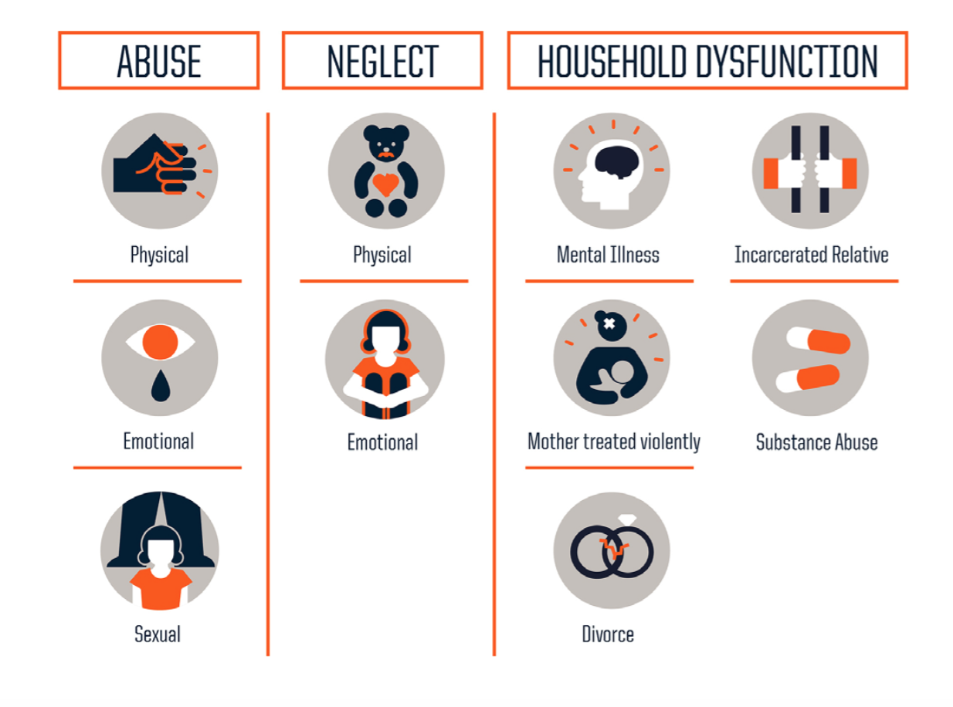

Slide 24
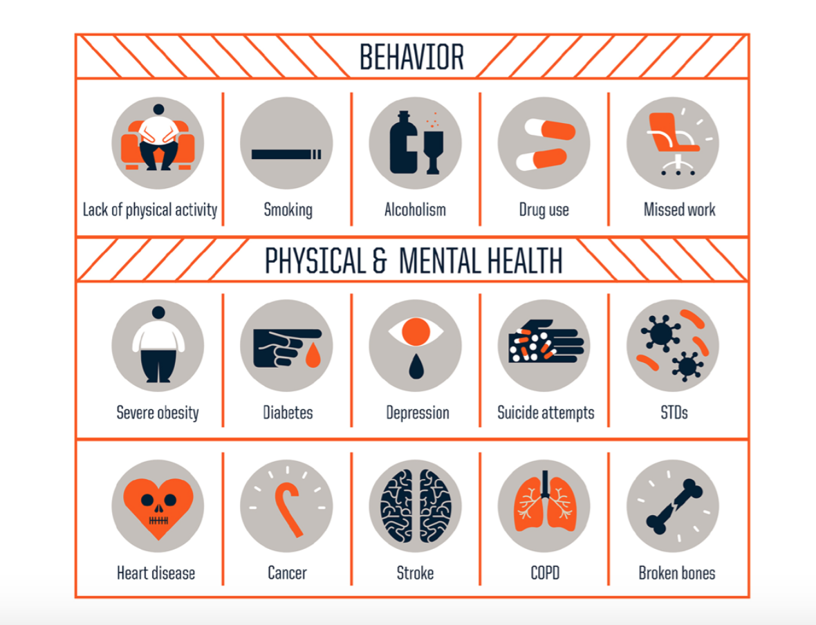

Slide 25
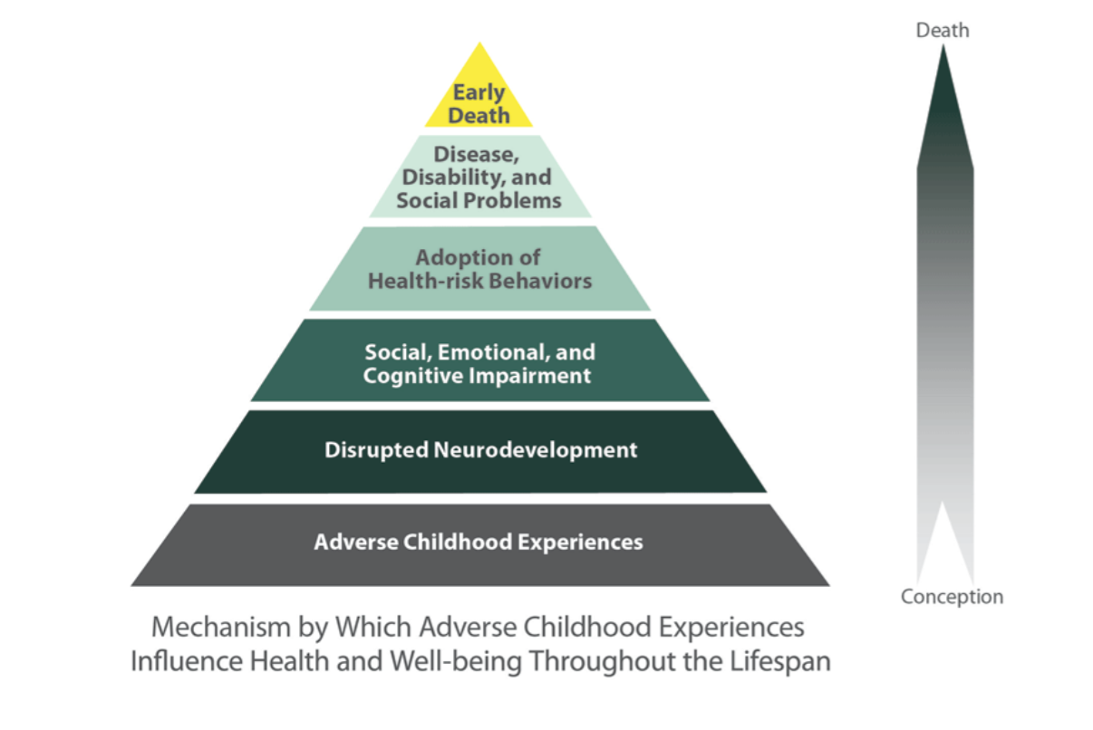

Slide 26
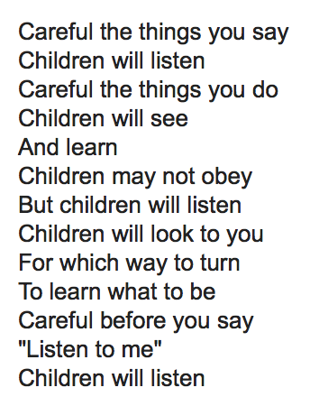

Slide 27
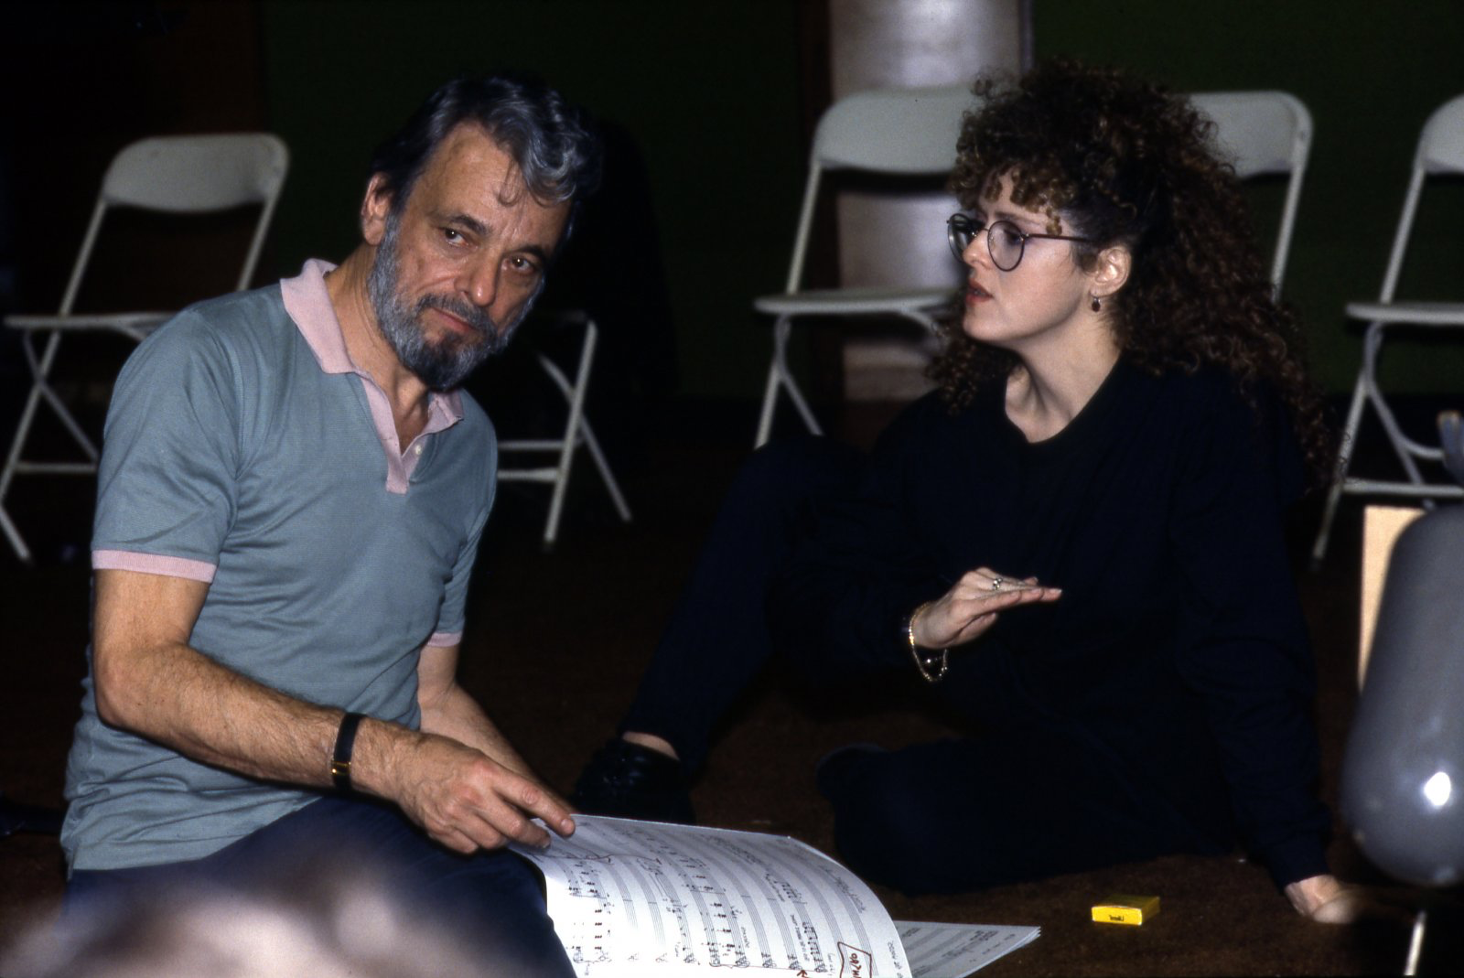

Slide 28
Posttraumatic Stress Disorder
Exposure to actual or threatened death, serious injury, or sexual violence either directly or by witnessing a traumatic event
Differences in presentation of symptoms depending on age/level of cognition
A child’s response can involve intense fear, helplessness, horror, or disorganized or agitated behavior
Often under-diagnosed because it is overlooked

Slide 29
Posttraumatic Stress Disorder
Children older than age 6 develop:
– Intrusive symptoms:
Recurrent memories
Distressing dreams or Nightmares
Flashbacks
– Persistent avoidance of stimuli associated with event
– Negative changes in mood and cognition
- Increased arousal and reactivity

Slide 30
Posttraumatic Stress Disorder
Children younger than age 6 develop:
– Intrusive symptoms:
-Recurrent memories: may not appear distressing, may be
expressed in play reenactment
-Distressing dreams/nightmares: may not be possible to connect content to related trauma
-Flashbacks: may be expressed in play reenactment
- Persistent avoidance of stimuli or negative changes in
mood and cognition
- Increased arousal and reactivity

Slide 31
Posttraumatic Stress Disorder
Trauma can be re-experienced in may different ways (visual, auditory, tactile, olfactory)
Often occur when relaxed
In adults, occur when stressed
Repetitive play or behaviors: Play or games are not fun for the child
– Behaviors usually repeat aspects of the trauma
– Behaviors can be disorganized, agitating
Trauma-specific fears: Fears related to the original trauma

Slide 32
Posttraumatic Stress Disorder
Short and long term effects of trauma:
– Changed attitudes about people, life, and the future􏰀 → a sense of a severely limited future
Recognize a profound vulnerability in all people, especially themselves
– Sexually abused often have problems with fear, worry, sadness, anger, feelings of isolation, low self-esteem, inability to trust, aggression, sexualized behaviors, self-injury, substance abuse

Slide 33
Posttraumatic Stress Disorder
Treatment:
Psychotherapy • Trauma-focused Cognitive Behavioral Therapy
• Family therapy • Group therapy • Play therapy
Pharmacotherapy
SSRIs: suicidal behaviors, aggression, obsessive/intrusive thoughts
Alpha-adrenergic agonists: hyperarousal
Atypical antipsychotics: explosive behavior, flashbacks, dissociation

Slide 34
Epidemiology
4 million children and adolescents with a serious mental disorder
Half of all lifetime cases of mental disorders begin by age 14

Slide 35
Epidemiology
Long delays (sometimes decades) between initial onset of symptoms and when treatment sought􏰀
Untreated disorders = more severe and more difficult to treat, greater development of comorbid mental illness
Only 20% of children with mental disorders are identified and receive mental health services

Slide 36
Epidemiology
Suicide - Third leading cause of death in ages 15-24
School failure
Juvenile/criminal justice involvement
Higher health care utilization
Higher financial costs
Identification and early treatment to minimize long-term disability

Slide 37
Epidemiology
<30% of youths with emotional problems are identified by their PCP
Of those recognized<50% referred to a mental health specialist

Slide 38
Intellectual Disability
Previously described as “mental retardation”
Deficits
– Intellectual : confirmed with testing (Reasoning, problem solving, planning, abstract thinking, judgment, academic learning, learning from experience)
– Adaptive functioning: conceptual, social and practical domains

Slide 39
Intellectual Disability
Borderline IQ: 70 to 85
Mild: IQ = 50-55 to 70
• In special education or “mainstreamed” classrooms
• Often function in community, have jobs
Moderate: IQ = 35-40 to 50-55 • Participate in self-contained classrooms • Usually require sheltered environments (group homes)
Severe: IQ = 20-25 to 35-40
Profound: IQ <20-25
Require institutional settings

Slide 40
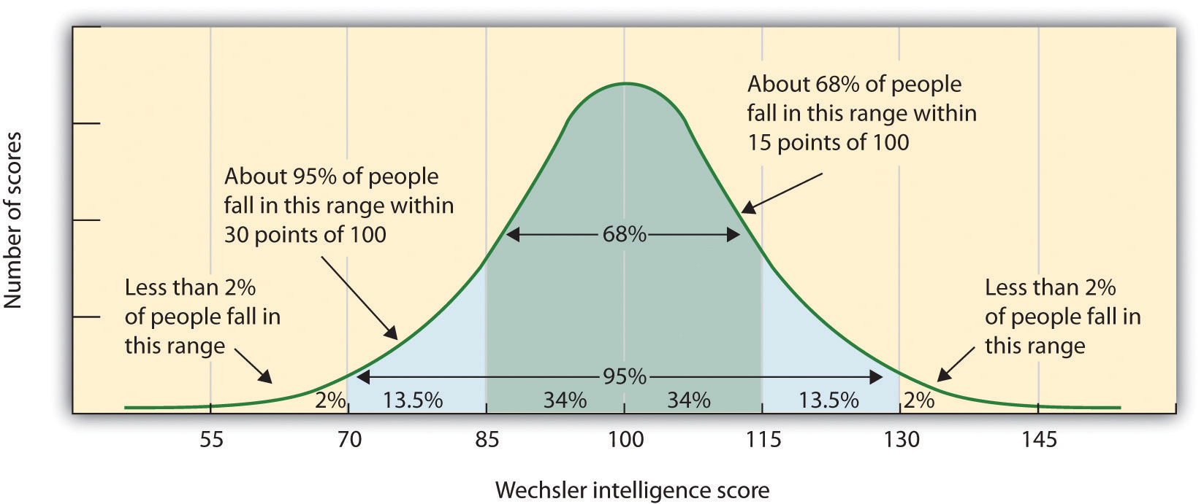

Slide 41
Learning Disability
Specific deficits in reading, writing, or mathematics
May occur in isolation or in combination

Slide 42
Psychotic Disorders
Biggest challenge in children:
– Distinguishing normal childhood fantasies form frank delusions and hallucinations
– Distinguishing disorganized speech and behavior from those due to developmental delays or intellectual disability
Although schizophrenia is usually diagnosed between the ages of 15-35, its onset can occur during childhood
If child is depressed and has hallucinations, 􏰀likely the beginnings of bipolar disorder (as opposed to schizophrenia)

Slide 43
Psychotic Disorders
Pre-adolescents
Usually have first degree relative with schizophrenia
Often exhibit minor neurological impairments, low average to borderline intelligence, high levels of anxiety, hyperactivity, impaired attention, delayed speech and language
Adolescents
Insidious symptoms (prodrome) including apathy, changes in personal hygiene, social withdrawal, anxiety, deteriorating school performance, depression, and suicidal ideation

Slide 44
Psychotic Disorders
Presenting symptoms
– Auditory and visual hallucinations
– Illogical and disorganized thinking
– Poverty of content of speech
– Delusions are not common until adolescence􏰀
Higher level of cognitive development necessary for delusion

Slide 45
Psychotic Disorders
Diagnosis
– Should be made only when symptoms are multiple, pervasive, persistent, have substantial effect on adaptive function
– Other medical, substance use or psychiatric disorders have been ruled out

Slide 46
Psychotic Disorders
Treatment
– Medications: antipsychotics
– Psychological interventions
Supportive Psychotherapy
Family Therapy Psychoeducation
– School interventions: including advocacy for special education needs (specialized setting)
– Hospitalization: If child is suicidal, paranoid, or if the family system cannot support the child during stabilization

Slide 47
Bipolar Disorder
Unlike adults, children who are manic rarely exhibit euphoria
Common Symptoms:
– Increased irritability and intense anger
– Aggression against others
– Hyperactivity
– Sexual preoccupation inconsistent with developmental level
– Poor concentration
– Emotional lability

Slide 48
Bipolar Disorder
How symptoms seen in adults can present in youth:
– Grandiosity: feel indestructible or believe heor she can fly
– High energy levels and need little sleep
– Excessive involvement in multiple projects
and activities and are easily distracted
– Speak rapidly (pressured speech) and change topics quickly, often refusing to be interrupted
– High risk-taking behaviors such as substance abuse, daredevil stunts, and sexual promiscuity

Slide 49
Bipolar Disorder
About 20-40 % of depressed children and adolescents will go on to develop Bipolar Disorder within five years after the onset of Major Depressive Disorder (MDD)
Risk Factors
– Early onset MDD (especially with psychotic features)
– Family History of bipolar disorder, depression with psychotic features, or any mood disorder
– Pharmacologically-induced mania

Slide 50
Bipolar Disorder
Treatment
– Medications:
Mood stabilizers (Lithium, Valproic acid, Lamotrigine, Carbamazepine)
Antipsychotic medications (especially for mania)
Antidepressants (to avoid switch to mania, should be used with mood stabilizer or antipsychotic)
– Psychosocial interventions
Individual therapy Family therapy Psychoeducation

Slide 51
Bipolar Disorder
Treatment
– Hospitalization: If behaviors are dangerous to the child or to others

Slide 52
References
Andreasen, Nancy C. and Black, Donald W. Introductory Textbook of Psychiatry. American Psychiatric Publishing, 2014.
Azzam, Amin et al. First Aid for the Psychiatry Boards. McGraw-Hill Education, 2010.

Slide 53
References
Diagnostic and Statistics Manual Version 5. American Psychiatric Association, 2014.
Felitti, Vincent J et al. “Relationship of Childhood Abuse and Household Dysfunction to Many of the Leading Causes of Death in Adults. The Adverse Childhood Experiences (ACE) Study.” The American Journal of Preventitive Medicine. 1998;14(4).
Le, Tao et al. First Aid for the USMLE Step 1. McGraw-Hill Education, 2015.

Slide 54
Contact
Michael.DiGiacomo@omh.ny.gov

