Slide 1
Eating Disorders
Michael R. DiGiacomo, MD
Clinical Assistant Professor of Psychiatry
SUNY at Buffalo Jacobs School of Medicine and Biomedical Sciences

Slide 2
Disclosures
Required Slide
  No significant financial, general or obligation interests to report

Slide 3
Objectives
Explain what is the difference between “normal” eating and an eating disorder
Describe the similarities and differences between anorexia nervosa and bulimia nervosa
Identify the principles of diagnosis and treatment of eating disorders

Slide 4

Special Thanks
Peter S. Martin, MD, MPH
Clinical Assistant Professor of Psychiatry

Slide 5
Going Back In Time
Ancient Egyptian physicians encouraged purging
1200s: Catherine of Sienna →complete control over her body was a sign of devotion
Middle Ages: Catholic church →“gluttony” is deadly sin
1600s: English physician Richard Morton in 1689 published two cases of “wasting” disease

Slide 6
Going Back In Time
1800s: Sir William Gull coined term “anorexia nervosa”
1920s: Decrease in literature about eating disorders due to increase in endocrine disease diagnoses
1940s: Psychoanalytic theories emerge
1970s: Release of Hilde Burch’s “Eating Disorders” in 1973 increased exposure

Slide 7
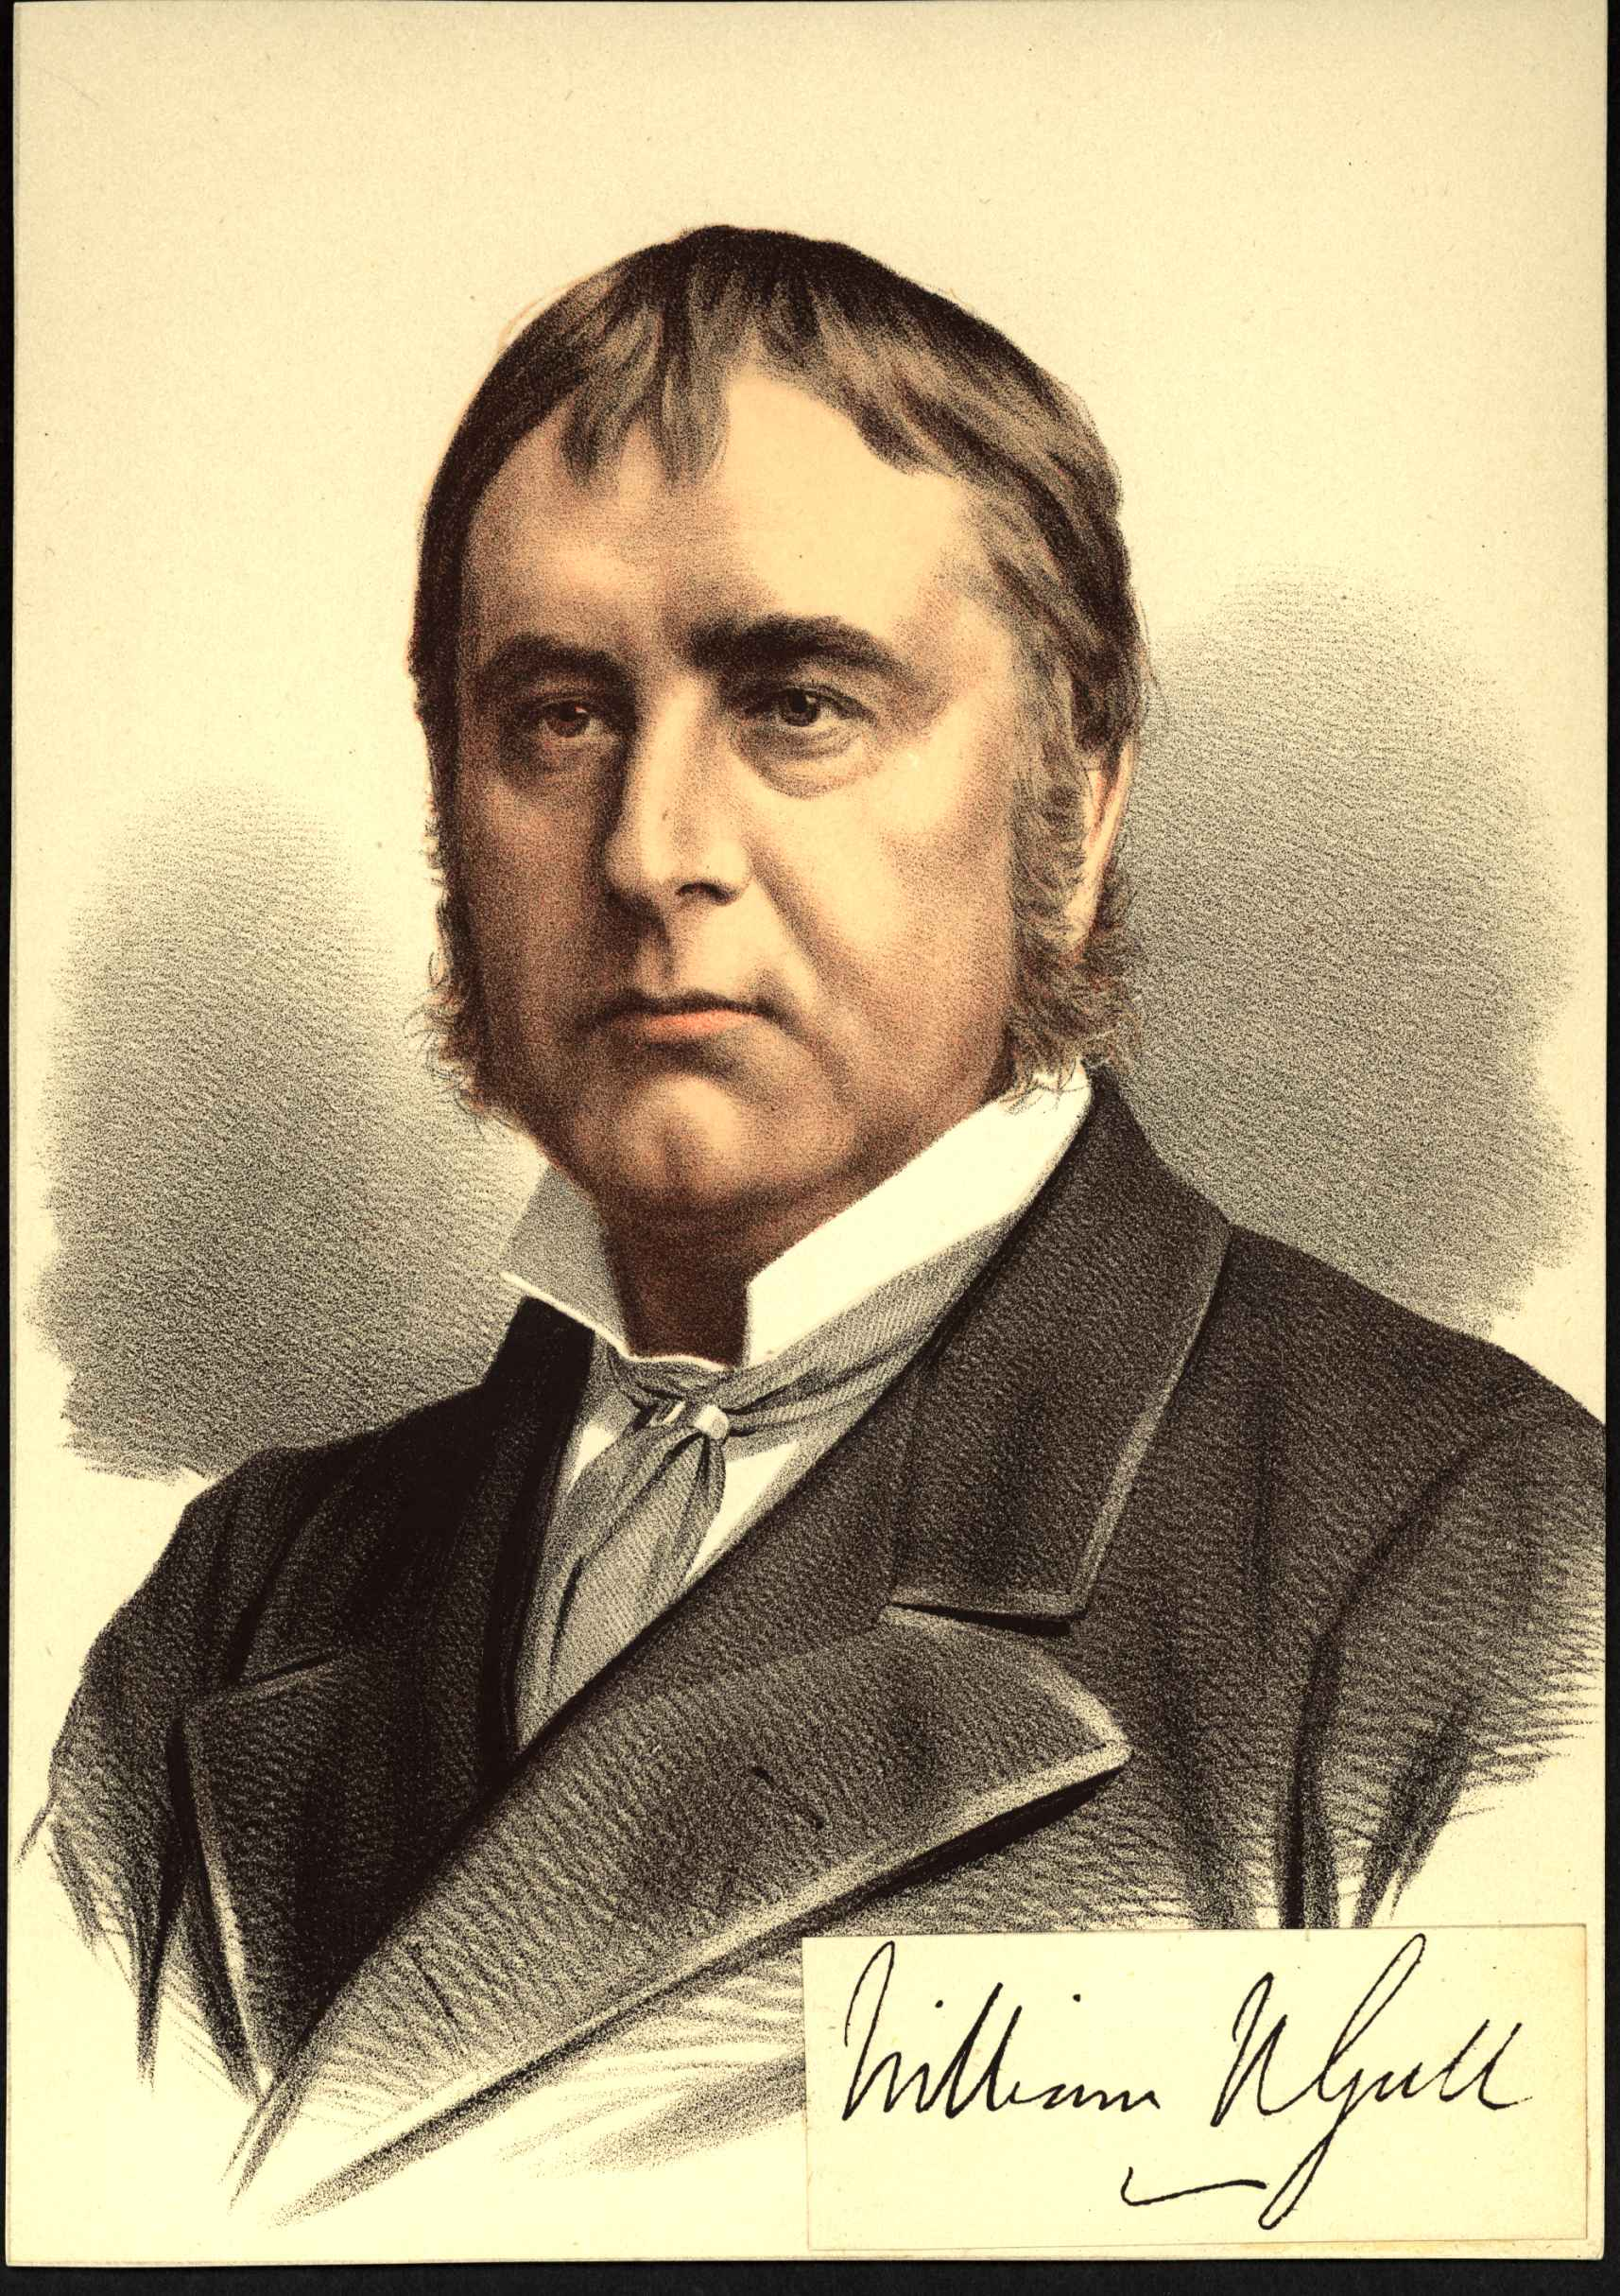
S

Slide 8
Eating Disorders
Severe disturbances in eating behavior resulting in physical, emotional, or functional impairments or suffering
Different types of Eating Disorders
Associated with weight loss
Associated with weight gain
Associated with no change in weight

Slide 9
Eating Disorders
Affect 1-3% of the population
Primarily seen in women
More prevalent in westernized industrial societies
May go undetected for years

Slide 11
FFeeding and Eating Disorders
Anorexia Nervosa
Bulimia Nervosa
Binge-Eating Disorder
Pica
Rumination Disorder
Avoidant/Restrictive Food Intake Disorder

Slide 12
Anorexia Nervosa
Persistent energy intake restriction
Intense fear of gaining weight or of becoming fat, or persistent behavior that interferes with weight gain
Disturbance in self-perceived weight or shape

Slide 13
Anorexia Nervosa
Restriction of energy intake relative to requirements leading to a significantly low body weight
“Significantly low weight”: a weight that is less than minimally normal or, for children and adolescents, less than that minimally expected

Slide 14
Anorexia Nervosa
Severity
Mild: BMI ≥ 17 kg/m2
Moderate: BMI 16–16.99 kg/m2
Severe: BMI 15–15.99 kg/m2
Extreme: BMI < 15 kg/m2
Increased severity also reflected by:
Clinical symptoms
Degree of functional disability
Need for supervision

Slide 15
Anorexia Nervosa
Another metric: <85% expected weight for age and height
“Goal weight” instead of saying “ideal body weight”
when discussing with patients
Determine BMI-for-age in children

Slide 16
Anorexia Nervosa
Intense fear of gaining weight or of becoming fat
Persistent behavior that interferes with weight gain, even though at a significantly low weight
Fear usually not alleviated by weight loss
Concern about weight gain may increase even as weight falls

Slide 17
Anorexia Nervosa
  May not recognize or acknowledge a fear of weight gain
  Diagnose using collateral, observations, physical and laboratory findings, persistent behaviors from history

Slide 18
Anorexia Nervosa
Disturbance in how a person experiences their body weight or shape
Self-evaluation inappropriately affected by body weight or shape
Persistently does not recognize the seriousness of the current low body weight

Slide 19
Anorexia Nervosa
Can feel overweight globally or realize that they are thin but are still concerned that certain body parts are “too fat”
Utilize a variety of techniques to evaluate their body size or weight
Frequent weighing, obsessive measuring of body parts, persistent use of a mirror to check for perceived areas of “fat”

Slide 20
Anorexia Nervosa
  Self-esteem of individuals is highly dependent on their perceptions of body shape and weight
  Weight loss - an impressive achievement and a sign of extraordinary self-discipline
  Weight gain - as an unacceptable failure of self- control
  Patient acknowledges being thin, but does not recognize the serious medical implications

Slide 21
Anorexia Nervosa
Restricting Type
Weight loss is accomplished primarily through dieting, fasting, and/or excessive exercise
Not engaged in recurrent episodes of binge eating or purging behavior
Binge-eating/Purging Type
Recurrent episodes of binge eating or purging behavior

Slide 22
Anorexia Nervosa
Amenorrhea for at least 3 months is no longer a diagnostic requirement
Often patient is brought to professional attention by family members after marked weight loss (or failure to make expected weight gains) has occurred
If individuals seek help on their own, it is usually because of distress over the somatic and psychological effects of starvation
Rare for a patient to complain of weight loss
Lack insight into or deny the problem

Slide 23
Anorexia Nervosa
Extreme dieting
Concerns about eating in public or with family members
Strong interest in food despite fear of gaining weight
Feelings ineffective
Strong desire to control one’s environment
Inflexible thinking
Limited social spontaneity
Overly restrained emotional expression

Slide 24
Anorexia Nervosa
Binge-Eating Type
More likely to be impulsive
More likely to abuse drugs or alcohol
Semi-starvation and purging can cause potentially life-threatening conditions
Psychiatric symptoms from being seriously underweight: Depressive signs and symptoms = depressed mood, social withdrawal, irritability, insomnia, and diminished interest in sex

Slide 26
Physical Manifestations of Profound Weight Loss
Appear emaciated
Hypothermia
Report cold insensitivity
Bradycardia
Hypotension
Constipation
Dependent edema
Lanugo
Hormonal abnormalities: decreased growth hormone levels, plasma cortisol, gonadotropin levels → delayed sexual development, thyroid hormones

Slide 27
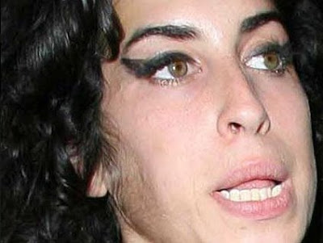

Slide 28
Anorexia Nervosa
Prevalence: 0.4% females overall
1% in high school and college-aged women
10:1 Female-to-Male ratio
Commonly begins in adolescents or young adults
Rare before puberty or after age 40
Age of onset usually younger compared to bulimia
Early teens in anorexia
Late teens to early 20s in bulimia
Usually associated with a stressful life event

Slide 29
Anorexia Nervosa
Period of changed behavior before onset of illness
Course and outcome are variable
Some have a single episode and fully recover
More often a chronic illness
Most remit after 5 years
Hospitalization may be required to restore weight
Mortality rate: Approximately 6% over ten years (0.56% per year)
Increased risk of suicide

Slide 30
Risk Factors
Anxiety Disorders or Obsessive Traits
Modeling or Athletics as career or interest
Family History of eating disorders, bipolar disorder or depression
Industrialized, high-income countries
Possible involvement of serotonergic system (5-HIAA levels increased)

Slide 31
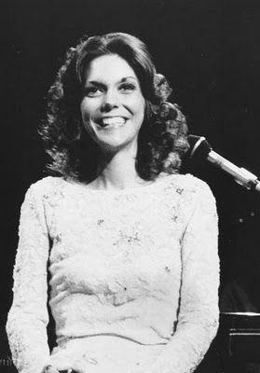

Slide 32


Slide 33
Bulimia Nervosa
Recurrent episodes of binge eating
Inappropriate compensatory behaviors to prevent weight gain
Self-evaluation that is excessively influenced by body shape and weight

Slide 34
Bulimia Nervosa
Recurrent episodes of binge eating
In a discrete period of time, eating an amount of food that is larger than what most individuals would eat in a similar period of time under similar circumstances
Lack of control over eating during the episode
Type of food eaten depends on the individual (usually includes food that would otherwise be avoided)

Slide 35
Binge Eating
  Typically ashamed of their eating problems and attempt to conceal their symptoms
    Usually occurs in secrecy or as inconspicuously as possible
  Continues until the individual is uncomfortably, or even painfully, full
  Triggers include
  Negative emotions
  Interpersonal stressors
  Dietary restraint
  Negative feelings related to body weight, body shape, and food
  Boredom

Slide 36
Binge Eating
May provide tension relief in the short-term
Can lead to negative self-evaluation and dysphoria= delayed consequences such as feelings of guilt or disgust

Slide 37
Compensatory Behaviors
Recurrent inappropriate compensatory behaviors in order to prevent weight gain
Self-induced vomiting
Misuse of laxatives, diuretics, or other medications Fasting
Excessive exercise

Slide 38
Compensatory Behaviors
“Purge behaviors,” “purging”
Vomiting is most common
    Immediate effects = relief from physical discomfort and reduction of fear of gaining weight
    Variety of methods to induce vomiting: use of fingers or instruments to stimulate the gag reflex
    Eventually able to vomit at will

Slide 39
Bulimia Nervosa
Self-evaluation is unduly influenced by body shape and weight
Body shape and weight are extremely important in determining self-esteem

Slide 40
Bulimia Nervosa
Typically within normal weight or overweight
Often restrict total caloric intake or avoid fattening food in between binges
May have menstrual changes
Induced vomiting → parotitis, enamel erosion, dorsal hand calluses, electrolyte disturbances (hypokalemia, hypochloremia, hyponatremia), metabolic alkalosis
Potentially fatal outcomes: esophageal tears, gastric rupture, cardiac arrhythmias

Slide 41
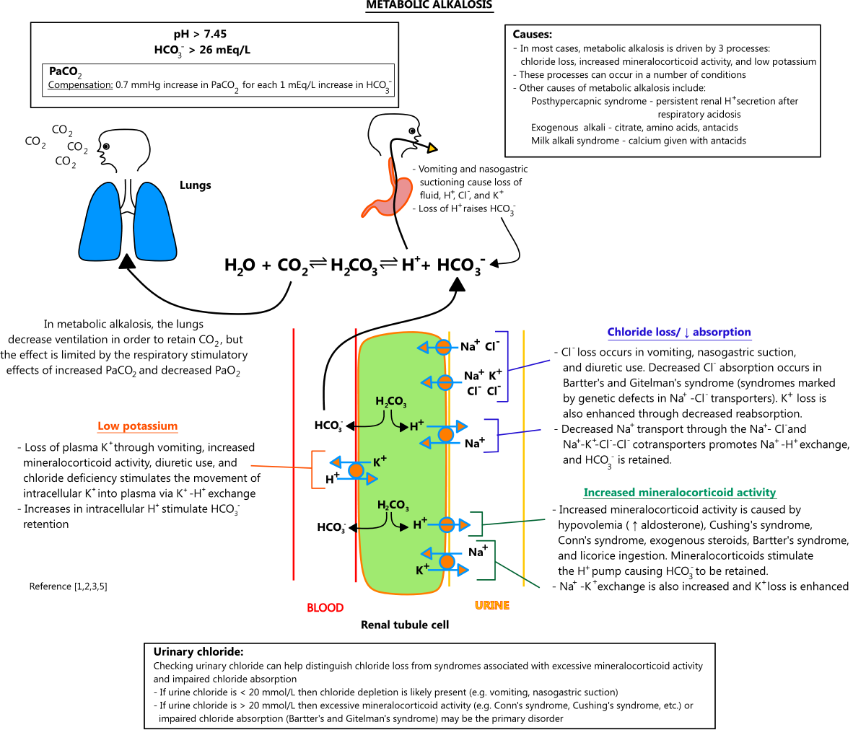

Slide 42
Bulimia Nervosa
Risk for depression and anxiety, substance abuse
Comorbid personality disorders (especially Borderline Personality Disorder)

Slide 43


Slide 44
Bulimia Nervosa
Prevalence: 1-4% of females in lifetime
10:1 Female-to-Male ratio
Begins in adolescence to young adulthood
Binge eating begins after episode of dieting to try to lose weight
Experiencing multiple life stressors
Most remit over time
Increased risk for mortality (all-cause and due to suicide) – 4% crude death rate

Slide 45
Risk Factors
As children: weight concerns, low self-esteem, depressive symptoms, social anxiety disorder, and overanxious temperament
Internalization of a thin body ideal → concerns about weight → increased risk for bulimia
Childhood obesity
Early pubertal maturation
Industrialized countries, primarily Caucasian

Slide 46
Binge Eating Disorder
Recurrent episodes of binge eating
In a discrete period of time, eating an amount of food that is larger than what most individuals would eat in a similar period of time under similar circumstances
Lack of control over eating during the episode
Abnormality in craving an amount of food more than in craving any specific nutrient

Slide 47
Binge Eating Disorder
The binge-eating episodes are associated with three (or more) of the following:
1) Eating much more rapidly than normal
2) Eating until feeling uncomfortably full
3) Eating large amounts of food when not feeling physically hungry
4) Eating alone because of feeling embarrassed by how much one is eating
5) Feeling disgusted with oneself, depressed, or very guilty afterward

Slide 48
Binge Eating Disorder
Marked distress regarding binge eating is present
The binge eating occurs, on average, at least once a week for 3 months
The binge eating is not associated with recurrent inappropriate compensatory behavior (as in bulimia nervosa)

Slide 49
Binge Eating Disorder
Typically ashamed of their eating problems and attempt to conceal their symptoms
Binge eating usually occurs in secrecy inconspicuously
Occurs in normal, overweight and obese individuals

Slide 50
Binge Eating Disorder
Prevalence: males = 0.8%; females = 1.6%
Less significant male-to-female ratio
Similar rates amongst different cultural groups
Less known about developmental course
Dieting seems to follow after binge eating begins (compared to Bulimia where precedes)
Often persistent course (similar to Bulimia)

Slide 51
Binge Eating Disorder
Treatment
Individuals more likely to seek treatment due to being overweight/obese compared to other eating disorders

Slide 52
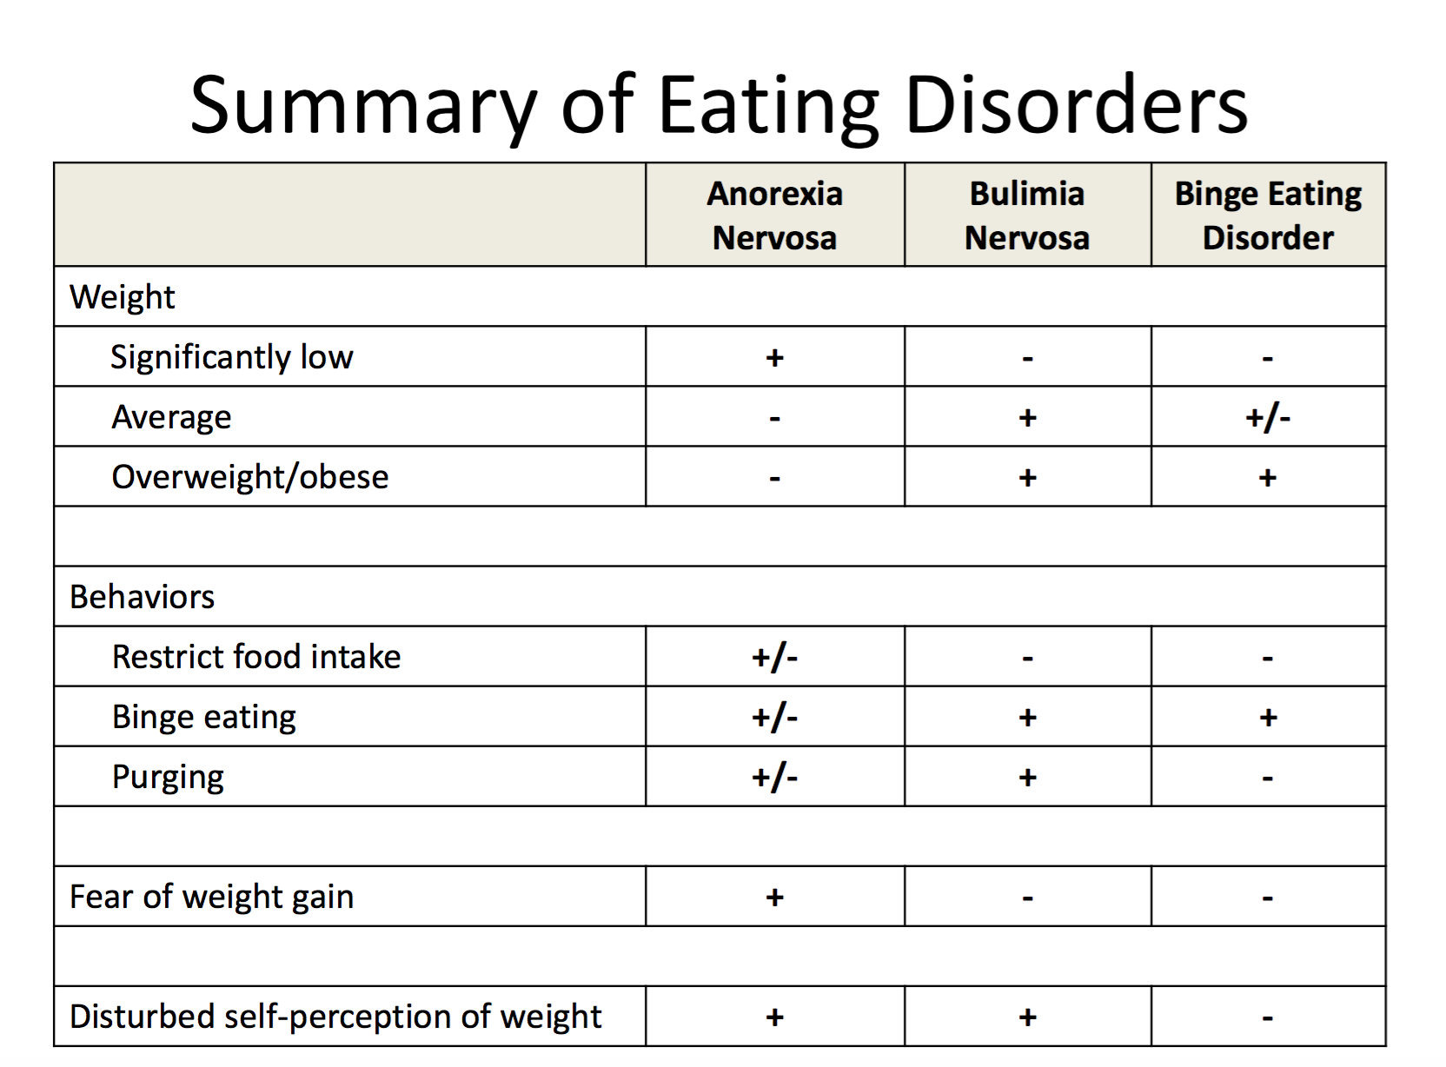

Slide 53
Assessment of Eating Disorders
Thorough History
Mental Status Examination
Physical Examination
Focus on vital signs, weight, skin, cardiovascular

Slide 54
Assessment of Eating Disorders
Labs and testing (also used to rule out other diagnoses):
More severely malnourished/symptomatic:
Cholesterol and lipids
Calcium, magnesium, phosphorus
Liver enzymes
Amylase and lipase
Thyroid function tests
Electrocardiogram
Bone mineral densitometry (looking for osteoporosis)

Slide 55
Assessment of Eating Disorders
Categories of medical conditions that can cause weight loss and appear as eating disorders:
Gastrointestinal- malabsorption as a component
Endocrine- especially hyperthyroidism
Neurologic- midline tumors

Slide 56
Assessment of Eating Disorders
Looking for psychiatric illness that can mimic as an eating disorder
Schizophrenia: bizarre eating habits related to psychosis
Major depressive disorder: poor appetite and significant weight loss
No distorted body image and weight loss is unwanted
Obsessive-compulsive disorder: ritualistic eating patterns but without distorted body image or fears of gaining weight
Autism spectrum disorders: particular eating habits

Slide 57
Treatment of Eating Disorders
Typically done in an outpatient setting
May require hospitalization
- Severe starvation and weight loss
– Hypotension
– Hypothermia
– Electrolyte imbalance
– Depressed with suicidal ideation or psychosis
– Failure to gain weight as an outpatient
Partial Hospital Program: provides increased supervision and support but allows patient to return home at night

Slide 58
Treatment of Eating Disorders
Psychological Treatments
Behavior modification: to restore normal eating behavior
Cognitive-Behavioral Therapy: effective for bulimia
Individual Counseling
Educate patient about illness
Understanding symptoms
Later in treatment - improving insight
Family therapy
Group therapy
Behavioral Contracts

Slide 59
Treatment of Eating Disorders
Hospitalization - structured programs
Set goals for changes in eating and weight gain
Do not focus on daily weights
Target particular behaviors
Reduce number of vomiting episodes
Positive reinforcement used to help
Attain specific weight goals→family pass

Slide 60
Hospitalization
Daily weights: early morning, after emptying bladder, wearing only hospital gown
Record fluid intake and output
Observe 2 hours after eating to prevent vomiting
Started on diet with increased number of calories than what is required to maintain current weight
Difficulty maintaining weight or severely malnourished → tube feeding

Slide 61
Treatment of Eating Disorders
Medications:
– Stool softeners or bulk laxatives may be needed for severe constipation
– Vitamin supplementation: especially calcium and vitamin D

Slide 62
Treatment of Eating Disorders
Psychotropic Medications:
Can be helpful in reducing bulimic behaviors; no role consistently found in anorexia nervosa
– SSRIs: fluoxetine (Prozac) only FDA-approved medication for bulimia nervosa with comorbid depression and/or anxiety
– Caution if using other antidepressant classes
• TCA and MAO-I – concern because of cardiac effects
•

Slide 63
Treatment of Eating Disorders
Psychotropic Medications:
Buproprion (Wellbutrin) – increased risk of seizures = contraindicated given electrolyte abnormalities already present
Antipsychotic Medications - assist with cognitive distortions

Slide 64
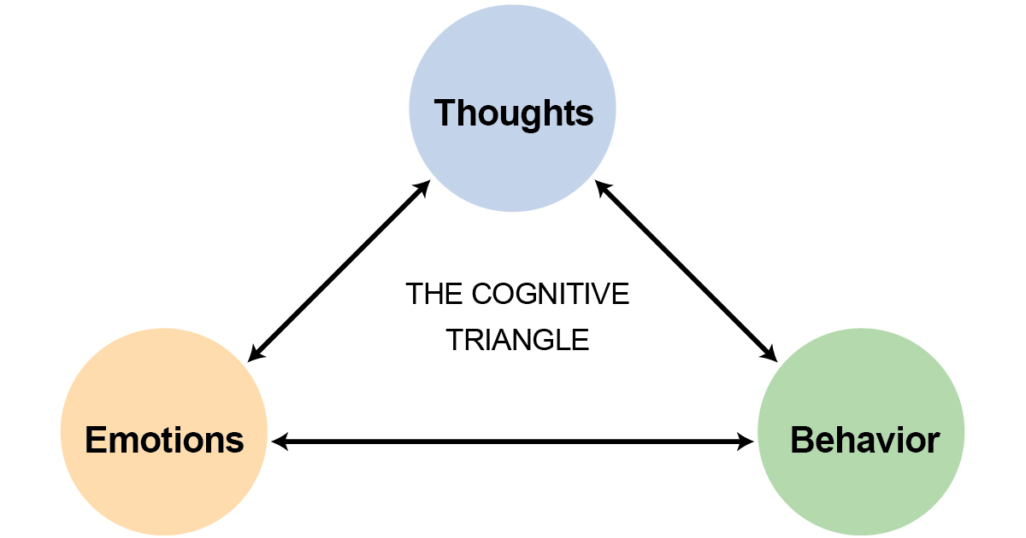

Slide 65
References
Andreasen, Nancy C. and Black, Donald W. Introductory Textbook of Psychiatry. American Psychiatric Publishing, 2014.
Azzam, Amin et al. First Aid for the Psychiatry Boards. McGraw-Hill Education, 2010.
Crow SJ et al. “Increased Mortality in Eating Disorders and other Eating Disorders.” American Journal of Psychiatry. 2009 December: 166 (2), 1342-1346.

Slide 66
References
Diagnostic and Statistics Manual Version 5. American Psychiatric Association, 2014.
Le, Tao et al. First Aid for the USMLE Step 1. McGraw-Hill Education, 2015.
Sullivan, PF “Mortality in Anorexia Nervosa.” American Journal of Psychiatry. 1995 July: 152 (7), 1073-1074.

Slide 67
Contact
Michael.DiGiacomo@omh.ny.gov

