Slide 1

LGBT Patients:
Mental Health Considerations
Lauren Derhodge, DO
UB Psychiatry
February 2018

Slide 2
Objectives
Identify populations at risk for health disparities
Discuss changes made throughout different versions of DSM concerning sexual orientation and gender identity
Identify the DSM Criteria of Gender Dysphoria
Describe the implications of ascribing mental illness to gender/sexual identity
Identify and list health disparities for LGBT individuals
List ways to address unique needs of LGBT patients

Slide 3
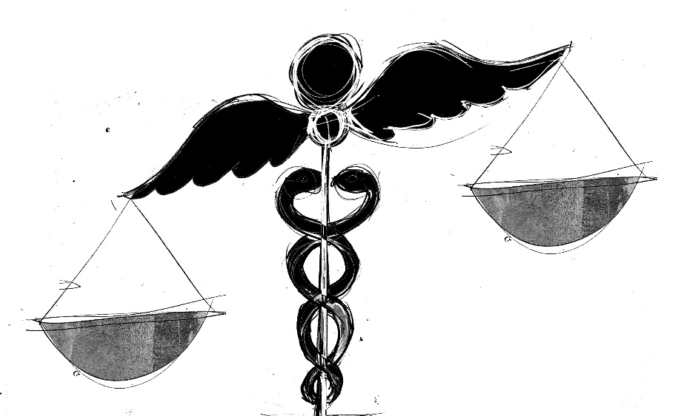
Disparities in Health Care
Important to identify and address
Marginalized or “at-risk” populations are at higher risk of poor health, disability and premature death (NIH 2010)
Experience greater obstacles to obtaining healthcare
Include lesbian, gay, bisexual, transgender (LGBT) individuals
Notes:
- Groups who are vulnerable and at risk of unequal access to healthcare include racial and ethnic minorities, gender minorities (women, transgender), immigrants and refugees, disabled individuals, individuals of low SES, patients with addiction & mental illness, rural, homeless
- The Institute of Medicine (2011): LGBT populations are health disparate & underserved, recognizing the lack of attention to sexual and gender identity as critical gaps in efforts to reduce overall health disparities

Slide 4
What is sexuality?
What is gender?
Notes:
- Sexual and gender identity are complex constructs and are highly dependent upon culture and social context, which can shift
rapidly over time.
- Sexuality encompasses at least three key components: sexual identity, sexual attraction, and sexual behavior.
- Sexual identity is an individual’s own perception of his or her overall sexual self. For many people their sexual identity, such as
lesbian, gay, bisexual, or heterosexual, is consistent with their sexual attraction and behaviors, but for some individuals sexual
identity may be inconsistent with attraction and/or behavior.
- For example, a man whose primary sexual partner is a woman may identify as heterosexual yet occasionally have sex with men.
Gender refers to the behavioral, cultural, or psychological traits that a society associates with male and female sex.
Transgender generally refers to people whose gender identity is at odds with the gender they were assigned at birth
For example, a transgender woman is a person who was born physiologically male but whose deepest sense of self is as female.
- It is important not to conflate sexual and gender identity because they are separate constructs (e.g., transgender individuals may have a heterosexual, bisexual, lesbian, or gay sexual identity).

Slide 5
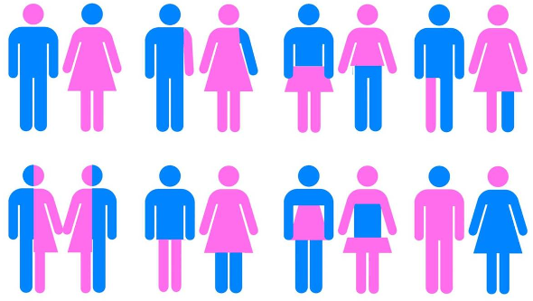
Moving away from a Binary view of Gender
Notes:
Rather than binary systems, both gender and sexual identities can viewed as continuums or spectrums
- It is important not to conflate sexual and gender identity because they are separate constructs (e.g., transgender individuals may have a heterosexual, bisexual, lesbian, or gay sexual identity).

Slide 6
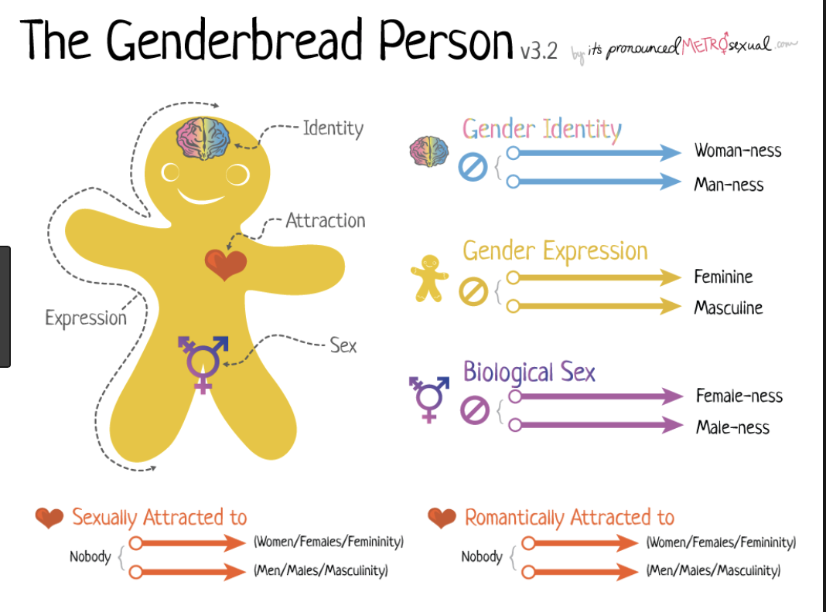

Slide 7
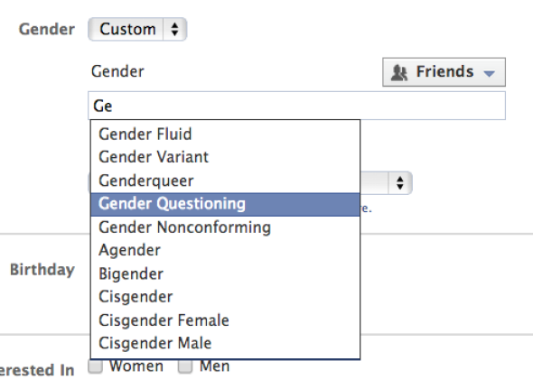
Facebook now offers 50+ customizable Gender options
Notes:
Now facebook offers 50+ customizable gender options

Slide 8
Terms:
Gender identity
Transgender
Gender non conforming
Gender Questioning
Gender Variance
Gender Expression
Gender Incongruence
Bi-gendered
Two spirited
Natal gender
Transvestite
Crossdresser
Cis gender
MTF
FTM
Transition
Gender Queer
Transsexual
Agender
Notes:
These terms are terms meanings vary over time within and between disciplines and cultures. Definitions I am using are taken from the national Center for Transgender Equality.

Slide 9
Highlighted Terms:
Gender Identity – An individual’s internal sense of being male, female or something else. Gender identity is internal and not necessarily visible to others.
Transgender – A term for people whose gender identity, expression or behavior is different from those typically associated with their assigned sex at birth.
Genderqueer – A term used by some individuals who identify as neither entirely male nor entirely female.
Gender Non Conforming – a term for individuals whose gender expression is different from societal expectations related to gender.
Notes:
gender nonconformity: refers to behaviors not matching the gender norms or stereotypes of the gender assigned at birth.
Gender non conforming is not synonymous with transgender or gender dysphoria

Slide 10
Highlight Terms Continued:
FTM – a person who transitions from “female-to-male” meaning a person who was assigned female at birth but identifies as male. Also known as a transgender man.
MTF – a person who transitions from “male to female” meaning a person who was assigned male at birth but identifies as female. Also known as a transgender female.
Cis gender – Individual who experiences their own gender as the same as which they were assigned at birth (people who are not transgender).

Slide 11
LGBT Demographics
Difficult to define size and distribution for various reasons:
heterogeneity of LGBT groups; complexity of sexuality/gender
Incomplete overlap b/n identity, sexual behavior, desires
lack of research, sample bias, political opposition to sex research, “social invisibility”
reluctance to participate in studies/surveys
Biases involved in census-taking practices
Notes:
The research that exists was often drawn from convenience samples: LGBT political groups, LGBT magazines, clubs/bars
Non-inclusive language in census questionnaires that did not allow options beyond male/female; had husband/wife and non-married partner, but in 2000 census data, it was considered invalid if non-married partners were identified as having the same gender

Slide 12
LGBT Demographic Estimates using population-based studies
3.5 % of US adults identified as being lesbian, gay or bisexual
Greater number reported same-sex attraction or behavior
National study of 18-44yos: 8.8% admitted to same-sex sexual behavior; 11% admitted to same-sex attraction
2010 US Census: 600,000 households headed by same-sex couples (at least one such couple in 99% of US counties)
0.3 % transgender (700,000)
Notes:
Overall 9 million people in US. Numbers increase significantly when you consider those who report engaging in same-sex sexual behaviors

Slide 13

Why is learning about LGBT health so important?
Long history of anti-LGBT bias in healthcare (including psychiatry) which continues to shape access and health-seeking behaviors for LGBT individuals
Some clinicians continue to harbor anti-LGBT attitudes
Notes:
1990s study: 10% of physicians in California surveyed endorsed homophobic viewpoints; 18% felt uncomfortable treating gay and lesbian patients
2002 survey: 6% of US physicians felt uncomfortable treating LGBT patients
Many LGBT patients report reluctance to reveal sexual orientation or gender identity to their doctor because of prior experiences of bias or expectation of poor treatment

Slide 14
Evolution of the DSM
“Through decades of speculation about the cause and effect of ‘deviant’ sexuality and gender identity or expression, LGBT persons have endured ever-changing interpretations of their mental state.”
Changes in DSM reflect evolving thought about defining the state of being LGBT as having mental illness

Slide 15
Evolution of the DSM – Sexual Orientation
1st & 2nd editions (1952, 1968): classified homosexuality as a mental d/o under the category “sexual deviation”
1940s and 50s: Kinsey & Hooker produced credible research challenging sexual norms and the classification of homosexuality as a mental illness
1973: In DSM-II, “homosexuality” is removed, replaced with “sexual orientation disturbance”, reserved for persons who were conflicted with, or wished to change their same-sex attraction
Notes:
Prior to 1973, persons labeled as “homosexual” or “fetish-like disorder” were subject to ECT and even lobotomy in some cases
1950s: “Lavender Scare” –> job terminations in US government fueled by DSM definitions of homosexuality
Sexual Orientation Change Practices: still practiced by some “fringe group” therapists, aversive therapy involving nausea-inducing drugs, electroshock to hands/genitals, behavioral modifications, religious-based methods of reconditioning; no evidence of benefit, evidence of harm especially in young patients; APA expressed opposition in 1998, reaffirmed stance in 2000; American College of Physicians announced official stance against Conversion therapies in May 2015; not taught in psychiatry, psychology or SW training settings

Slide 16
Evolution of the DSM – Sexual Orientation
1980: DSM-III added “ego-dystonic homosexuality”
1987: ego-dystonic homosexuality is removed due to controversy, however “sexual d/o NOS” is retained which included persistent and marked distress about one’s sexual orientation
This category existed until DSM-5 (2013)

Slide 17
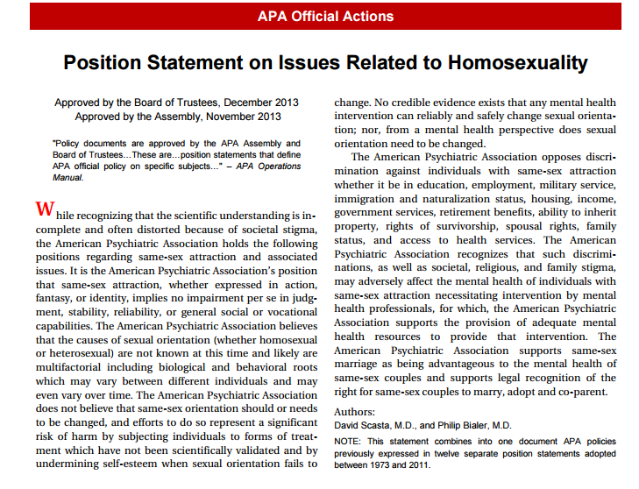
Notes:
Highlights:
APA does not believe that same-sex orientation should or needs to be changed…
… efforts to do so represent a significant risk of harm
No credible evidence exists that any mental health intervention can reliably or safely change sexual orientation
APA opposes discrimination against individuals with same sex attraction
APA supports same-sex marriage as being advantageous to the mental health of same-sex couples and supports legal recognition… to marry, adopt and co-parent

Slide 18
Evolution of the DSM – Gender Identity
Gender Identity Disorder, in previous editions, was changed to Gender Dysphoria in DSM-5
Shifted from focusing on one’s incongruence with identity to an individual’s distress about the incongruity
Less stigmatizing; better characterizes the experience of affected individuals
Can be diagnosed in children, adolescents and adults
Given it’s own chapter; no longer grouped with sexual dysfunction and paraphilic disorders
Notes:
For GID the focus was a person’s gender identity being at odds with the gender assigned at birth.
In the DSM 5, dropping the term “disorder” helps eliminate the notion that being transgender in and of itself is a mental disorder
Instead focus on distress that one may feel in relation to this in

Slide 19
DSM 5: Gender Dysphoria (Adults/Adolescents)
A marked incongruence between one’s experienced/expressed gender and assigned gender, of at least 6 months’ duration, as manifested by at least two of the following:
1) a marked incongruence between one’s experienced/expressed gender and primary and/or secondary sex characteristics
2) A strong desire to be rid of one’s primary and/or secondary sex characteristics because of a marked incongruence with one’s experienced/expressed gender.
3) A strong desire for the primary and/or secondary sex characteristics of the other gender
Notes:
The DSM criteria take into account a non-binary view of gender

Slide 20
DSM 5: Gender Dysphoria
4)A strong desire to be of the other gender (or some alternative gender different from one’s assigned gender).
5) A strong desire to be treated as the other gender (or some alternative gender different from one’s assigned gender)
6) A strong conviction that one has the typical feelings and reactions of the other gender (or some alternative gender different from one’s assigned gender)
associated with clinically significant distress or impairment in social, occupational or other important areas of functioning.
Notes:
Note: being post-transition is not one of the criteria for gender dysphoria; some patients choose not to undergo any transitional treatments/procedures
Can add specifiers:
With a disorder of sex development: i.e. congenital hyperplasia, androgen insensitivity syndrome
Post-transition: The individual has transitioned to full-time living in the desired gender (with or without legalization of gender change) and has undergone (or is preparing to have) at least 1 cross-sex medical procedure or treatment regimen – hormone treatment, gender reassignment surgery (vaginoplasty, penectomy, mastectomy, phalloplasty, etc.)

Slide 21
DSM 5: Differential Diagnosis
Nonconformity to Gender Roles – Gender dysphoria must be distinguished from non conformity to stereotypical gender role behavior. The diagnosis of GD is limited to those individuals who experience distress and impairment in relation to gender identity.
Transvestic Disorder – cross dressing behavior generates sexual excitement and causes distress and/or impairment without drawing primary gender into question.
Body Dysmorphic Disorder – individual focuses on alteration or removal of specific body part because it is perceived as abnormally formed, not because it represents the assigned gender which is incongruent to the expressed gender. Both diagnoses can be given if patient meets criteria for both.
Notes:
Important to out rule and clarify any additional diagnosis which may initially present with similar symptoms. Diagnosis may take time and may not be the initial presenting problem.

Slide 22

What are the implications of viewing gender dysphoria as a mental disorder?
Are there potential benefits? Downfalls?

Slide 23

What are the implications of viewing gender dysphoria as a mental disorder?
Potential benefits – Having a diagnosis may provide better access to treatment, i.e. insurance coverage for hormone therapy
Potential downfalls – stigma, discrimination from employers/military/custody issues if given a mental health diagnosis

Slide 24
Health Disparities
LBGT individuals more likely to experience difficulty accessing healthcare (let alone culturally competent health care)
Individuals in same-sex relationships less likely to have health insurance
Twice as likely to smoke tobacco
Higher rates of HIV among gay and bisexual men, as well as transgender women
Higher rates of disability & poorer general health per some studies

Slide 25
Mental Health Disparities
Limited research involving gay and lesbian individuals, even less pertaining to bisexual or transgender populations
Several studies indicate higher risk of poorer mental health, psychological distress, suicidal ideation and mental health disorders among gay, lesbian & bisexual (GLB) individuals
GLB more likely to see MH provider over past year
Higher rates of mood disorders and anxiety disorders in homosexual men
Notes:
Presenting to MH providers: 19% of gay/bisexual men vs. 8% of heterosexual men; 33% of lesbian/bisexual women vs. 11% of heterosexual women
Dutch study, rate of mood disorders in men: 17% vs 5% of heterosexual men;
rate of anxiety d/o in men: 20% vs 8%

Slide 26
Mental Health Disparities
Higher rates of major depression in gay and bisexual men
Several studies show higher risk of suicide among LGBT adults and adolescents
Level of family rejection correlates with increased risk in adolescents (8.4X more likely to report suicide attempt vs. individuals reporting low/no family rejection)
LGBT individuals at increased risk for violence, victimization, even being murdered, compared to general population
Notes:
US study of major depression 31% vs. 10 % of heterosexual men)
Research on this population and the prevalence of psychiatric conditions is in its early phases, and some studies have found similar rates of psychiatric hospitalizations, and even somewhat lower rates of psychotic disorders among LGBT people compared with the general population

Slide 27
Mental Health Disparities
LGBT students more likely to be injured in a fight, be threatened/harmed with a weapon while at school, experience dating violence, forced to have intercourse and avoid school because of safety concerns
Intimate partner violence – likely same occurrence between same-sex and opposite-sex couples, but often under-recognized/under-addressed in LGBT community
Notes:
The Stress Process Model (Pearlin, Lieberman, Menaghan, & Mullan, 1981) first addressed the influence of stressful life events
associated with structural inequalities on mental health. According to the model, disadvantaged status, traumatic early events, and unexpected life transitions in one’s social role, behaviors, and social relationships cause both long-term stressors and proliferated stressors, which, in turn, impact health and well-being.
Minority Stress Model (Meyer, 2003) postulates that sexual minorities experience increased mental health problems because of stress processes unique to their status, namely discrimination, expectations of rejection, concealment, and internalized homophobia. Hatzenbuehler (2009) expanded upon this
model with the Psychological Mediation Framework, which suggests that emotion dysregulation, interpersonal problems, and cognitive processes mediate the link between heightened stressors because of sexual minority status and psychopathology.

Slide 28
Injustice at Every Turn:
Largest survey to date of transgender and gender non conforming individuals
National Gay and Lesbian Task Force and National Center for Transgender Equality
70 question survey distributed online and by paper (to reach rural , homeless and low income populations).
6450 transgender and gender non conforming study participants from across the US.

Slide 29
Injustice at Every Turn:
Highlights from the Survey
Double the rate of unemployment as general population
90% reported harassment mistreatment at work
26% reported losing a job due to transgender identification
16% reported feeling compelled to work in underground economy (sex work)
20% reported homelessness due to identifying as transgender
29% reported police harassment or disrespect
Notes:
National Gay and Lesbian Task Force and National Center for Transgender Equality
Largest survey to date of transgender (or gender non conforming) individuals
70 question survey distributed online as well as by paper surveys (to reach rural , homeless and low income populations).
6450 transgender and gender non conforming study participants from across the United States.

Slide 30
Injustice at Every Turn: Suicide Attempts
41% of respondents reported attempting suicide at least once
Those who were bullied harassed, assaulted or expelled reported significantly higher levels of attempted suicide attempts (51% of respondents)
54% of respondents reported attempting suicide who make less than $10,000 a year.
61% who reported attempting suicide, were victims of violence.
64% of those who attempted suicide were victims of sexual assault

Slide 31
Injustice at Every Turn: Discrimination in Healthcare and Poor Health Outcomes
19% reported being refused medical care due to transgender or gender non conforming status
50% of sample reported having to teach medical providers about transgendered care
When sick or injured, 28% postponed medical care due to discrimination

Slide 32

Transgender Discrimination
https://www.youtube.com/watch?v=hmoAX9f6MOc
John Oliver, June 2015
Notes:
June 2015
16 min

Slide 33
The Importance of Offering Culturally Competent Treatment of Gender Dysphoria:
Several studies have demonstrated decrease in psychological distress with treatment of GD.
Significant reduction in anxiety, depression, somatization, interpersonal sensitivity.
Degree of symptom reduction differed with each step in gender reassignment therapy; largest decrease in symptoms was found to be after initiation of hormone therapy.
Screening for and responding to suicidal ideation; in one study 71.8% of patients with GD (without psychiatric comorbidity) disclosed SI
Notes:
One study out of Belgium in 2014 looked at the effect of different steps in gender reassignment therapy on psychological symptoms and distress. Found that the largest reduction in symptoms was after initiation of hormone therapy. I think that this is a study to share with patients as knowledge of the possibility of sig symptom decrease can be very encouraging.

Slide 34
Goals of Treatment in Gender Dysphoria:
Diverse population with diverse needs
Each patients gender narrative will be different (as will their goals)
As providers we need to be aware of treatment options as well as what our role in providing this treatment is.

Slide 35

How can we begin to address needs of our LGBT patients?
Discussion

Slide 36

How can we begin to address needs of our LGBT patients?
Take an open, non-judgmental approach to history taking
Don’t make assumptions
Ask open-ended questions
Inclusive language: ex. instead of asking “are you married?”, “do you have a boy/girl-friend?”, consider, “do you have a partner?”, “are you in a relationship?”, “what do you call your partner?”

Slide 37

How can we begin to address needs of our LGBT patients?
Ask patient what sex they were assigned at birth
Ask how they identify their gender now
Mirror terms/pronouns a patient uses to describe themselves
If you do make a mistake, apologize and move forward
Notes:
How to we do this.
Don’t assume anything, allow pt to discuss gender issues on their own terms. When appropriate during a discussion about gender make sure to ask patient what sex they were assigned at birth. Make sure to use preferred names and pronouns. Now this may sound intuitive but at times it can be challenging and mistakes are made. If you do make a mistake apologize and move forward.

Slide 38

How can we begin to address needs of our LGBT patients?
Create environment inclusive of LGBT patients
Use inclusive intake forms that reflect wider range of sexual orientations and gender identities
Develop and display non-discrimination policies
Train all staff to respectfully interact with LGBT patients, including using patient’s preferred names and pronouns
Have brochures, posters, literature related to LGBT health/social topics where patient ed materials are displayed
Research appropriate groups and web resources for patients and their families
Promote social inclusiveness and connectedness with family

Slide 39

How can we begin to address needs of our LGBT patients?
Promote health equity
Advocacy for policy change, equitable access to services
Educate ourselves about LGBT health topics (training in sparse in medical school about LGBT health)
Understand our own biases
Advocacy against any discrimination/ transphobia at a societal level

Slide 40
Inclusive intake forms
1. What is your current gender identity? (Check and/or circle ALL that apply)
☐ Male
☐ Female
☐ Transgender Male/Transman/FTM
☐ Transgender Female/Transwoman/MTF
☐ Genderqueer
☐ Additional category (please specify): ________________________________
☐ Decline to answer
2. What sex were you assigned at birth? (Check one)
☐ Male
☐ Female
☐ Decline to answer
3. What pronouns do you prefer?_______________________ [6]
Notes:
I’ve included a form that I came across from the center of excellence for transgender health. University of California San Francisco. What I like about this form is that it gives the patient total autonomy. Question 1 the last 2 answers additional category and decline to answer emphasis that the patient is in control of they identify and that they are not expected to fit into a box

Slide 41
Resources available in Buffalo:
The Center for Psychosexual Health Buffalo
Gender counselling is available for children, adolescents, adults and their families. Included as part of the center is a Gender Dysphoria Support Group
Pride Center of Western New York
Transgender Health Initiative at Pride Center of Western New York
Spectrum Transgender Group of Western New York
Evergreen Health Services
Downtown Clinic (ECMC)

Slide 42
General Resources
Center for Excellence for Transgender Health
San Francisco, CA www.transhealth.ucsf.edu
National Center for Transgender Equality www.transequality.org
World Professional Association for Transgender Health (WPATH) http://www.wpath.org

Slide 43
References:
American Psychiatric Association. Diagnostic and Statistical Manuel of Mental Disorders, Fifth Edition. Washington, DC; 2013.
National Center for Transgender Equality. Transgender Terminology Updated January 2014. Retrieved January 25 2016 from http://www.transequality.org/issues/resources/transgender-terminology.
GLAAD. Victims or Villains: Examining Ten Years of Transgender Images on Television.2015. Retrieved February 3 2016 from http://www.glaad.org/publications/victims-or-villains-examining-ten-years-transgender-images-television
Gates, G.J. How many People Are Lesbian, Gay, Bisexual and Transgender? The Williams Institiute. 2011. Retrieved January 10 2016 from http://williamsinstitute.law.ucla.edu/wp-content/uploads/Gates-How-Many-People-LGBT-Apr-2011.pdf
Grant JM, Mottet LA, Tanis J, Harrision J, Herman JL, Kiesling M: Injustice at Every Turn: A report of the National Transgender Discrimination Survey. 2011. Washington: National Center for Transgender Equality and National Gay and Lesbian Taskforce. Retrieved January 10 2016 from www.thetaskforce.org/downloads/reports/reports/ntds_full.pdf
Center for Excellence for Transgender Health. Patient Intake Primary Care Protocol. 2016. Retrieved Jan 10 2016 from http://transhealth.ucsf.edu/trans?page=protocol-intake
Byne W, Bradley S, Coleman E, Evan Eyler A, Green R, Mevielle Edgardo J, Meyer-Bahlburg H, Pleak R, Tompkins AD. Report of the APA Task Force on Treatment of Gender Identity Disorder. Am J Psychiatry 2012; 169:8 Suppl., 1-35
American Psychiatric Association: Position Statement on Access to Care for Transgender and Gender Variant Individuals. 2012. Retrieved January 10 2016 from http://www.psychiatry.org/home/policy-finder
American Psychiatric Association: Position Statement on Discrimination Against Transgender and Gender Variant Individuals. 2012. Retrieved January 10 20116 from http://www.psychiatry.org/home/policy-finder

Slide 44
References:
World Professional Association for Transgender Health (WPATH) Standards of Care. Retrieved February 3 2016 from http://www.wpath.org/uploaded_files/140/files/Standards%20of%20Care,%20V7%20Full%20Book.pdf
Heylens G, Verroken C, De Cock S, T’Sjoen, De Cuypere G. Effects of Different Steps in Gender Reassignment Therapy on Psychopathology: A Prospective Study of Persons with a Gender Identity Disorder. J Sex Med 2014; 11:119-126.
Colizzi M, Coasta R, Todarello. Transsexual patients’ psychiatric comorbidity and positive effect of cross-sex hormonal treatment on mental health: Results from a longitudinal study. Psychoneuroendocrinology 2014; 39:65-73.
Heylens G, Elaut E, Kreukels B, Paap M, Cerwenka S, Richter-Appelt H, Cohen-Kettenis P, Haraldsen I, Cuypere G. Psychiatric characteristics in transsexual individuals: multicenter study in four European countries. B Journal of Psychiatry 2014; 204:151-156.
Bradford J, Reisner S, Honnold J, Xavier J. Experiences of Transgender-Related Discrimination and Implications for Health: Results from the Virginia Transgener Health Initiative Study. American Journal of Public Health 2013; 103:10.
Nuttbrock L, Bockting W, Rosenblum A, Hwahng S, Mason M, Macri M, Becker J. Gender Abuse, Depressive Symptoms, and Substance Use Among Transgender Women: A 3-year Prospective Study. American Journal of Public Health 2014; 104:11.
Perez-Brumer A, Hatzenbuehler M, Oldenburg CE, Bockting W. Individual-Structural-Level Risk Factors for Suicide Attempts Among Transgender Adults. Behavioral Medicine 2015; 41:3.
Hoshiai M, Matsumoto Y, Sato T, Ohnishi M, Okabe N, Kishimoto Y, Terada S, Kuroda S. Psychiatric comorbidity among patients with gender Identity Disorder. Psychiatry and Clinical Neurosciences 2010; 64:514-519
Moody C, Grant Smith N. Suicide Protective Factors Among Trans Adults. Arch Sex Behav 2013; 42:739-752.
Bauer GR, Scheim A, Pyne J, Travers R, Hammond R. Intervenable factors associated with suicide risk in transgender persons: a respondent driven sampling study in Ontario, Canada. BMC Public Health 2015; 15:525.

Slide 45
References
Ard KL & Makadon HJ. Improving the health care of gay, lesbian, bisexual and transgender people: Understanding and eliminating health disparities. The Fenway Institute.
Fredrickson-Goldsen K, et al. The health equity promotion model: reconceptualization of LGBT health disparities. Amer J Orthopsych. 2014; 84(6)653-663.
Huygen C. Understanding the needs of lesbian, gay, bisexual, and transgender people living with mental illness. Medscape General Medicine. 2006; 8(2):29
Killerman S. http://itspronouncedmetrosexual.com/2015/03/the-genderbread-person-v3/
Levounis, Drescher & Barber. The LGBT Casebook. American Psychiatric Publishing 2012.
Perone, AK. The social construction of mental illness for lesbian, gay, bisexual and transgender persons in the United States. Qualitative Social Work. 2014; 13(6) 766-771.
Ruiz P & Primm A. Disparities in Psychiatric Care: Clinical and Cultural Perspectives. Lippincott 2010.

