Slide 1

Graduate Student Employees Union
(GSEU)
Professional Development Fund 2022 - 2023

Slide 2
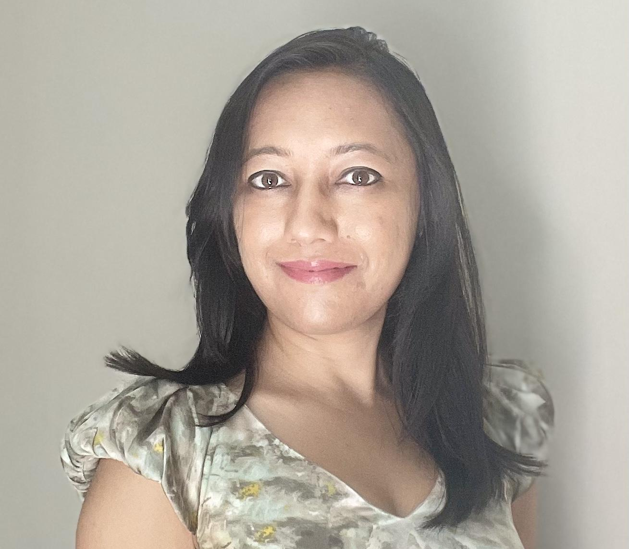
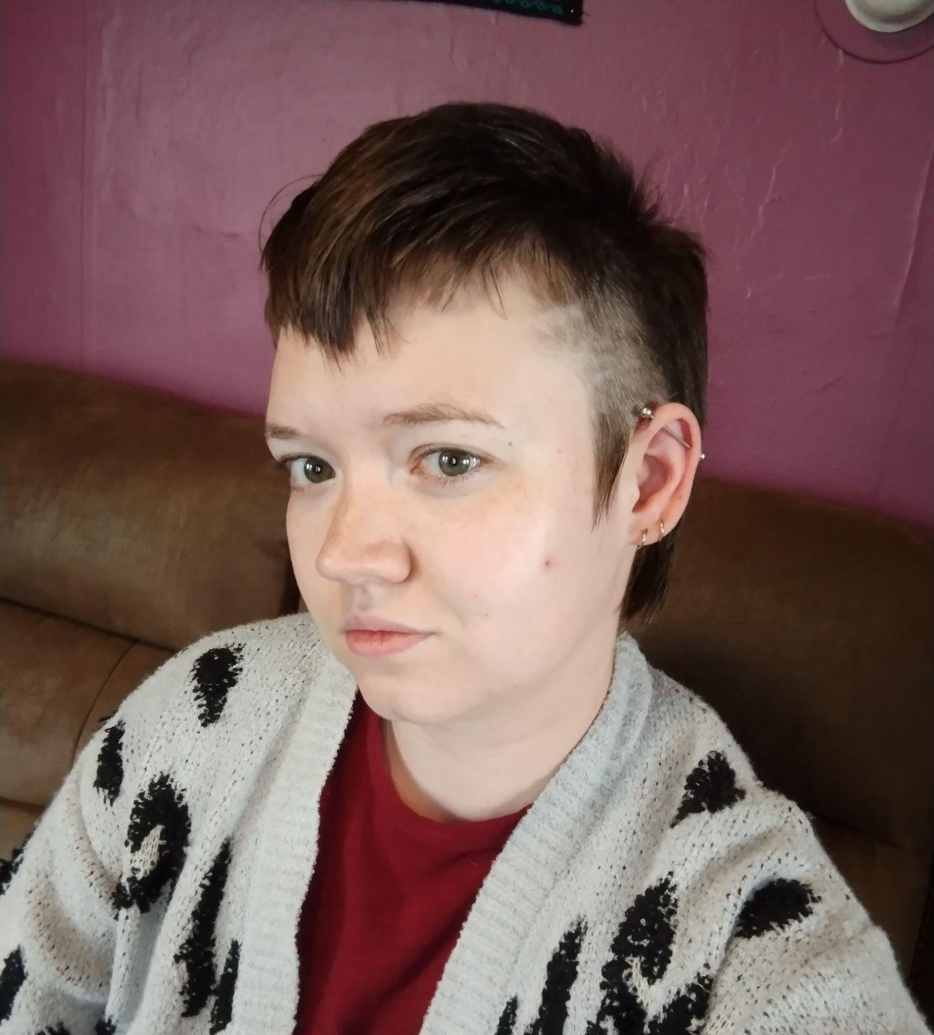
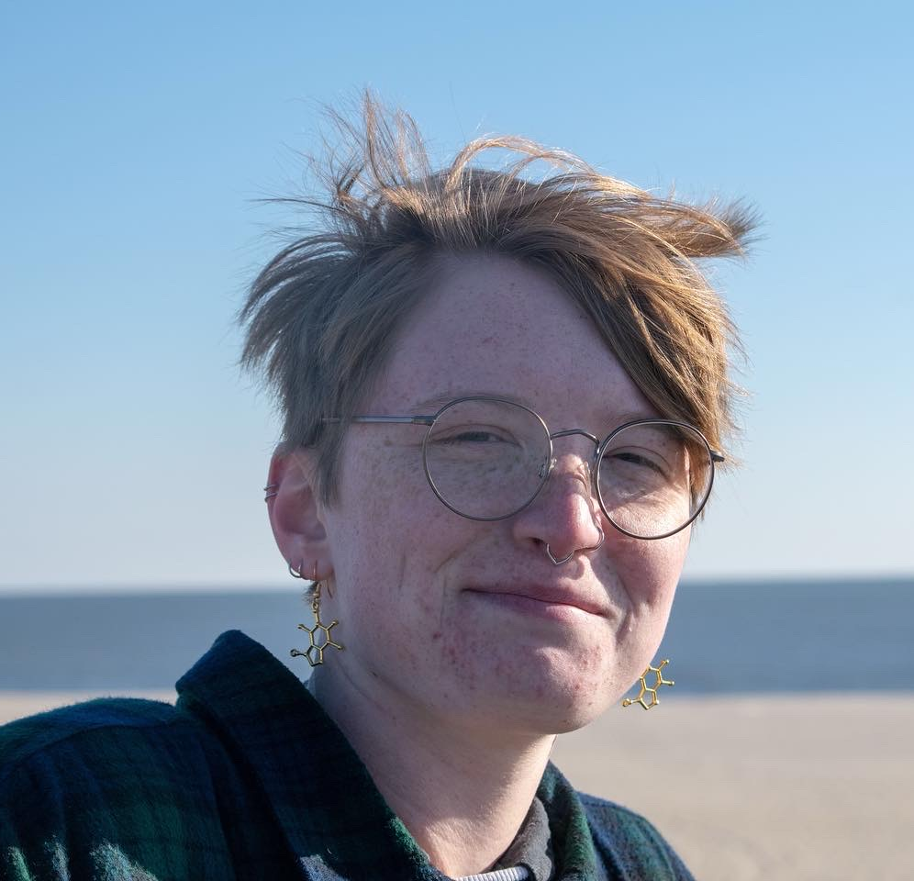
University at Buffalo Elected Union Leadership
Michelle Williams, Co-Vice President
Pronouns: they/them
Department: Sociology
Email: m98williams@gmail.com
Lawrence Mullen, President
Pronouns: they/them
Department: English
Email: lawrence.l.mullen@gmail.com
Prerna Shah, Co-Vice President
Pronouns: she/her
Department: Communication
Email: shahprerna121@gmail.com
Notes:
Remind we are NOT gsa
Email Lawrence with Qs

Slide 3
What is the Professional Development Fund & Who is Eligible?

Slide 4

PDF: The Basics
What is the Professional Development Fund (PDF)?
It is a yearly, renewable funding pool for full-time or part-time state-funded TAs and GAs to apply for up to $1,000 of reimbursement costs for one ‘professional development’ activity. This funding pool does not diminish over time, so that every year you are eligible to apply, you can ask for up to $1,000.
Activities for this round of PDF must have occurred (or will occur) between July 2, 2022 and July 1, 2023.
Notes:
Different from GSA conference money since our money is replenished every year and can be applied for every year
Our goal is to spend the money! So the govt knows its useful

Slide 5
PDF: The Basics
Who can apply?
Be employed a full-time or part-time state-funded TA or GA.
UBF and RF employees (RAs) are NOT eligible for this fund
Be employed for the duration of the project or activity.
Be employed or matriculated (with an open student account) at the time payment is made.
Notes:
No RAs :( no unfunded masters
Don’t have to be a member, do have to be in the unit
If you switch lines, activity has to be done while you’re a TA/GA
If you’re graduating this year, might be difficult since you can’t get money after you’ve graduated

Slide 6

What types of activities are covered by PDF?
Basic, applied or historical research (not related to dissertation).
Curricular or instructional material development.
Conference, workshop or seminar attendance.
Conference participation (e.g. presiding, presenting).
Course work or internship not part of earning a degree.
Preparation of material for publication.
Grant proposal development.
Artistic or creative endeavors.
Other work-related professional development projects or activities
Notes:
Don’t need to read all of these, but conferences, workshops, and coursework/certs are good
EG MBAs sometimes get project management certificates
Creative and artistic endeavors (loosely defined)
Just check what budget items can and can’t be funded (software, some supplies and stuff)

Slide 7
How can PDF be used?
Funding may be used for:
Tuition for course work at the SUNY rate for the course level, provided the course work is not part of the applicant’s degree program.
Registration fees for conference, workshop or seminar attendance.
Travel and related expenses.
Funds may not be used for:
Salaries, stipends or income to compensate the applicant or any other person.
Expenses related to a course, internship, project or activity that is part of an applicant’s degree program.
Purchasing equipment, software, consumable or non-consumable supplies.
Notes:
Can pay for any coursework but it CAN’T be for salary/stipend of someone else or payment for someone to be in a study (different from Mark Diamond)
CAN’T be for anything part of your degree (e.g. extra classes)
CAN’T be equipment, supplies, etc
Mileage, conferences, etc. are good
When writing application, applicant MUST tie the funding to GA/TA appointment and NOT the degree
Might feel like a reach and that’s fine (networking, practice public speaking)

Slide 8
Some Examples of Common PDF Applications

Slide 9
Student Example 1: Sun
Sun is a PhD student and state-funded GA in the Mechanical Engineering department. They attended a conference and presented a poster on their research in October 2022. They are asking for $750 of PDF to cover their: conference registration fee, AirBnB, and Amtrak.
Sounds good! Giving a conference presentation is entirely permissible under PDF guidelines, and conference registration fees, travel, and lodging are reimbursable expenses.

Slide 10
Student Example 2: Moon
Moon is an MFA student and state-funded GA in the Art department. They will be attending a workshop on avante-garde textiles in June 2023. They are asking for $1000 of PDF to cover their: workshop attendance cost, AirBnB, and Amtrak.
Sounds good! Attending a workshop as a creative endeavour is entirely permissible under PDF guidelines, and workshop registration fees, travel, and lodging are reimbursable expenses.

Slide 11
Student Example 3: Cloud
Cloud is an PhD student and state-funded TA in the English department. They are working on instructional material development and are seeking $250 to cover a yearly Adobe subscription that is necessary to create these new materials.
Unfortunately, this won’t work. While creating instructional materials is permissible under PDF guidelines, software costs are not.

Slide 12
Timeline for PDF Applications

Slide 13
When will I hear back about my PDF application?
May 5: Applications are due!
Before May 19: GSEU leadership will review all applications and submit funding recommendations to NY OER (Office of Employee Relations)
1st or 2nd Week of June: NY OER will meet with GSEU leadership to confirm which applications have been approved
3rd or 4th Week of June: GSEU leadership and UB HR will notify applicants
Notes:
IF someone is a dues-paying member we will review and give feedback to people (ONLY for members)
Email union inbox for this
Evaluations are not based on merit but completeness
Then we review applications, submit recommendations to state, state approves, sends back to us
We’ll let them know whether or not they get the reward and will give info on how to submit receipts in early july/august

Slide 14
Questions?

Slide 15
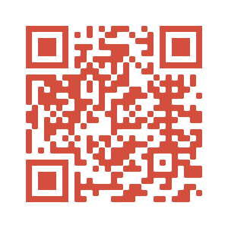



Reach out!
Elected Representatives:
Lawrence Mullen, President (lawrence.l.mullen@gmail.com)
Michelle Williams, Vice President (m98williams@gmail.com)
Prerna Shah, Vice President (shahprerna121@gmail.com)
email reps with any questions about benefits or protections!
Campus Organizers:
Gabby Pascuzzi, Joey Sechrist, & Hanyu Liao (ubgseu@gmail.com)
email organizers if you want to be more involved in union activities!
MORE INFO AT UBGSEU.COM
ubgseu.com
@GSEUatUB
@UBGSEU
Notes:
Remind to send to our general union inbox
Admin won’t send notifications that they’ve received people’s applications and we can’t see if :( so they need to email HR ub-hr@buffalo.edu instead
Can offer to do this presentation at departmental GSAs, if they want this, have them email general union inbox

