Slide 1




Travel for Purpose
Travel to South Africa
Explore Mzansi
(Proposed dates: 12.27.22 – 1.10.23)

Slide 2
Inkululeko (A Xhosa word meaning “freedom”)
We are a proudly South African non-profit organization that believes in the transformative power of education. We work with motivated young people from socioeconomically marginalized backgrounds in Makhanda, South Africa. We support students in finishing high school with the necessary skills to move on to university or to be gainfully employed upon graduation.
Kunye (A Xhosa word meaning “together”)
The concept of togetherness captures the spirit of the travel infinitive that hopes to bring people together through education.

Slide 3
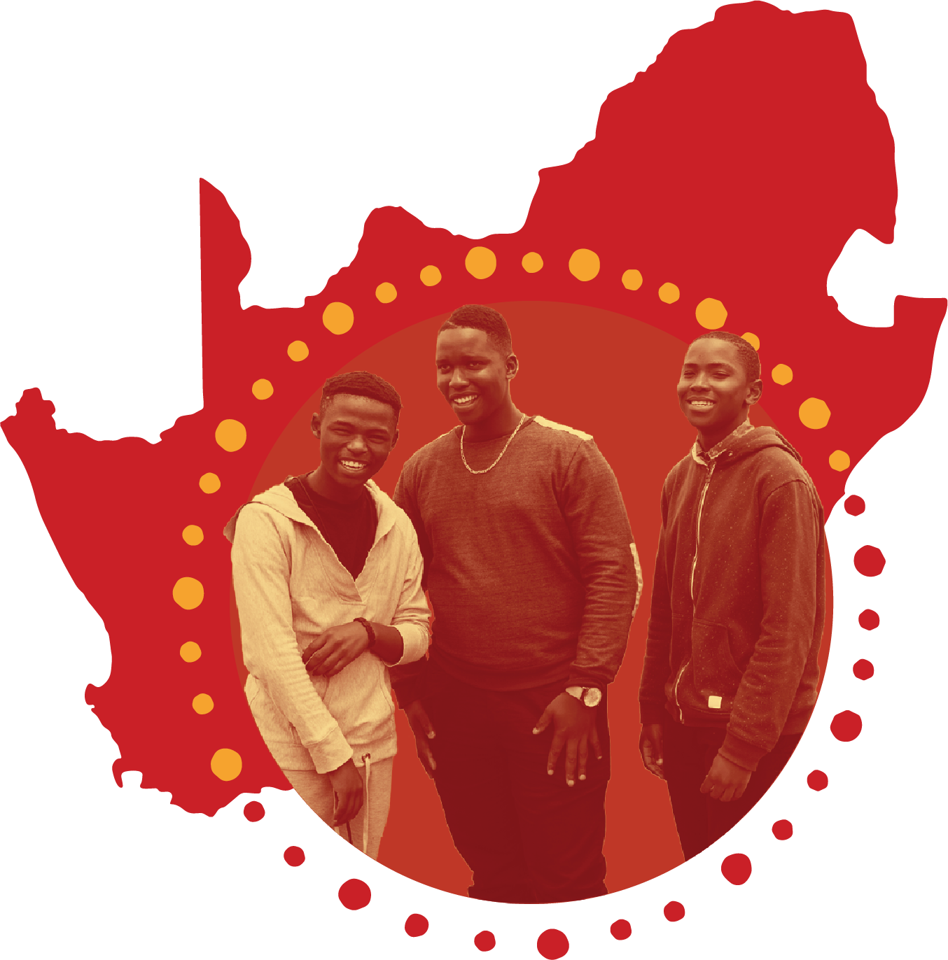
At Inkululeko, we believe learning, un-learning,
and re-learning is a life-long journey.
Escape for a transformative, exciting trip to the Rainbow Nation: South Africa, to learn, un-learn and re-learn
alongside high school students in Makhanda (formerly Grahamstown), situated in the heart of the Eastern Cape Province.

Slide 4


So, What Will I Do?
Support awesome students on their academic journeys (and learn about yourself, too!)
Work alongside local micro-entrepreneurs to build and enhance a social enterprise in a community brimming with entrepreneurial zeal and possibility.
Learn from human rights activists working tirelessly to build on the assets of the community.
Immerse yourself in rich, local culture that embodies the spirit of Ubuntu.
Co-create initiatives that can be carried forward long after you depart the Rainbow Nation for home.

Slide 5

CHANGE A LIFE: YOURS.
This is not a volunteer program: It’s a robust, socially responsible, overseas engagement initiative where both the local resident and the international visitor are seen as having value and something to contribute. It’s a unique opportunity to be a part of a truly transformative experience for yourself and for others.
People who join Inkululeko’s Kunye program will be immersed in local culture and have the opportunity to experience daily life in a small town. Participants will take isiXhosa language lessons, explore our local township, meet with local artists and learn about the work of Inkululeko while engaging in purposeful projects collaborating on academic and social enterprise endeavors.

Slide 6

Previous Projects Include:
Co-creating tools and systems to maintain sanitary conditions in both the social enterprise and academic space in a community where water is extremely scarce and service delivery is often lacking.
Using photovoice as a tool to explore the unique assets of a community and how learners can leverage those assets for their own personal/professional development.
Working collaboratively with local students on the development of study skills, conflict resolution, and creating and maintaining a positive academic atmosphere for all learners.
Don’t miss out on this unique opportunity to join a rich, collaborative, responsible overseas experience.

Slide 7

The Program Fee Includes:
Accommodation (same gender identifying individuals sharing one room), local guides, Xhosa lessons, all breakfasts and 3 dinners, a trip to a game reserve, pre-departure paperwork (for non-US passport holders, additional paperwork or a visa may be required), basic international medical insurance, in-country transport and airport transfers, and tips.
The airports are Johannesburg (JNB) and Port Elizabeth (PLZ)
with easy and inexpensive connections to all major cities
in South Africa.
It does not include international airfare.

