Slide 1
Yes Means Yes: A Collaborative Outreach Affirming Positive Relationships
Dawn E LaFrance, Psy.D.
Associate Director, Outreach Coordinator
Colgate University

Slide 2
Workshop Agenda
Yes Means Yes!
Rationale for Discussing
Logistical Setup
Content
The Press
Data Examining Effectiveness

Slide 3

Are you confused by the “hook up culture”? Do you ever wonder about how to ask for what you want in a relationship? Would you like to think about how to navigate your sexuality better? Could you learn how to better help others with these areas? If you answered yes to any of these questions, this series if for you!
The Yes Means Yes Series
Join other students, faculty, and staff as we explore healthy relationships through positive sexuality, assertive communication, and better understanding ourselves.

Slide 4
Why Share?
Mental Health Focus with Collaboration
Student’s Initiation
Committee Work
Notes:
We do meeting very well – lots of meetings, want to see programs coming out of them. Committee on campus – Keep It Sexy, Colgate. Committee focused on talking about the healthy aspects of relationships and promoting positive interactions and communication. Website, other programs across campus
Mental Health Focus – as we know many problems can arise out of difficulties in relationships, on the flip side, healthy relationships can serve as buffer in a difficult world and offer safety net and social support. College students are attempting to figure out who they are and what they want from others who they are close to and decide to trust. Therefore, this is mental health focus but at the same time, many other university administrators are interested in positive sexuality, better understanding the hook up culture, how the dating scene influences students’ adjustment and successes at college. This was the perfect opportunity to collaborate with others and examine positive relationships from a variety of perspectives
Student initiation – Jaclyn Berger wrote a draft of the YMY syllabus as her SOAN senior thesis. Gave it to me and said that she would love to see some form of it put into action. Took what she wrote and made it work. Whenever students give us their suggestions, we are more likely to be on target.

Slide 5
Mental Health Focus with Collaboration
Relationship Issues as Presenting Problem
Relationship Focus Developmentally Appropriate for Our Population
Other Mental Health Areas Affected: Self-Esteem, Anxiety, Depression...

Slide 6
Brown, Taylor, & DiTrapano, ACPA, 2010, Hooking Up: Students and the Search for Sex Positive Culture.
As higher education professionals, it is important to be able to understand and dissect the social world in which our students are operating, particularly to hone in on the deleterious aspects of this cultural shift, including alcohol abuse, violence, underperformance, and regret.
Sexuality is a highly-personal issue, but has ramifications for the campus community. A greater understanding of this phenomenon can help individuals and groups navigate this issue more effectively.

Slide 7
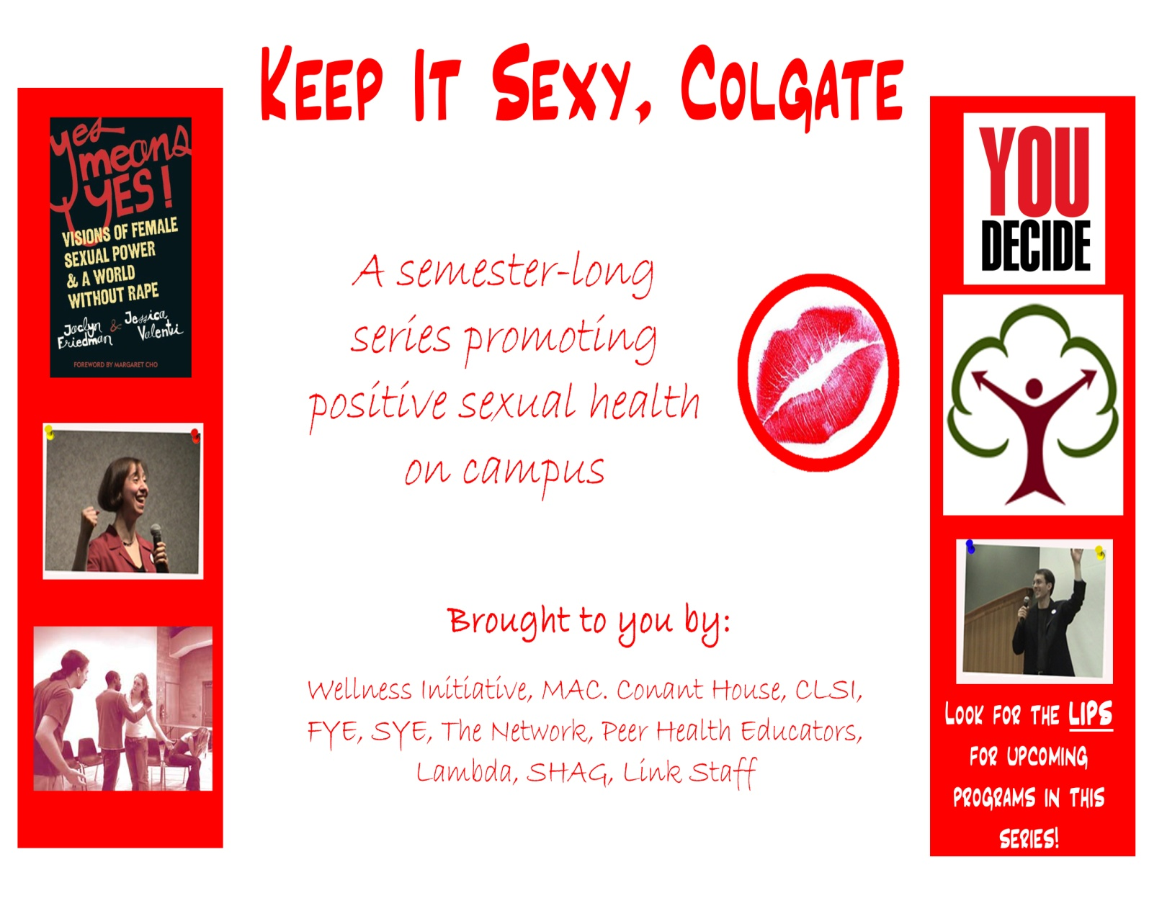
Cross-Departmental Committee Work

Slide 8
Positive Sexuality
“An understanding of sexuality as a natural and healthy aspect of human life;
Knowledge of human sexuality and reproductive rights with which to make responsible choices;
Respectful communication and exchange of personal thoughts and feelings between partners; and
Practice of safe and mutually consensual sexual activity.”
Resource Center for Adolescent Pregnancy Prevention, website

Slide 9
Lessons learned about sex positive programming
Community issue: involve all
Examine culture
Enthusiastic, constant consent
Start the conversation(s)
Provide permission to interact
Provide focus, language, structure, skills, practice
Create opportunities for sober, coed interactions
Utilize multi-modal, concrete strategies that reflect the culture

Slide 10
Student’s Initiation
Jaclyn Berger's (’09) Senior Thesis
Students' perceptions
Buy-In

Slide 11
Goals of Yes Means Yes
Engage in honest discussion about sexuality
Increase understanding about selves as sexual beings
Improve sexual self image and satisfaction
Discuss how consent can be given and how to gain appropriate consent in sexual relationships
Consider the ways that the current social scene could be improved (i.e., the “hook up culture”)

Slide 12
Timing and Recruitment
Campus climate survey data released
Sexual harassment policy revision
Speak-out following campus assault and judicial case

Slide 13
Funding/Logistics
Wellness Initiative
Dinners provided
Copies of “Yes Means Yes: Visions of Female Sexual Power and A World Without Rape” by Jaclyn Friedman & Jessica Valenti (2008)
7-8:30, 5 consecutive Wednesdays, necessary attendance
Comfortable location

Slide 14
Facilitation
Faculty/Staff/Students
Co-facilitation
Minimal work and time commitment
Very little preparation/coordination
Flexibility of style

Slide 15
Facilitation
Staff: Mark Thompson, Shelly Lear, Dawn LaFrance (Counseling Center)
Tennille Haynes (Center of Leadership & Student Involvement
Colleen Nassimus (Center of Volunteerism)
Heather Dockstader (Women’s Studies Center)
Scott Brown (Associate Vice President of the College)
Kim Taylor (Assistant Dean of the Sophomore Year Experience)
Tim Mansfield (Director of Alumni Affairs)
Faculty: Ken Valente (Departments of Mathematics, Queer Studies)
Meika Loe (Departments of Sociology & Anthropology, WMST)
Eliza Kent (Department of Religion)
Nisha Thapliyal (Department of Education)
Ulla Grapard (Departments of Economics, WMST)
Students: Eugene Riordan, Rachel Greenberg, Courtney Walsh

Slide 16
Recruitment
word of mouth
campus email distribution
faculty encouragement
peer encouragement
Brownbag advertising

Slide 17
Semester 1: 21 women, 4 men, demographic data not collected, racially diverse, many seniors
Semester 2: 17 women, 5 men, 14 White, 8 Students of Color, all class years represented
Who took the class?

Slide 18
Some Key Elements
Several discussion formats – large group, dyads and report back to larger group, writings
Self-disclosure – encourage honesty and open communication, consider ways to get introverts involved
Facilitators speak genuinely, participate, don't dominate
Apply readings to life at Colgate

Slide 19
Class 1: Kick Off & Defining “Hooking Up”
Overview
Ground rules
Thermometer Exercise
Define Hooking Up
Participant Expectations & Goal-Setting

Slide 20
Class 1: Ground Rules
Privacy Speak for Yourself
Challenge Yourself Notice Judgments
Take Care of Our Space Respect Each Other
Learn Names! Put Cell Phones Away
SAY WHAT’S ON YOUR MIND
“Ouch” Moments and Figure Out How to Move Through
Read the Chapters Assigned and Show Up
Use the Finger System for Taking Turns
Make an Inclusive Circle to Include Everybody

Slide 21
Class 1: Thermometer Exercise
Agree/Disagree/Unsure
IceBreaker – Progressively More Disclosure
Two intoxicated people can have consensual sex
Public displays of affection are okay
Pornography can be a healthy component of a positive sexual relationship
Drunk sex is better than sober sex

Slide 22
Class 1: What is “Hooking Up”?
The definitions of the practice differ depending on who one asks.
Vagueness is strategic.
Many of our students are dissatisfied with their social options and lack of authentic personal relationships.

Slide 23
Class 1: Defining “Hooking Up”
A casual, noncommittal sexual experience ranging from making out to sexual intercourse [with a potential lack of mutual commitment, affection, attachment, emotion, and there is not necessarily a balance of power].

Slide 24
Class 1: Defining “Hooking Up”
Pros
&
Cons
of “Hooking Up”

Slide 25
Class 2: “An Immodest Proposal” Ch. 15
Meaning of first time sexual encounters
Experiences of men and women
Goals of sex
Sexual agency and power

Slide 26
Class 3: “Gray Rape and Why it Matters” Ch. 13 & “Fantasy of Acceptable “Non-Consent” Ch. 9
What is rape?
Rape vs. gray rape
College life and acquaintance rape
Consent within unexplored relationships

Slide 27
Class 4: “Beyond Yes or NO: Consent as a Sexual Process” Ch. 3
Responsibilities in sexual relationships
Men and women in LGBTQ relationships
Using consent to achieve sexual goals

Slide 28
Class 5: “Offensive Feminism: The Conservative Gender Norms That Perpetuate Rape Culture” Ch. 1 & Action-Planning
What does rape mean on THIS campus?
Does college culture impact sexual relationships?
Hierarchies that perpetuate entitlement and power
Obstacles to healthy sexuality

Slide 29
Class 5: Action-Planning
 | This month | This semester
What I will do as a result of this class
What I will encourage my organization or group to do as a result of this class

Slide 30
Class 5: Action-Planning
 | This month
What I will do as a result of this class | Communicate my intentions & feelings Spread the knowledge I’ve learned Go on more dates Not glorify the hook up culture Lend my “Yes Means Yes” book to a friend! Have confidence to make my own sexual decisions Be genuine with my friends Be honest, don’t play games Don’t put myself in situations where negative activity could occur Assert myself when I’m at a party

Slide 31
Class 5: Action-Planning
 | This semester
What I will do as a result of this class | Keep in touch with Yes Means Yes buddies to keep the discussions going Encourage friends to be open about what they want sexually Engage in more activities like this, TALK Bring it up in class, participate in actions on a bigger scale Resist harmful places Have confidence to make my own sexual decisions Change speak-out to a Friday at midnight Get to know my partners/love interests better and listen to their needs as well as mine Participate in the Take Back the Night and try to get my friends to support it. Get involved in campus-wide awareness events with the Network

Slide 32
The Press!
KISC Creates Hook-Up Convos: "Yes Means Yes!" Series Introduced at 'Gate (Maroon News article)
Feministing.com Blog
The Colgate Scene (Alumni Magazine)
Colgate Homepage
Facebook Group

Slide 33
Did It Work????

Slide 34
Experimental Design
2X2 Design
Pretest/Posttest
Experimental/Control
Measures
Yes Means Yes Objectives Instrument
Rape Supportive Attitude Scale (Lottes, 1998)
The Multidimensional Sexual Self-Concept Questionnaire (MSSCQ; Snell, 1998)

Slide 35
The Multidimensional Sexual Self-Concept Questionnaire
20 subscales – 5 questions each, scored in different directions
Sexual Self-Efficacy Sexual Optimism
Sexual Consciousness Power-Other Sexual Control
Sexual Satisfaction Chance/Luck Sexual Control
Sexual Self-Schemata Sexual Anxiety
Sexual Esteem Fear of Sex
Sexual Self- Monitoring Sexual Assertiveness
Sexual Problem Self-Blame Sexual Depression
Internal Sexual Control
Preoccupation with Sex Sexual Motivation
Motivation to Avoid Risk Sexual Problem-Management
Sexual Problem Prevention
*
*
*
*
*
*
*
*
*
*
*
*
*
*
*Scales trending in appropriate direction
? ?
No Findings:
Notes:
Sexual motivation increased for the exp. Group more than control – but it is a judgment if that is a good thing, preoccupation increased for both groups (again a judgment)

Slide 36
MSSCQ 6 Subscales Total Score
F (1, 36) = 4.49, p = .04
Notes:
The interaction is significant.

Slide 37
Yes Means Yes Objectives Instrument
I feel comfortable talking in a group about sexual topics.
I feel equipped with enough knowledge to engage in intellectual discourse about intimate relationships.
I understand the “hook up culture” and can articulate my opinions about it.
I understand what consent means and I am able to provide examples of verbal and non-verbal means of giving consent.
I behave in ways that are consistent with my values regarding relationships.
I believe that positive, healthy relationships come in many forms and I can give examples of these.
I can define rape and sexual assault.

Slide 38
Yes Means Yes Objectives Instrument
I know who is available at Colgate to support me if I am sexually assaulted, or I can refer a friend to a support person on campus if s/he is sexually assaulted.
I have considered how sexual assault affects the LGBTQ community on campus.
I know how to talk with my friends about sexual climate, rape, and sexual identity.
I can name three obstacles that stand in the way of a healthy sexual climate at Colgate.
I have considered realistic ways of transforming the culture towards a more positive sexual climate.
I feel supported in making changes that would be positive for the sexual climate at Colgate.

Slide 39
Yes Means Yes Objectives Instrument
Good Internal Consistency, Cronbach’s Alpha = .78
F (1, 36) = 4.76, p = .036
F (1, 36) = 4.76, p = .036
Good Internal Consistency, Cronbach’s Alpha = .78
Notes:
Alpha high enough to suggest that the 13 items hang together nicely

Slide 40
Yes Means Yes Objectives Instrument
Qualitative:
What I liked most about this class:
What I learned about myself during this series:
Ways to improve this series:
I think that this series should be offered again: Yes or No
Demographic Information:
Gender (please circle one) Female Male Transgender
Race / Ethnicity (please circle one) African-American / Black American Indian or Alaskan Native
Arab American Asian American / Asian
East Indian European American / White / Caucasian
Hispanic / Latino/a Native Hawaiian or Pacific Islander
Multi-racial Prefer not to answer
Other (please specify)
Age
Class Year

Slide 41
What I liked most
“So open! And such good ideas that I can start applying in my life. Also, I feel so much more empowered knowing that others feel the same way I do. ”

Slide 42
What I liked most
“The ideas and people gave more insight into sexual health”
“Being able to discuss in a mixed group, so many of the things I have been thinking about the past 4 years.”

Slide 43
What I learned about myself during this series:
“My own weaknesses in addressing consent and non-verbal cues I give. I also learned to be more comfortable with myself.”
“How much I didn't know myself about what is consent, and sexual assault, and sexuality.”

Slide 44
What I learned about myself during this series:
“I need to start being more confident with what I want - healthy relationships”
“I can use my ideas/experiences/position to help and influence the culture”
“To stand up and speak out on what is and is not okay”

Slide 45
What I learned about myself during this series:
“There are other people who dislike the way things are as much as I do.”
“That I can express my desires and that I should. I can say no and I can give enthusiastic consent.”
“I am a very strong woman and I can make a difference on this campus and in people’s lives!”

Slide 46
Ways to improve this series:
“I would have liked to learn more about LGBTQ issues on our campus. Also, it would have been cool if we had set up a committee to make sure we keep up with all the ideas we came up with! I want to make sure we act on this and keep the momentum going! AND don’t get apathetic!”
“I wish there were more heterosexual men in the class”

Slide 47
Ways to improve this series:
“More time talking about Change. Realistic ways to do this.”
“Make it 2 hours long. We never have enough time to discuss.”
“Mandatory! Longer!”

Slide 48
I will say Yes... when I mean Yes

Slide 49
References
Brown, S., Taylor, K., DiTrapano, J. (2010). Hooking Up: Students and the Search for Sex Positive Culture. Presentation at American College Personnel Association, 2010.
Friedman, J. and Valenti, J. (2008). Yes Means Yes! Visions of Female Sexual Power and a World Without Rape. Seal Press: Berkeley, CA.
Feministing.com
Lottes, I. (1998). Rape Supportive Attitude Scale. In C.D. Davis, W.L. Yarber, R. Bauserman, G. Schreer, & S.L. Davis (Eds.), Handbook of sexuality-related measures (pp. 504-505). Thousand Oaks, CA: Sage.
Resource center for adolecent pregancy prevention: http://www.etr.org/recapp/index.cfm?fuseaction=pages.TopicsInBriefDetail&PageID=61#Definitions
Snell, W.E. (1998). The Multidimensional Sexual Self-Concept Questionnaires. In C.D. Davis, W.L. Yarber, R. Bauserman, G. Schreer, & S.L. Davis (Eds.), Handbook of sexuality- related measures (pp. 504-505). Thousand Oaks, CA: Sage.
Thanks to Jaclyn Berger, Kevin Carlsmith, the Wellness Initiative, and all the co-facilitators!

