Slide 1


An Innovative Outreach Program at Cornell University
Carrie Cragun, Susan Han & Matt Boone
Cornell University

Slide 2

Outline
Description of Let’s Talk
Why it is needed
How it works and runs
Utilization details
Case examples
Questions & Discussion

Slide 3
What is Let’s Talk?

Slide 4
Let’s Talk
Daily walk-in availability
Free
9 sites
9 different counselors
“informal consultation” not “counseling”
Notes:
Historical context?

Slide 5
Let’s Talk vs. CAPS
No appointments
No telephone triage
Outside of medical setting
In students’ communities
No paperwork
No formal intake
Flexible visit length
Anonymous visits if requested

Slide 6
Let’s Talk
Anonymity & Confidentiality
“LET'S TALK VISIT NOTE This is a record of an informal consultation. It is not a record of treatment. Let's Talk is a pre-counseling service and notes from Let's Talk conversations are not part of the releaseable record and should not be discussed with students.“

Slide 7
Why is Let’s Talk needed?

Slide 8
Hard-to-reach students
Some students will not access counseling services despite obvious need and many referrals

Slide 9
Why?
Stigma associated with seeking psychological help
Cultural barriers
Institutional barriers

Slide 10
Goals
Demystify counselors and counseling process
Early intervention
Some students only access counseling at the point of crisis. Students may access Let’s Talk sooner.
Engage students prior to counseling process
May be more likely to come back in the future
May be more likely to access counseling services

Slide 11
Site Placement
Two goals:
(1) Reach and support a specific community
(2) Easy access for entire Cornell community

Slide 12
Sites
International students office
Learning Strategies Center
College of Engineering
College of Arts and Sciences
Latino Studies Program
Asian-American Studies Program
African-American program house
Freshman community center
Graduate school
Law school
Business school
Veterinary school
Graduate housing
Notes:
Talk a little about our sites

Slide 13
Accessing Let’s Talk

Slide 14


Slide 15


Slide 16
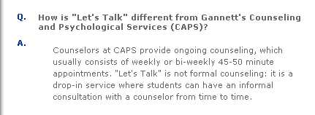

Slide 17
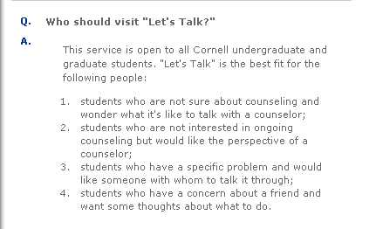

Slide 18
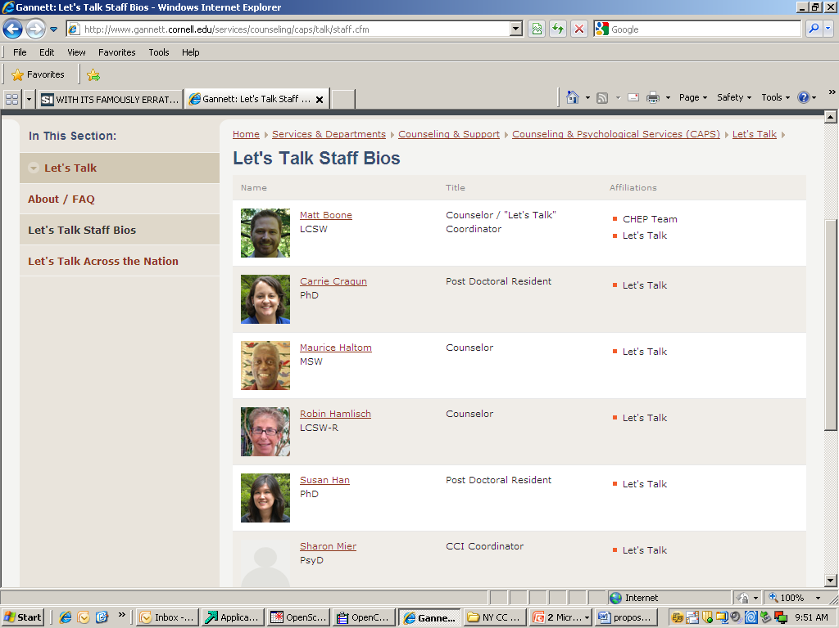

Slide 19
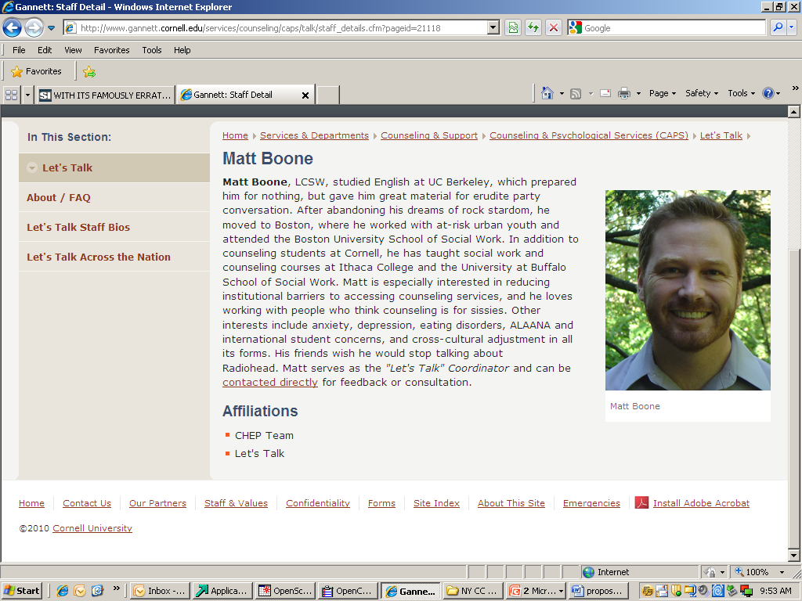

Slide 20
Counselor Profiles
Gives students agency to choose
Doesn't make assumptions about best "match"

Slide 21
Utilization of Let’s Talk

Slide 22
Let’s Talk Utilization
2006-2007
Students seen: 233
Total visits: 397
Average visits per student: 1.4
2007-2008
Students seen: 263
Total visits: 458
Average visits per student: 1.7
(2008-2009 data currently being analyzed)

Slide 23
Let’s Talk Utilization
Let’s Talk
25% utilized used CAPS and Let’s Talk services
25% were referred to CAPS
½ never came through counseling center door
Notes:
About 25% of students seen at Let’s Talk are referred directly to CAPS
Another ~25% are served at CAPS at some other time

Slide 24
Let’s Talk Utilization
CAPS
Served 34% of students of minority/color/international
Let’s Talk
Served 52% of students of minority/color/international

Slide 25
Utilization
Anonymity
2007-2008
5% of visits
2008-2009
2% of visits

Slide 26
Let’s Talk at Other Schools
6 have started programs
University of Chicago
Notre Dame
UC Berkeley
Montclair State University
Williams College
Portland State University
3 are in the process
List serve

Slide 27
Let’s Talk at Other Schools
For questions
Contact: Matt Boone, Let’s Talk Coordinator
607-255-5208
mb352@cornell.edu
Website:
http://www.gannett.cornell.edu/services/counseling/caps/talk/index.cfm

Slide 28
Clinical Case Examples
Notes:
One time student from Chile after earthquake Carrie
2 times masturbation student

Slide 29
Case Examples
Seen once
Seen twice
Referrals
Gradual engagement
Notes:
Seen Once
Carrie – concerned friend
-Chile
Seen Twice
Susan – Oct/May
Carrie – masturbation international student
Referrals
Carrie - ADHD
Susan – refer to CCI
Gradual Engagement
Susan – (Matts’ client)

Slide 30
Discussion / Q&A

Slide 31
Thank you

