Slide 1
Cultivating Gratitude: Evidence-Based Practices
Robert A. Emmons
NY Counseling Workshop
June 9th, 2010
Contact: raemmons@ucdavis.edu

Slide 2
Enhancing feeling and being…
How can I go beyond just feeling more grateful to actually BEING a more grateful person?”

Slide 3
Gratitude | Non-Gratitude | Ingratitude
Recognize benefit | Fail to recognize benefit | Find fault with the benefit
Acknowledge receiving it | Fail to acknowledge receiving it | Impugn motive of benefactor
Return the favor | Fail to return the favor | Return harm for good

Slide 4
The failure to express gratitude: exploring why
Those who have supported and sustained us deserve our thanks. It would not be an exaggeration to say that we have a moral obligation to be grateful. Yet there are many times in our lives where we have failed to tell someone how grateful we are. Similarly, at other times people have failed to show us gratitude. What are some reasons you can think of for failing to express gratitude?

Slide 5
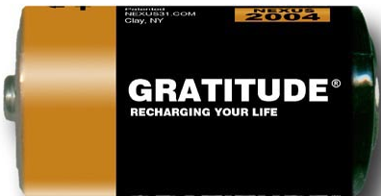
Taking AIM on gratitude…
Attention
Interpretation
Memory

Slide 6
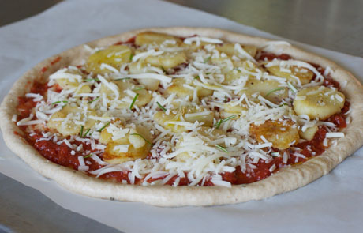
Gratitude Exercises I:
The “Mystic” Pizza Exercise

Slide 7
The Positive Psychology Movement
Attempts to correct the overemphasis on weakness and pathology that has dominated psychology for past ½ century (the disease model)
Purpose: To define, understand scientifically and help build fulfilling lives

Slide 8
Fix What’s Wrong vs. Build What’s Strong
Negative Psychology
The alleviation of:
Debilitating symptoms
Negative emotions (F.A.D.)
Maladaptive character traits
Positive Psychology
Fostering:
Positive emotions
Strengths/virtues
Optimal functioning and well-being

Slide 9
Positive Psychology: Assumptions
Positive is not just the absence of the negative
Positive emotions and traits are essential in preventing problems, coping with problems, and recovery from problems
An emphasis on strengths and potentials might prove more effective than the “fixing what is wrong” approach

Slide 10
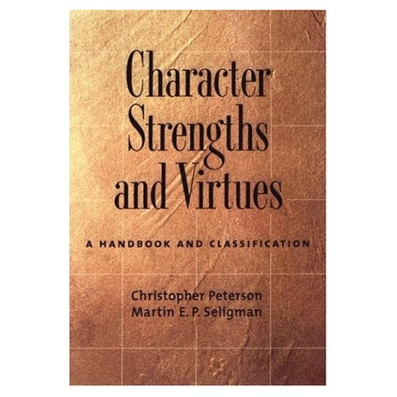
Manual of the Sanities: The VIA

Slide 11
The 24 Character Strengths *
(Shown by 6 Virtues)
Wisdom and Knowledge
  Curiosity/interest
  Love of learning
  Judgment
  Creativity
  Perspective
Courage
  Valor
  Persistence
  Integrity
  Zest/enthusiasm
Temperance
  Forgiveness/mercy
  Modesty/humility
  Prudence/caution
  Self-regulation
Justice
  Citizenship
  Fairness/equity
  Leadership
Love
  Love/intimacy
  Kindness
  Social/Emotional Intelligence
Transcendence
  Appreciation of beauty
  Gratitude
  Hope/optimism
  Playfulness/humor
  Spirituality
* Peterson & Seligman, 2004
Notes:
11

Slide 12
Why Focus on Character Strengths?
Strengths-based Approach
What’s best
Positive Outcomes
  Reduced anxiety and depression
  Well-being and happiness
  Mental and physical health
Notes:
12

Slide 13
Group PPT – Pilot Study
Six exercises presented over the course of six 1.5-hour sessions
  Practice the assigned exercise over the course of a week
  Complete written assignment
Manualized, led by a graduate student or postdoctoral fellow
Each session equally divided between discussing the previous week’s homework, and explaining the upcoming assignment
Notes:
13

Slide 14
Group PPT – Pilot Study
Targeted mild-moderately depressed College freshmen
Randomly assigned to group PPT (N=16) vs. no-intervention control (N=21)
Outcome measures: Beck Depression Inventory (BDI), Satisfaction With Life Scale (SWLS)
Web-based assessments at pre, post, 3-month, 6-month, and 1-year
Notes:
14

Slide 15
Group PPT exercise descriptions:
Using Your Strengths: Complete the VIA-IS strengths assessment, then every day use one of your strengths in a new way
Three Good Things: Each evening, write down three good things that happened and why you think they happened.
Life Summary: Write a 1-page summary of your life as you would like it to be remembered.
Gratitude Visit: Write a letter to someone expressing your gratitude and deliver it in person.
Active-Constructive Responding: Listen carefully to when people you care about report good events to you, and go out of your way to respond actively and constructively.
Savoring: Every day, savor at least two experiences.
Notes:
15

Slide 16
Group PPT – Pilot Study
d = .48
d = .67
d = .77
d = .59
Notes:
16

Slide 17
Next step: When to use PPT?
Stand-alone treatment
  May not be appropriate for more severe depression
Adjunct to existing treatments
  For people who have successfully completed CBT
  For CBT non-responders/non-compliers
Other disorders?

Slide 18
Are PP Interventions Effective?
Meta-analysis of 51 interventions with 4,266 persons found they enhance WB (mean r = .29) and decrease depressive symptoms (mean r = .31)
Depression status, age, self-selection, format and duration of interventions impact the effectiveness
Source: Journal of Clinical Psychology, 2009

Slide 19
Recommendations:
Turn short-term strategies into long-term habits
“Shotgun” approach is more effective than is a single PP intervention
People in individualistic cultures benefit more from PPI’s than those in collectivistic cultures

Slide 20
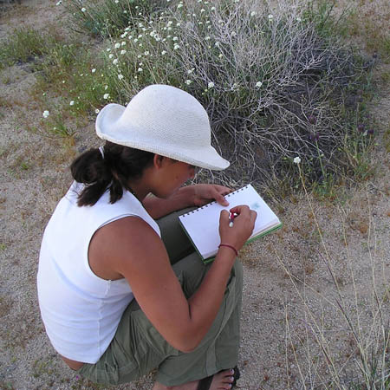
Evidence-Based Prescriptions for Building Gratitude: The Top 10
Keep a gratitude journal
Remember the bad
Ask yourself 3 questions
Gratitude prayers/meditations
Come to your senses

Slide 21
The Benefits of Gratitude Interventions
Psychological (Positive affect: alert, energetic, enthused, attentive)
Physical (exercise, better sleep, fewer symptoms)
Interpersonal (more helpful and connected, less lonely and isolated)
Source: R.A. Emmons & M.E. McCullough, Journal of Personality and Social Psychology, 2003, 84, 377-389.

Slide 22
Are there limits to the benefits?
The gratitude intervention appears to increase pleasant emotions more than it decreases unpleasant emotions
The gratitude intervention was not able to reduce physical pain in patients with neuromuscular disease
The effects may be short-term
The effects may be gender-specific

Slide 23
Why is journaling beneficial?
As an aid to memory
Helps us go from the global to the specific
Stimulates surprise
Is inspirational

Slide 24
An Integrated Mind-Body Gratitude Training

Slide 25
Gratitude Exercise II:
The Daily Gratitude Inventory
Recall your day
a. everyday pleasures
b. important people
c. my life
Associate each item with the word gift. Take time to relish and savor this gift.
In what ways might I “give back" to others as an appropriate response for the gratitude I feel?

Slide 26
What is the optimal gratitude intervention?
Emmons & McCullough, Study 1: Once a week for 10 weeks
Emmons & McCullough, Study 2: Every day for 3 weeks
Lyubomirsky (2005) compared a once a week with a 3x a week intervention

Slide 27
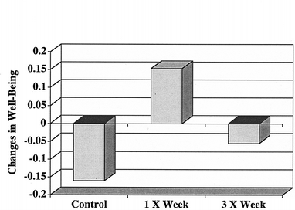
Changes in well-being as a function of counting blessings
Source: Review of General Psychology, 2005

Slide 28
It’s not how often, it’s how…
“when we reflect upon a benefit that God (or by extension, another person) has done for us, we should break it into its multiple components, meditating on each element. This will engender a greater appreciation of the effort that was expended by the benefactor and of the multiplicity of the benefits that inhere in the ‘global’ one, that a more hurried and superficial acknowledgment of gratitude might overlook (Schimmel, 2004, p. 40)

Slide 29
How to develop a practice of “counting your blessings”
Develop a practice that’s best for you
First, think about 3 good things--3 things that went well recently
Then write abut how you are grateful for these things
Begin by counting your blessings every day for a week, then follow this week up with regular “booster” sessions
Be creative, not repetitive
Notes:
29
1--the best way to do this will vary considerably for each person, and you have to thoughtfully consider the best way to engage in this practice for yourself. Different people will find that different times of the day, different frequencies, whether you want to journal your thoughts…or just think about them. Different people will find different practices more or less effective.
2--It won’t just happen…I find that I really have to carve out a time in the day for this practice…
3--I find this works best in the evening, but again you may need to find the time in the day that works best for you. Might be for today, or the last 48 hours, but for this specific practice of gratitude I recommend something fairly recent.
4--Why are you thankful for this? (Think about the 4 recognitions of gratitude here.) Why do these things make you feel grateful. How can you feel grateful for these things?
5--I believe that just one week will help you develop a “mind set” of gratitude, so that you will more naturally notice the good things in life, and will process them in a mindful manner. Basically, this practice is encouraging you to develop a way of seeing the world--viewing the world through your “gratitude glasses”…if you will.
6--There is some evidence that mindless repetitive listing of benefits is not of much value…

Slide 30
Gratitude Exercise III:
Group 1: Think about how a positive event for which you are grateful happened easily or was not surprising (presence)
Group 2: Think about how a positive event might never have happened or might never have been part of your life (absence)

Slide 31
It’s a Wonderful Life:
The George Bailey effect
Thinking about the absence of a positive event from one’s life improves happiness more than thinking about the presence of an event
The way in which people think about positive life events is critical
Therefore, gratitude journaling should include writing about how one’s life would be like without that event/person/gift in the list

Slide 32
Naikan: “Looking inside”
Japanese self-reflective psychotherapy
The Three Questions:
What have I received from________?
What have I given to_____________?
What troubles and difficulty have I caused________________________?

Slide 33
Two principal themes:
The rediscovery of authentic guilt for having been unappreciative and neglectful toward people in the past
The (re)discovery of positive gratitude toward those persons who have given to the person in the past

Slide 34
Naikan has reported to be effective in the following domains:
Eating disorders
Delinquency
Existential concerns
Narcissism and related pathologies of the self
Substance abuse
Mild to moderate depression
Marital and relationship problems

Slide 35
Myths About Gratitude
Gratitude just another form of positive thinking.
Gratitude strips people of initiative and leads to complacency or even passive resignation.
Most expressions of gratitude are insincere.
There is an optimal level of gratitude beyond which any more is maladaptive.
Gratitude is fine in a religious context, but it has little relevance in secular society.
It is impossible to be grateful in the midst of suffering.

Slide 36
Gratitude:
“An attitude toward the giver, and an attitude toward the gift, a determination to use it well, to employ it imaginatively and inventively in accordance with the giver’s intention”
(Harned, 1997)
Notes:
Gratia, gratis meaning grace—free gift, unmerited favor
Any 1 of a dozen ways to define gratitude. The ones that I like emphasize “undeserved merit”

Slide 37
“the willingness to recognize the unearned increments of value in one’s experience, whether the emotional response of gratitude is present or not, by thought and action suitable to the value received” (Bertocci and Millard, 1963)

Slide 38
Two components of gratitude:
Positive feelings
Feelings of indebtedness

Slide 39
Can people be too grateful?
Is there an optimal level of gratitude?
“Excess on any one character strength does not diminish life satisfaction” (Park, Peterson, & Seligman, 2004)

Slide 40
Gratitude in the VIA: Some data from Peterson and colleagues
Gratitude scores increased 1 and 2-mos. post 9/11
Gratitude is one of 5 strengths that is robustly related to life satisfaction
Across 54 nations, gratitude is the 4th most common strength
Gratitude is correlated with work satisfaction across various occupations

Slide 41
Can people be too happy?
Highest levels of happiness are associated with success in close relationships, but
The highest level of income, education, and political participation are reported by moderately happy and satisfied persons, not the most happy
Source: Psychological Science, 2007

Slide 42
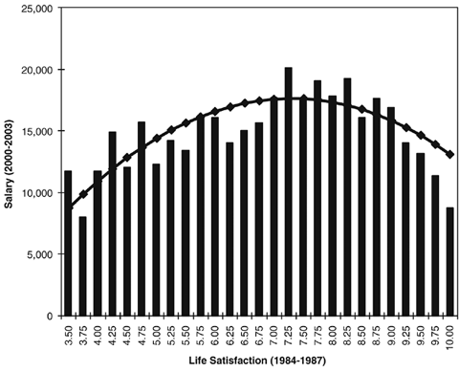
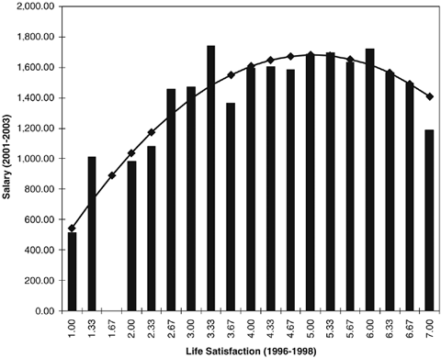

Slide 43
Why?
Complete satisfaction with current conditions might prevent individuals from energetically pursuing change in achievement domains such as education and income, but
the optimal mindset for an intimate relationship might be to see mostly the positive aspects of the partner and relationship, whereas the optimal mindset for income, education, and political participation might be to simultaneously consider the empty part of the glass as well as the fullness of it.

Slide 44
Myths About Gratitude
Gratitude just another form of positive thinking.
Gratitude strips people of initiative and leads to complacency or even passive resignation.
Most expressions of gratitude are insincere.
There is an optimal level of gratitude beyond which any more is maladaptive.
Gratitude is fine in a religious context, but it has little relevance in secular society.
It is impossible to be grateful in the midst of suffering.

Slide 45
Does gratitude encourage passivity?
Gratitude facilitates goal attainment
Participants identified 6 personal goals they intended to pursue in the next 2 months
Academic/vocational, relational, health
Participants in the gratitude condition made 20% more progress, yet were no more satisfied with the progress they had made compared to those in other conditions

Slide 46
Myth: Gratitude just another form of positive thinking, akin to denial (unrealistic)
The definition of gratitude (examples)
Requires a more elaborate set of cognitive processes (recognition, thinking and thanking)
Gratitude amplifies positive emotions and states more so than diminishing negative emotions and states (both from IV’s and trait correlates)
Gratitude often co-occurs with mild levels of anxiety, as well as feelings of responsibility, obligation, and even indebtedness.

Slide 47
Does gratitude motivate moral action?
Receiving gifts leads to helping behavior
Correlates of the grateful disposition
Gratitude and service: volunteerism and altruism
Gratitude and organ donation
Distinguishing gratitude from reciprocity and indebtedness

Slide 48
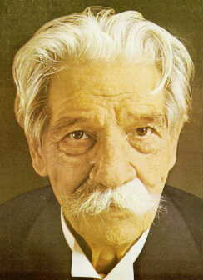
Albert Schweitzer on gratitude
“The gratitude that we encounter helps us believe in the goodness of the world, and strengthens us thereby to do what is good”

Slide 49
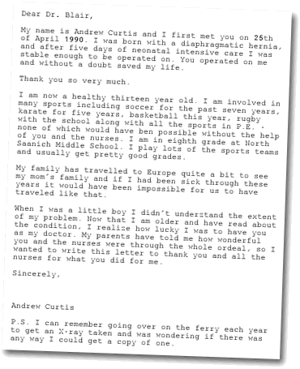
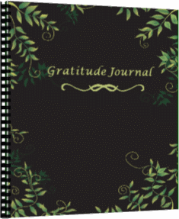
What’s Beyond the
Letter and the Journal?

Slide 50
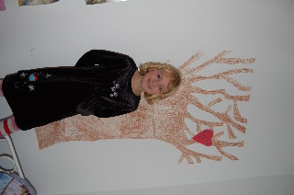
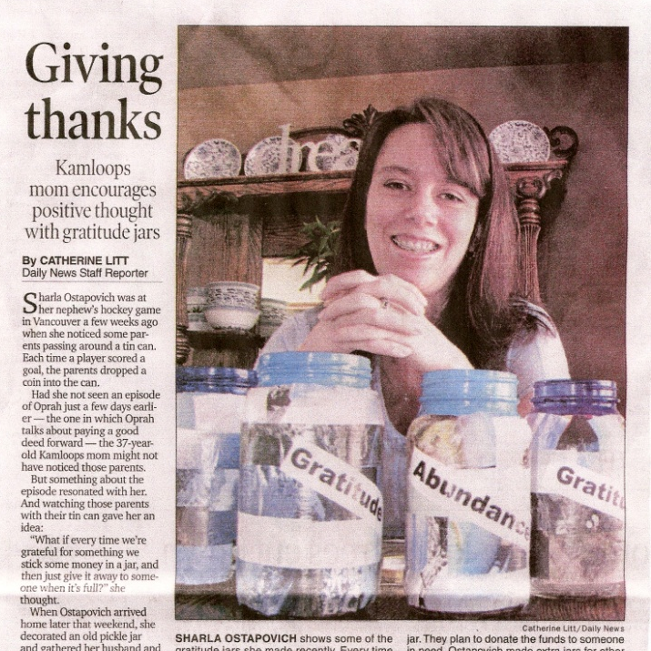
Use visual reminders/cues
Watch your language
Make a vow to practice gratitude
Go through the motions
Think outside the box

Slide 51
Come to your senses:
Gratitude for our bodies
Breath of thanks
Awareness of miracles
What has you body done for you lately?
Body Naikan
Yoga and other mind-body practices

Slide 52
Grateful vs. Ungrateful People: Contrasting Worldviews
Lens of abundance
What life is offering
Life as a gift
Satisfaction
Lens of scarcity
What life is denying
Life as a burden
Deprivation

Slide 53
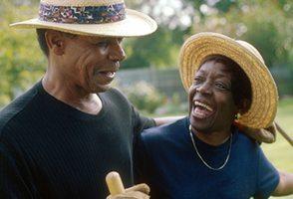
Self-Concepts of Low-Income Older Women
Not old or poor, but “fortunate” and “blessed”
“I know I’m poor. But I thank the Lord in a way. He ain’t gonna let his children starve. Even if it ain’t nothing but milk and bread, I’ll eat…I don’t consider myself poor, but I consider myself…blessed.”

Slide 54
9. Going through the motions can trigger the emotion
People who held pencils in their teeth, who were, unbeknownst to them activating their zygomatic (smiling) muscles, rated cartoons funnier than those who held the pencils with their lips (activating their frowning muscles)
Source: The Facial Feedback Hypothesis. Strack & Martin, 1988, Journal of Personality and Social Psychology

Slide 55
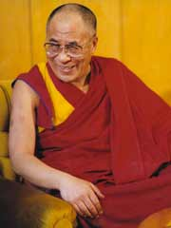
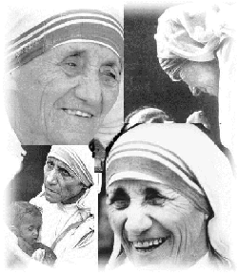
10. Thinking Outside the Box
Gratitude to those who harm you
Gratitude to those whom you help

Slide 56
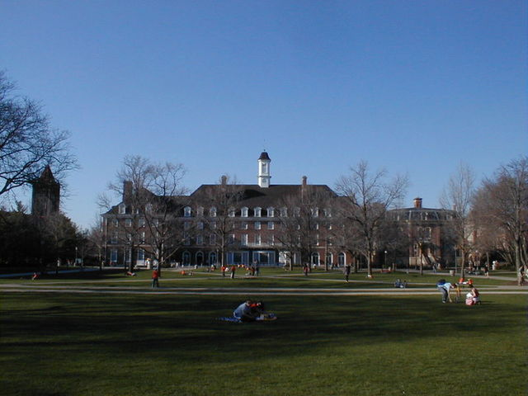

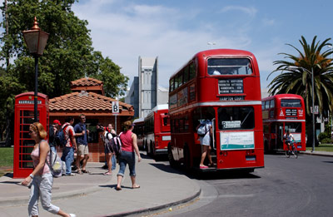

Gratitude to Institutions?

Slide 57
A therapeutic/psycho educational program for gratitude: Six sessions
Defining gratitude and assessing personal practice
Building gratitude in the personal life
Practice of gratitude in the family context
Practice of gratitude in the work context
Practice of gratitude in the community context
Practice of gratitude post-group experience
Source: Louisiana Counseling Association

Slide 58
Integrated Mind-Body
Gratitude Training: Goals
Self-exploration
Self-mastery
Distress tolerance
Strength building

Slide 59
Attentional Training: Three stages
Awareness of usual patterns and responses
Disengagement from these patterns
Engagement with desired pattern
Source: Kristeller & Johnson, 2005

Slide 60
Effects of Attentional Gratitude Training
Usual patterns
and habits of
non-gratitude
Basic Practice:
Awareness and
Disengagement
Self-mastery
Self-exploration
Distress tolerance
Engagement of
gratefulness,
appreciation,
positive indebtedness,
giving back
Focus on
gratitude-supporting thoughts,
(e.g. humility, sense of giftedness, surprise)

Slide 61

“Two years after I had lost my job due to my physical condition I am still struggling with it. My work had been such a large part of my life--seven days a week and all hours of the day and night. I liked doing it and was very good at it. Now I could no longer work at what I had spent most of my life training for. Emotionally I was very low at this time.

Slide 62
I was at a meeting along with four other people working out class schedules for lay training school. I had been teaching lay people public speaking for the Methodist church for twenty years. As the meeting was almost over the district superintendent asked me If I would be willing to help him out, that he had a small church and could not afford a full time pastor and would like me to take the job. This was a direction I had not ever gave the slightest thought to. My first reaction was more of shock and surprise.

Slide 63
It has been three years now…although gratitude was not my initial feeling the sense of thankfulness is still growing. My life has changed so much that I no longer give any thought to what my physical troubles may have cost me. If they had not happened I would have missed something so great that I can no longer imagine myself without it. Disability is still a big part of my world and it looks like as time goes on it will become even more so, but it is not my life. It cannot and will not rule me.”
--59 year-old male, Post-Polio syndrome

Slide 64
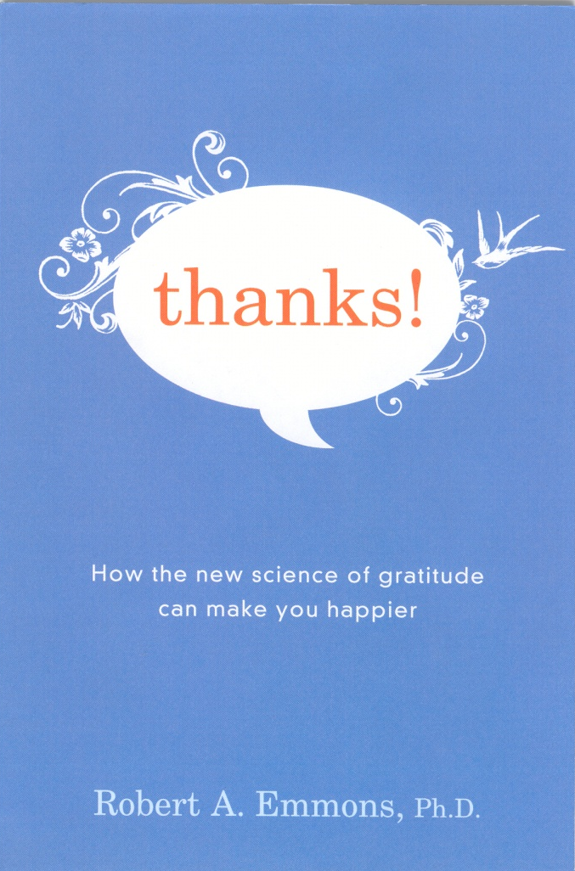
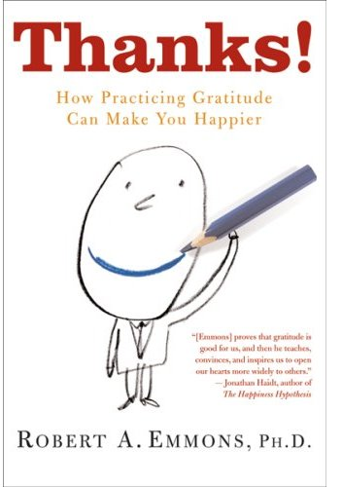
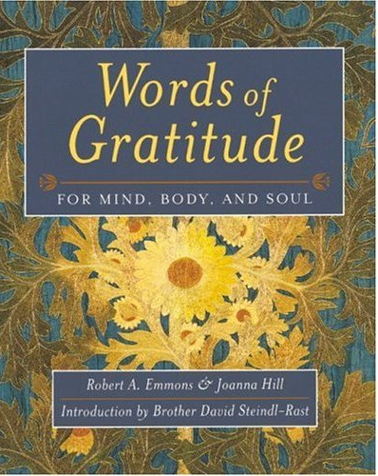
For more information…

Slide 65
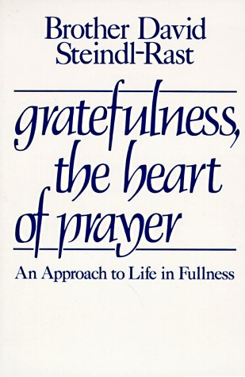
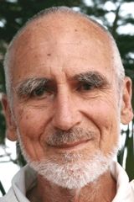
“Love wholeheartedly, be surprised, give thanks and praise– then you will discover the fullness of your life”

