Slide 1
Does grateful processing help take care of the emotional business of unpleasant memories?
(Watkins, 2009, The Journal of Positive Psychology)
Notes:
1
By reframing the memory, we might be able to see how a difficult experience fits into our good life story…

Slide 2
Study Procedure
Participants recalled an unpleasant open memory.
An open memory is a troubling memory from your past that you feel is not yet behind you and is poorly understood. It’s an emotional memory that may intrude into your consciousness at unwelcome times, and you feel you have some “unfinished business” associated with this memory. In other words, in many ways this emotional memory is still an “open book” for you.
Notes:
2

Slide 3
Procedure
Control
Writing
Condition
All Ps
recalled
open
memory
& took
pretest
measures
Emotional
Expression
Condition
Ps took
1-week
follow-up
measures
Random
Assignment
Ps took
posttest
measures
Grateful
Processing
Condition
Notes:
3

Slide 4
Please recall your open memory that you remembered for this study. For the next 20 minutes we would like you to write about your open memory. Think again about this experience for a few moments. At first it may seem that the event you wrote down might not have had any positive effects upon your life. However, sometimes even when bad things happen, they ultimately have positive consequences, things we can now be grateful for. Try to focus on the positive aspects or consequences of this difficult experience. As the result of this event, what kinds of things do you now feel thankful or grateful for? How has this event benefited you as a person? How have you grown? Were there personal strengths that grew out of your experience? How has the event made you better able to meet the challenges of the future? How has how the event put your life into perspective? How has this event helped you appreciate the truly important people and things in your life? In sum, how can you be thankful for the beneficial consequences that have resulted from this event?
Notes:
4
Because the instructions in the gratitude condition may be important for clinical interventions, we provide them verbatim here.

Slide 5
“How open/closed would you say the memory is?”
Notes:
5
In this case higher numbers indicate that the memory is more closed.
We used a covariance model in our analysis where the relevant pretest measure served as the covariate.

Slide 6
Effect of the intervention on the emotional impact of the memory
Notes:
6

Slide 7
“How does recalling this memory affect you now?”
Notes:
7
Higher numbers indicate more positive emotional impact…
In this way, it appears as though grateful processing helps redeem negative memories…

Slide 8
How did the gratitude intervention impact the intrusiveness of the memory?
Notes:
8

Slide 9
Intrusiveness of Open Memory
Notes:
9
Real time Intrusive memory mx…

Slide 10
Grateful processing of unpleasant open memories:
Brought more closure to those memories
Decreased the unpleasant emotional impact of recalling those memories
Decreased the intrusiveness of the memories
Notes:
10
To sum up our findings…

Slide 11
Conclusions
Grateful processing helps bring closure to troubling memories, which appears to decrease their intrusiveness and unpleasant emotional impact
Grateful processing of pleasant events may increase the accessibility of these events in memory
These results may have important implications for improving cognitive treatments of depression
Notes:
11
Cognitive-behavioral treatments of depression tend to focus on repairing unpleasant thoughts and emotions, but there is also evidence that depressed individuals suffer from deficits in positive thoughts and memories.
Thus, gratitude interventions may be a helpful ancillary to cognitive treatments.

Slide 12
Gratitude reduces stress
Gratitude leads to higher levels of perceived social support and to lower levels of stress and depression over time
Giving people the skills to increase their gratitude may be as beneficial as such cognitive behavioral life skills as challenging negative beliefs
Source: Wood et. al., JRP, 2008

Slide 13
Gratitude is related to distinct patterns of coping
Is positively related to:
Emotional social support
Instrumental social support
Positive reinterpretation and growth
Planning
Is negatively related to:
Behavioral disengagement
Self-blame
Substance abuse
Denial

Slide 14
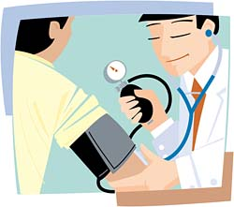
Gratitude lowers blood pressure
The effectiveness of a 10-week, gratitude-based intervention for the treatment of hypertension in low-income, inner-city, African-American patients was compared to a control condition
Patients in the gratitude condition achieved statistically significant decreases in their systolic blood pressures, increases in gratitude, and decreases in hostility

Slide 15

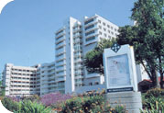
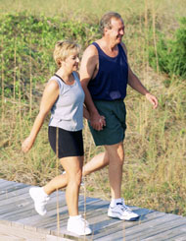
Gratitude and weight loss/dietary fat
Gratitude journaling facilitates compliance with and success of a weight management program (LIFESTEPS®)
Participants enrolled in Preventive Cardiology program at UCD Medical Center

Slide 16
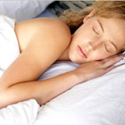
Gratitude and sleep quality
Gratitude is related to
more positive pre-sleep cognitions and fewer negative pre-sleep cognitions
Journal of Psychosomatic Research, 2009

Slide 17
Gratitude heals relationships
One of the transformational, healing affects identified by Fosha in her “accelerated experiential dynamic psychotherapy (ADEPT)
Journal of Psychotherapy Integration, 2008

Slide 18
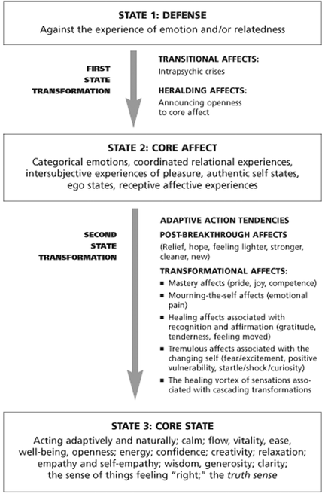

Slide 19
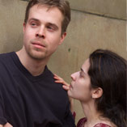
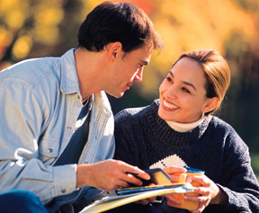
Finding and Fostering the Good: Gratitude in Couples Therapy
Gratitude may improve couples therapy outcomes
Frequent positive affect precedes and promotes enhanced marital satisfaction
Balancing the focus; enhancing positive emotions; build on strengths
Source: Kauffman & Silverman JCP, 2009

Slide 20
Expressed gratitude changes one’s view of the relationship
Perceived communal strength increased in couples who openly expressed gratitude
(Lambert et. al., Psychological Science, 2010)

Slide 21
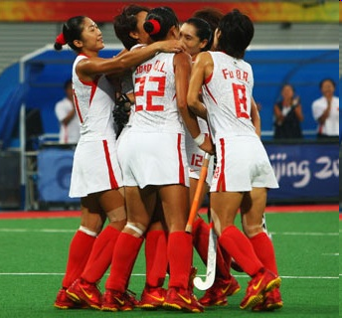
Does gratitude promote an athlete’s well-being?
Grateful athletes are more satisfied with their team and show less athlete burnout
(Source: Social Indicators Research, 2008)

Slide 22
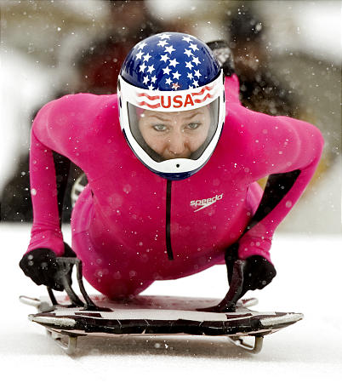
U.S. skeleton Olympian Noelle Pikus-Pace
"I spent maybe three hours yesterday writing on my sled. I wrote everybody's name who helped me get here. I have like 500 names on there--hundreds of loved ones, 10 years, four runs, one sled, one dream."

Slide 23
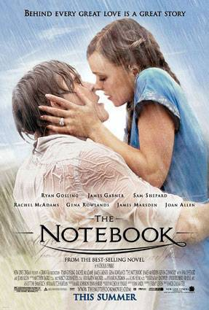
Gratitude is sexy…
“Strengths of character” including the capacity to love and be loved, wisdom, spirituality, kindness, forgiveness and gratitude are highly desirable traits in a romantic partner
(Journal of Adolescence, 2003)

Slide 24
Gratitude and Susceptibility to Lifetime Psychiatric Disorders
Study sample: 2,616 male and female twins from the Virginia Twin Registry.
Study results:
Social religiosity and thankfulness were associated with reduced risk for both internalizing and externalizing disorders.
“Thankfulness may tap a dimension of intrinsic religiosity that reduces risk for major depression.”
Kendler, KS, et al. Dimensions of religiosity and their relationship to lifetime
psychiatric and substance use disorders. American Journal of Psychiatry,
2003, 160(3):496-503.

Slide 25
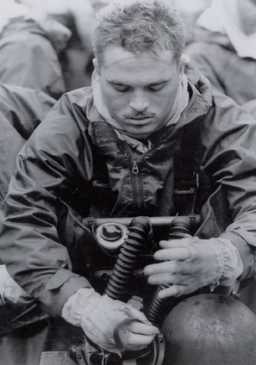
Gratitude and PTSD in Combat Veterans?

Slide 26
Combat Veterans and Trauma Survivors
Several Difficulties
Amplified negative affect
Diminished positive affect
Impaired and restricted social functioning
Experiential avoidance
Rumination
“Frozen” in trauma
Hyper-accessible “semantic fear networks”
Source: Kashdan, 2006, Behaviour Research and Therapy

Slide 27
Results
Characteristics | PTSD group | Non-PTSD group
PTSD severity | 128.1 ± 16.8 | 77.8 ± 10.8***
Trait gratitude | 22.1 ± 9.4 | 33.7 ± 7.0***
Daily gratitude | 4.1 ± 3.2 | 5.1 ± 3.14 (p = .17)
Daily PA | 14.7 ± 4.8 | 18.2 ± 5.2*
Daily NA | 16.2 ± 5.5 | 9.9 ± 4.4***
Daily social activity | 5.7 ± 1.2 | 6.6 ± 1.4*
Daily intrinsically motivating activity | 4.5 ± 1.8 | 5.4 ± 2.1 (p = .11)
Daily self-esteem | 11.8 ± 3.9 | 16.9 ± 2.6***
% of pleasant days | .45 ± .37 | .80 ± .29***
*p < .05. **p < .01. ***p < .001. Based on series of t-tests.

Slide 28
Conclusions
Compared to non-PTSD veterans, veterans with PTSD
Exhibit less behavioral tendencies to experience gratitude
Minimal differences in daily experience of gratitude
Both groups reap similar psychological benefits from trait and daily gratitude
Gratitude effects not attributable to distress levels or serial dependencies
The validity of findings is limited:
Sample issues
Unstructured clinical interviews to assess PTSD
Data provide merit on the clinical importance of examining and cultivating gratitude in individuals with trauma-related experiences

Slide 29
There is a difference between feeling grateful and being grateful.
Feeling grateful is a response to a benefit.
Being grateful is a way of life.

Slide 30
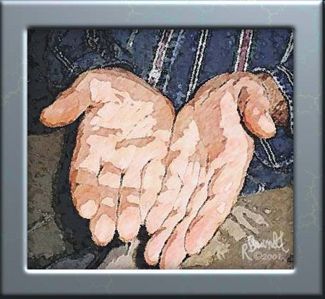
What is a grateful person?
The grateful person accepts all of life as a gift

Slide 31
Measuring Dispositional Gratitude
The GQ (McCullough, Emmons, & Tsang, 2002)
“If I had to list everything that I felt grateful for, it would be a very long list”; “When I look at the world, I don’t see much to be grateful for.”
The GRAT (Watkins et. al., 2003)
“Often I think, "What a privilege it is to be alive”; “I really don't think that I've gotten all the good things that I deserve in life.”

Slide 32
Grateful vs. Ungrateful People: Contrasting Worldviews
Lens of abundance vs. lens of scarcity
What life is offering vs. what life is denying
Life as a gift vs. life as a burden
Satisfaction vs. deprivation

Slide 33
Myths About Gratitude
Gratitude just another form of positive thinking.
Gratitude strips people of initiative and leads to complacency or even passive resignation.
It is impossible to be grateful in the midst of suffering.
Notes:
33

Slide 34
Does gratitude encourage passivity? No! Gratitude facilitates goal attainment
Participants identified 6 personal goals they intended to pursue in the next 2 months
Academic/vocational, relational, health
Participants in the gratitude condition made 20% more progress, yet were no more satisfied with the progress they had made compared to those in other conditions
Notes:
34

Slide 35
Is Gratitude Counterintuitive?
It contradicts the self-serving bias
It contradicts the need for control
It contradicts the just-world hypothesis

Slide 36
The Gratitude Visit
Select one important person from your past who has made a major positive difference in your life and to whom you have never fully expressed your thanks. Choose someone who is still alive. Write a testimonial just long enough to cover one laminated page. Take your time composing this – several weeks if required. Invite that person to your home or travel to that person’s home. It is important that you do this face to face, not just in writing or on the phone. Do not tell the person the purpose of the visit in advance. Bring a laminated version of your testimonial with you as a gift. Read your testimonial aloud slowly, with expression and eye contact. Then let the other person react unhurriedly. Reminisce together about the concrete events that make this person so important to you.

Slide 37
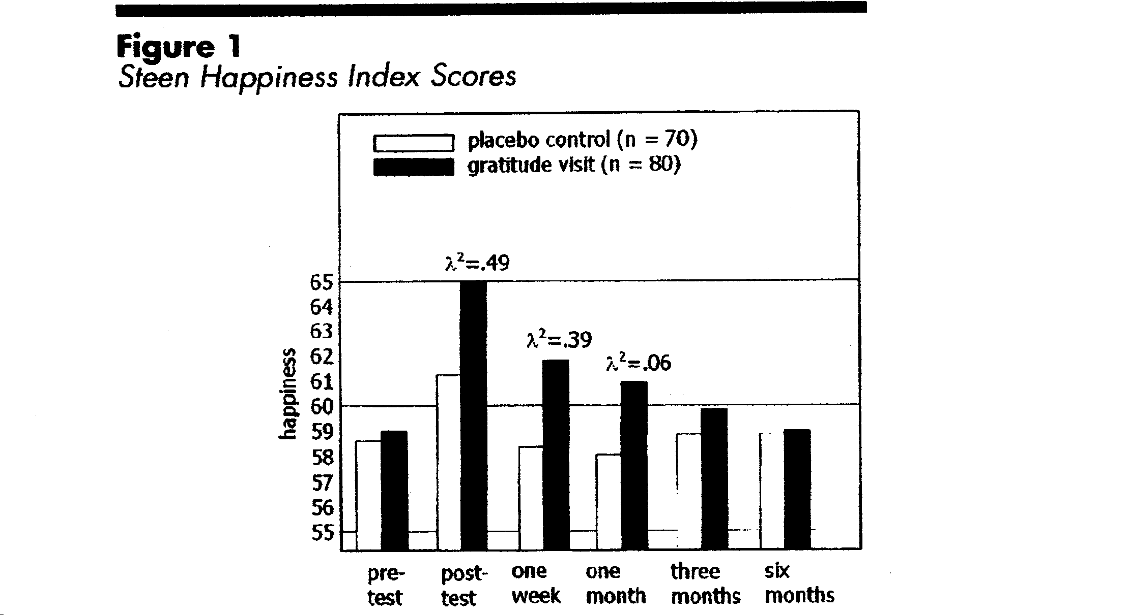

Slide 38
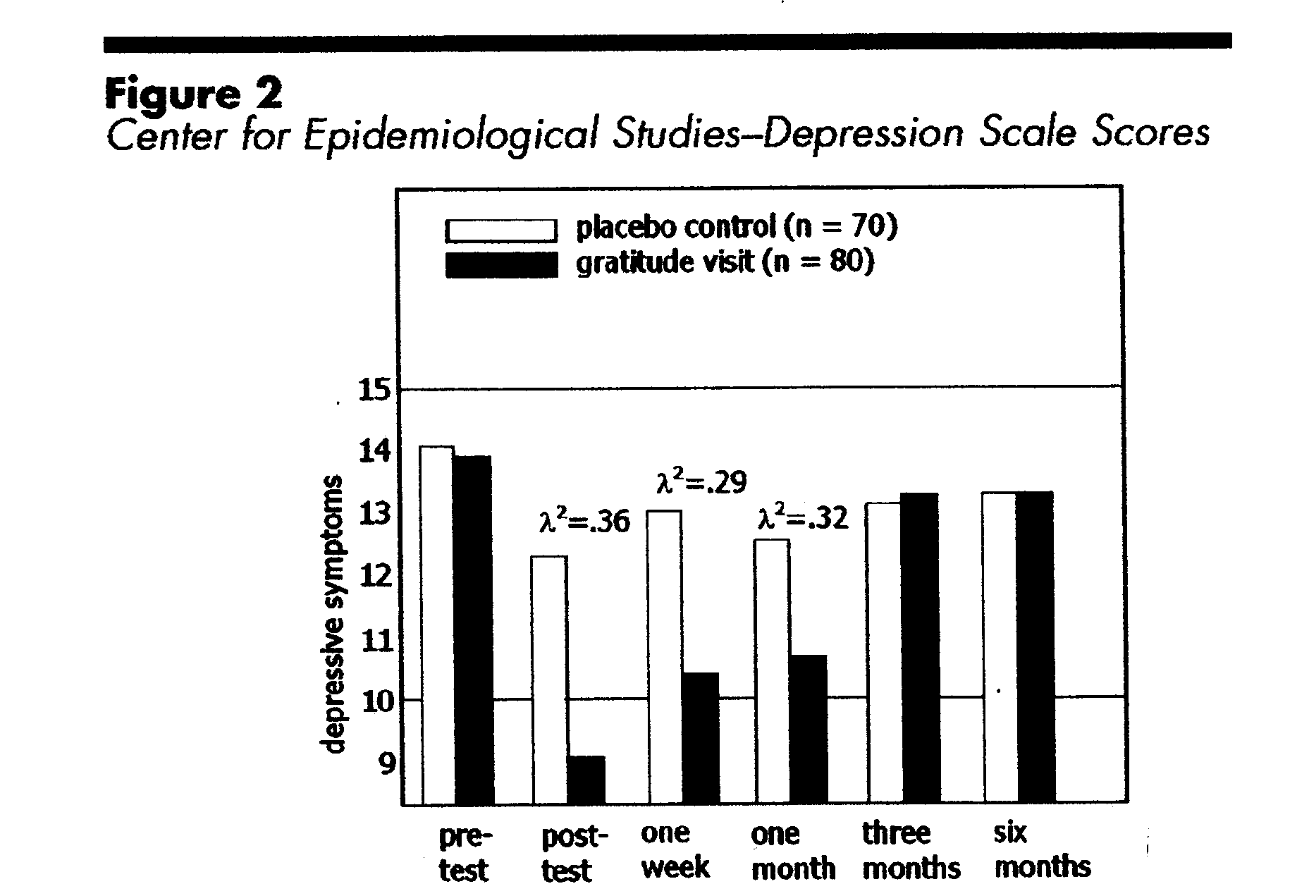

Slide 39
Gratitude Interventions
Gratitude improves retention (↑12%) in unguided online self-help therapies (JCP, in press)
CBI group participants reduced depression and stress, decreased fat intake, and lost weight (de Leon et. al, 2009)
Gratitude is a component of resilience enhancement therapy (Drury et al., 2009)

Slide 40
If Gratitude Is So Good, Why Is It So Difficult? Obstacles to Gratefulness
Pervasive negativity
Entitlement
Distractions/Forgetfulness
Inability to accept dependency
Suffering
Notes:
Skip if short on time

Slide 41
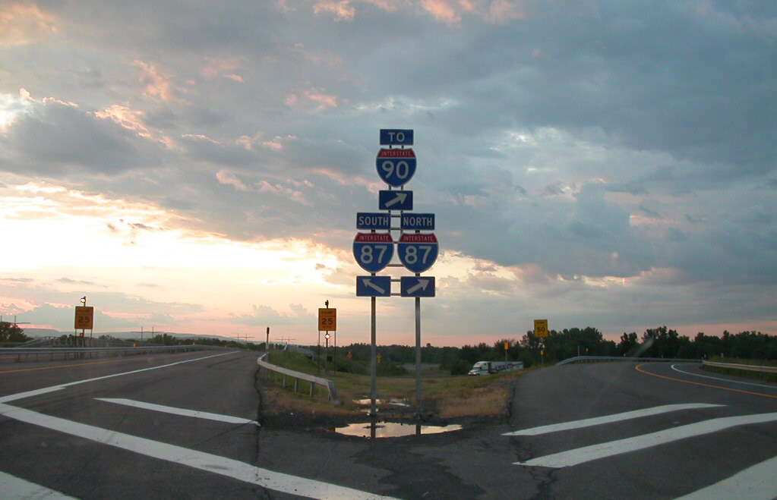
Gratitude is a choice…

Slide 42

“I believe that life is not always fair. It has certainly been true in my case. It is not fair that I should have wonderful, caring, supportive parents who raised me right, and brothers and sisters that are there when I need them. It’s not fair that I should be blessed with a beautiful, talented wife and together

Slide 43
we should have two equally, beautiful, talented daughters who make us proud daily. No, life is not fair. Why should I have had so many years of good health and energy and good friends to camp and backpack with through the years…ALS is a terrible disease, but it does not negate the rest of my life.” --49 yr. old male with ALS

Slide 44

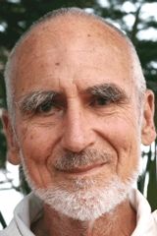
Video: A Good Day

Slide 45

“In ordinary life we hardly realize that we receive a great deal more than we give, and that it is only with gratitude that life becomes rich" --Dietrich Bonhoeffer

