Slide 1
Gratitude: Insights from the Science of Well-Being
Robert A. Emmons
June 9th, 2010
Contact: raemmons@ucdavis.edu
Notes:
1

Slide 2
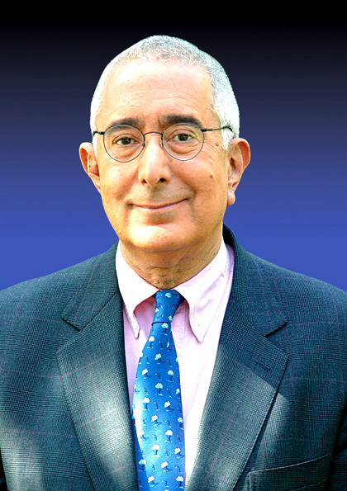
How to get rich quick…
“I cannot tell you anything that, in a few minutes, will tell you how to be rich. But I can tell you how to feel rich, which is far better, let me tell you firsthand, than being rich. Be grateful…It's the only totally reliable get-rich-quick scheme.”
--Ben Stein, lawyer, writer, actor and economist

Slide 3
Gratitude has the power
to heal,
to energize, and
to transform lives.

Slide 4
Gratitude:
Affirming goodness and recognizing that the sources of this goodness are outside the self

Slide 5
Recognitions of Gratitude
Recognize the gift
Recognize the goodness of the gift
Recognize the goodness of the giver
Recognize the gratuitous nature of the gift
Notes:
5
In summary, How can I experience more gratitude?…Essentially, what am I asking you to do here?…-->

Slide 6
The Dual Nature of Gratitude
Worldly, common, transactional
Spiritual, ethereal, transcendent
What is gratitude?
What we know about gratitude
Why gratitude matters

Slide 7
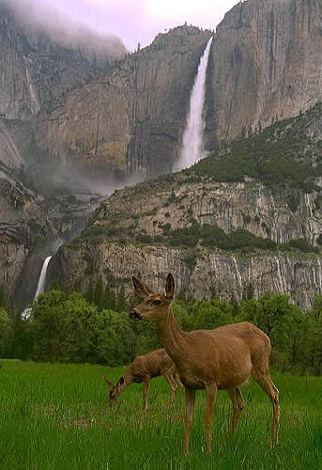
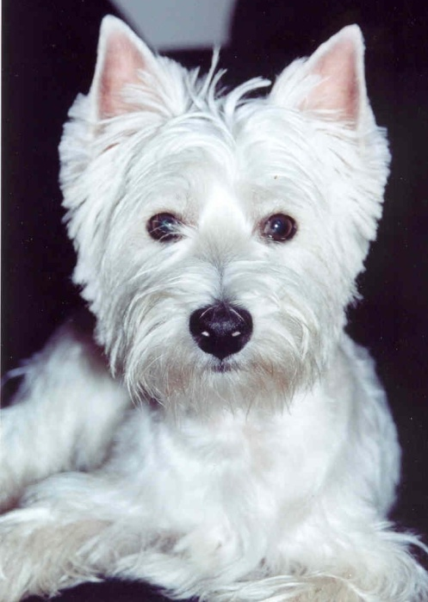
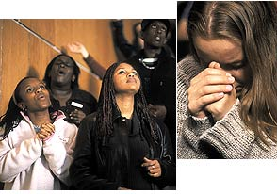
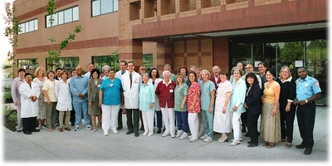
Targets of Gratitude
Other people
God
Animals
Nature

Slide 8
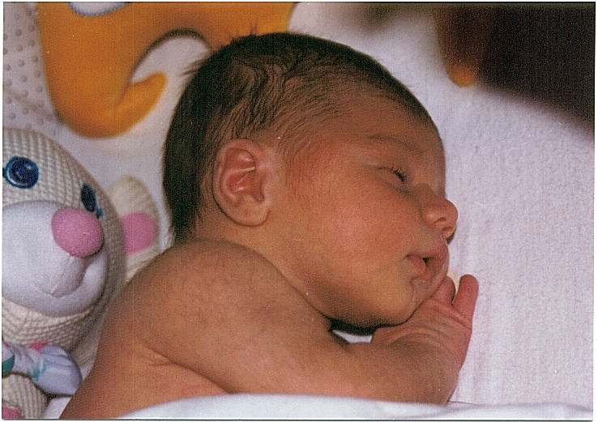
Additional Meanings: Cosmic/religious gratitude
“Vast thankfulness” that cannot be expressed to any human being
Religious naturalism:
Awe, wonder, reverence, gratitude

Slide 9
“We are moved to awe and wonder at the grandeur…the richness of natural beauty; it fills us with joy and thanksgiving
(Goodenough, The Sacred Depths of Nature)

Slide 10
Quotes about Gratitude
“Gratitude is the moral memory of mankind”
“Gratitude is not only the greatest of the virtues, it is the parent of all the others”
"Nothing is more honorable than a grateful heart."
“Ingratitude…is the essence of vileness”

Slide 11
Let us rise up and be thankful, for if we didn’t learn a lot today, at least we learned a little, and if we didn’t learn a little, at least we didn’t get sick, and if we got sick, at least we didn’t die;
so, let us all be thankful
--The Buddha

Slide 12
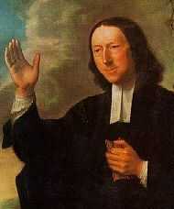
John Wesley (1703-1791)
“True religion is right tempers towards God and man. It is, in two words, gratitude and benevolence; gratitude to our Creator and supreme Benefactor, and benevolence to our fellow creatures”

Slide 13
Two main questions:
Can gratitude be cultivated on a regular basis? How?
If so, what are the effects of gratitude on human health, happiness and well-being?

Slide 14
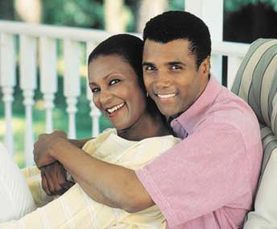
Why happiness matters:
Happy people are more successful in life
Health and well-being
Career success and income levels
Relationship duration
and satisfaction
Notes:
14

Slide 15
Happiness makes good things happen:
higher income and superior work outcomes (e.g., greater productivity, higher quality of work, greater occupational attainment)
larger social rewards (more satisfying and longer marriages, more friends, stronger social support, and richer social interactions)
more activity and energy, better physical health (e.g., a bolstered immune system, lowered stress levels, less pain) and even longer life

Slide 16
Notes:
16

Slide 17
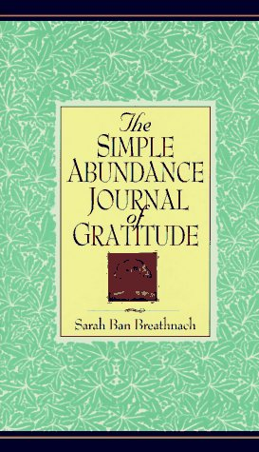
Gratitude: The Key to Life?
“Whatever you are in search of—peace of mind, prosperity, health, love—it is waiting for you if only you are willing to receive it with an open and grateful heart.”
Notes:
17

Slide 18
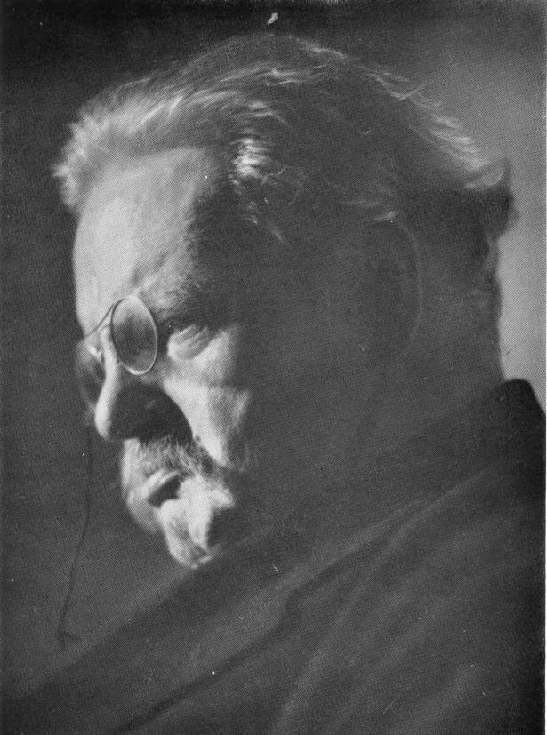
G. K. Chesterton on Gratitude
“gratitude produced the most purely joyful moments that have been known to man”
“All goods look better when they look like gifts”
Notes:
18
18

Slide 19
You say grace before meals. All right. But I say grace before the concert and the opera, and grace before the play and pantomime, and grace before I open a book, and grace before sketching, painting, and swimming, fencing, boxing, walking, playing, dancing, and grace before I dip the pen in ink.
— G. K. Chesterton
,
Notes:
19
19
A life of pervasive thankfulness

Slide 20
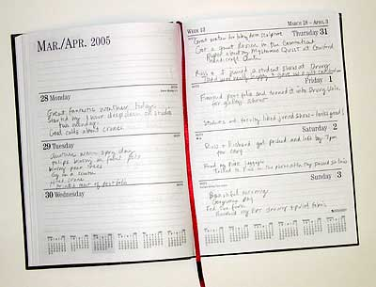

Counting Blessings or Burdens?
Random assignment, placebo controlled experimental trials

Slide 21
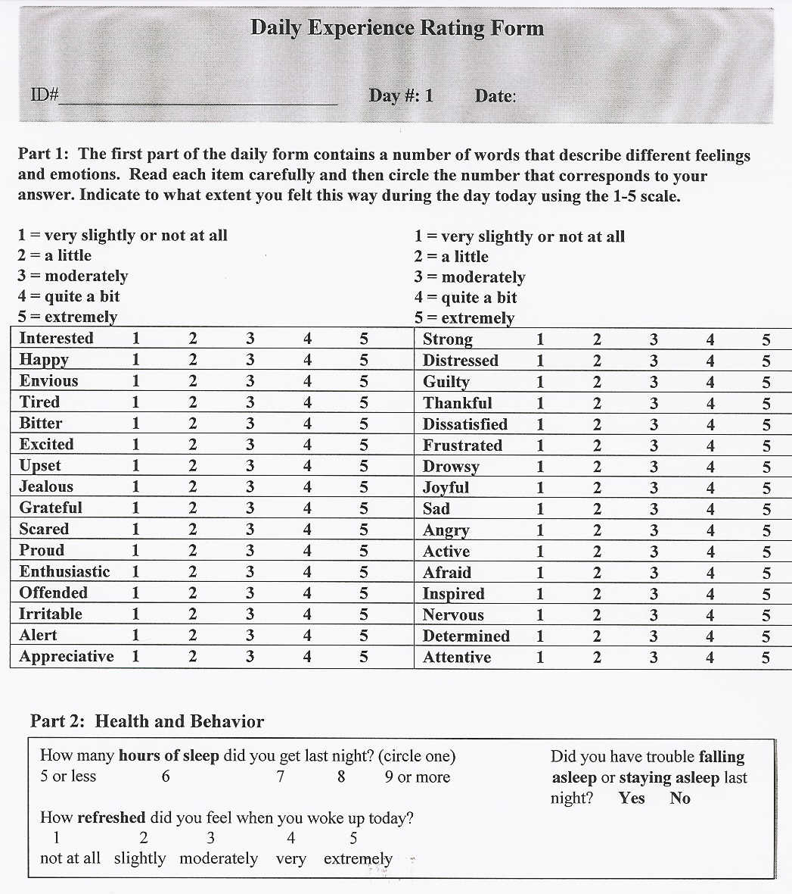
Notes:
21

Slide 22
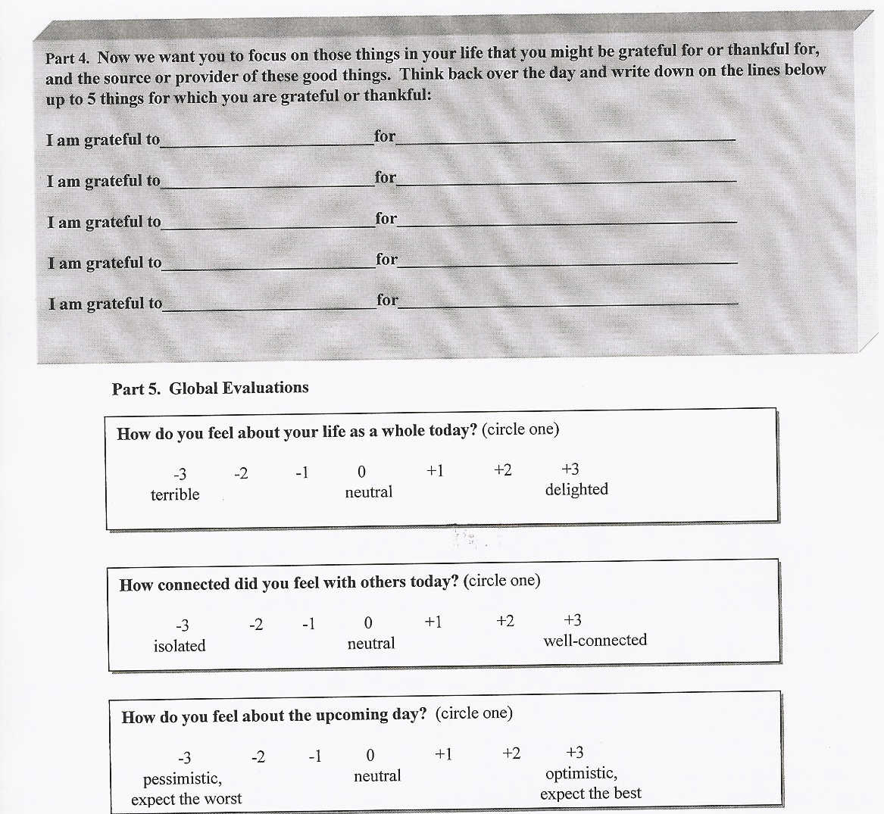
Notes:
22

Slide 23
Examples of Hassles
Hard to find parking
Messy kitchen no one will clean
Finances depleting quickly
No money for gas
Our house smells like manure
Burned my macaroni and cheese
Doing favor for friend who didn’t appreciate it

Slide 24
Examples of ‘‘Blessings”
Generosity of friends
The right to vote
Saw grandson get first haircut
That I have learned all that I have learned
Sunset through the clouds
The chance to be alive
That my in-laws live only 10 mins. away

Slide 25
Research on the Benefits of Gratefulness: Experimental Findings
Psychological (Positive emotions: alert, energetic, enthused, attentive)
Physical (more exercise, better sleep, fewer symptoms)
Interpersonal (more helpful and connected, less lonely and isolated)
Source: R.A. Emmons & M.E. McCullough, Journal of Personality and Social Psychology, 2003, 84, 377-389.

Slide 26
Gratitude in Persons With Chronic Disease
140 persons with neuromuscular disease
Randomly assigned to one of two groups:
  Gratitude listing
  or to a
  Control group
Outcomes: Emotional, physical, and social
well-being, 3-week time frame

Slide 27

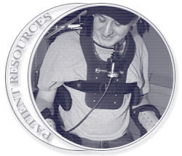
Hereditary and Acquired
Neuromuscular Diseases
Peripheral disorders of the nervous system affecting anterior horn cells, peripheral nerves, neuromuscular junction, and muscle
> 300 Diseases (over 248 distinct genes)
Overall prevalence > 4 million in U.S.

Slide 28
Main Results:
Significantly higher levels of positive emotions in the gratitude condition
No differences in negative emotions
Significant effects for life appraisal items (life as whole, upcoming day, connected to others)
More hours of sleep (7.58 vs. 7.05), no effect for exercise or pain

Slide 29
Table 1. Six-Month Follow-Up Comparisons on Well-Being, NMD Study
Dependent Variable | Gratitude | Control | F(1,54)
Positive affect | 3.69 | 3.31 | 3.60*
Negative affect | 1.76 | 1.86 | ns
Life satisfaction | 4.42 | 3.63 | 5.97**
Life as a whole | 5.54 | 4.91 | 6.46**
Connectedness | 5.77 | 5.17 | 4.77**

Slide 30
“Being forced, consciously to reflect, contemplate and sum up my life on a daily basis was curiously therapeutic, and enlightening. I was reminded of facets of myself that I very much like and others that could use improvement.”
“I don’t believe participating in the study changed my level of gratitude, but it made me more aware of it-- I have always tried to live my life in a positive, upbeat manner. I believe my faith has helped me accomplish this”

Slide 31
Gratitude in Educational Settings
Does counting blessings impact children’s well-being?
Gratitude intervention with 6th and 7th graders
Notes:
31

Slide 32
Main results:
The gratitude induction was related to optimism, overall life satisfaction, and domain-specific life satisfaction (e.g., school experience, residency)
The gratitude group reported greater satisfaction with their school experience at both the immediate post-test and 3-week follow-up
Journal of School Psychology, 2008

Slide 33

What good is gratitude?
Gratitude allows celebration of the present
Gratitude blocks toxic emotions
Grateful people are more stress-resilient
Gratitude strengthens social ties and self-worth
Gratitude brings health benefits
Notes:
33

Slide 34
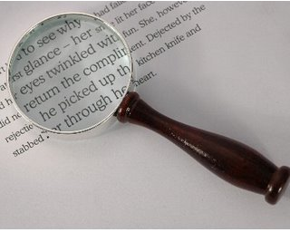


Gratitude Amplifies the Good
Notes:
Just as an amplifier can turn up the volume of the sound going in to a microphone, so gratitude “turns up the volume” to the good in our life…
Just as a magnifying glass magnifies the text it is focused on, so gratitude magnifies the good in our life…

Slide 35
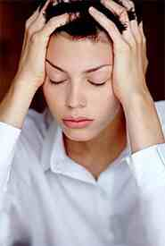
Is Gratitude a Buffer Against Loneliness and/or Depression?
Gratitude is important in the prevention of depression
Grateful people show a positive memory bias
Gratitude enhances the retrievability of positive experiences (Watkins et al., 2003)
Grateful people are less isolated

