Slide 1
Using Campus Radio to Promote Student Wellness
Dr. Bernadette Peters
Licensed Psychologist
Assistant Director Counseling Services
Niagara University

Slide 2
Using Campus Radio to Promote Student Wellness
What is your interest in campus radio??
“Door prize!”

Slide 3






Using Campus Radio to Promote Student Wellness
Niagara University

Slide 4
Using Campus Radio to Promote Student Wellness
The Beginnings
My initiation of the idea
Other shows
Consultation with Dr. Barbara Streets- “Mindful Moments”
Liability concerns
Co-host
Shrink Rap Web page

Slide 5
Using Campus Radio to Promote Student Wellness
APA Ethics Code
5.04 Media Presentations When psychologists provide public advice or comment via print, Internet, or other electronic transmission, they take precautions to ensure that statements (1) are based on their professional knowledge, training, or experience in accord with appropriate psychological literature and practice; (2) are otherwise consistent with this Ethics Code; and (3) do not indicate that a professional relationship has been established with the recipient. (See also Standard 2.04, Bases for Scientific and Professional Judgments.)
2.04 Bases for Scientific and Professional Judgments Psychologists' work is based upon established scientific and professional knowledge of the discipline.

Slide 6
Using Campus Radio to Promote Student Wellness
Disclaimer:
Opinions heard on Shrink Rap are meant to support and not replace professional healthcare and mental health treatment. Listeners should not infer that a relationship has been established with the hosts personally. If you feel you are in need of professional help and are an NU student, please contact NU’s Counseling Services at 286-8536 or Niagara County Crisis Services at 285-3515. If you are not an NU student, please contact Crisis Services in your county, 9-1-1, or your local mental health agency or your insurance provider for a referral. {sound clip}

Slide 7
Using Campus Radio to Promote Student Wellness
Disclaimer:
This show was not intended as a substitute for professional counseling. If you feel you need professional help, please contact Counseling Services if you are an NU student, or 9-1-1 if this is an emergency. Other listeners may contact their respective county’s crisis service hotline or their local mental health agency or insurance company.
{sound clip}

Slide 8
Using Campus Radio to Promote Student Wellness
Email:
Niagara University’s WNIA has a new radio program titled "Shrink Rap" with licensed psychologist Dr. Bernadette Peters and licensed mental health counselor Monica Romeo. The hour long show features a variety of mental health and wellness topics and will frequently include guest speakers. Listen in on Monday mornings from 10am – 11am at www.wniaradio.com or tune to campus TV channel 20 for a live stream. Please call with questions and comments during the show at 716-286-7315.

Slide 9
Using Campus Radio to Promote Student Wellness
The WNIA station…

Slide 10
Using Campus Radio to Promote Student Wellness
The Beginnings
WNIA- history
Internet radio station, streaming live online 24/7
WNIA Homepage
Facebook Page
Myspace
Campus TV - Ch. 20- live stream of WNIA
“Broadcasts” in Commons

Slide 11

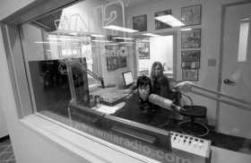

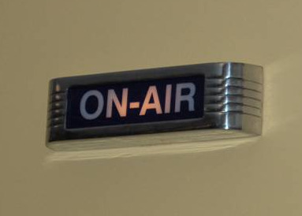
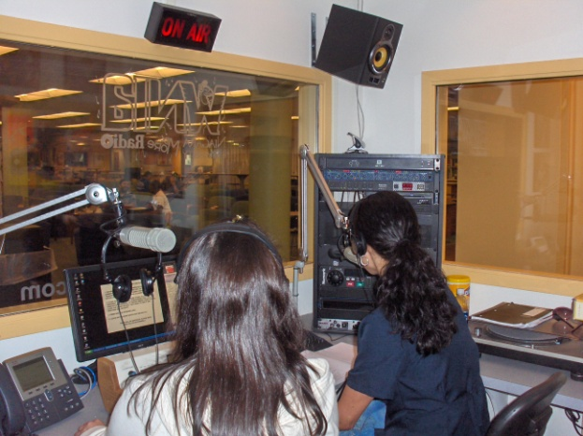
Using Campus Radio to Promote Student Wellness
Photo/ Charles Lewis/Buffalo News

Slide 12
Using Campus Radio to Promote Student Wellness
Leading up to FIRST SHOW!
Before the first show
Learning the equipment
Equipment breaking
Naming the show- “SHRINK RAP”

Slide 13
Using Campus Radio to Promote Student Wellness
Quiz Question:
How did I come up with the name, Shrink Rap?
From the Robert B. Parker novel
I took a student poll
I asked fellow psychologists
It came to me in a dream

Slide 14
Using Campus Radio to Promote Student Wellness
The first show- Spring 2009 mid-semester
Quiz Question:
How many Shrink Rap shows have aired to date?

Slide 15
Using Campus Radio to Promote Student Wellness
27

Slide 16
Using Campus Radio to Promote Student Wellness
Spring 2009
Show 1: Introduction - Nervous! Interviewed by DJs Show 2: Domestic Violence – guest speaker Director of Niagara County Child & Family Services
Show 3: Sexual Assault- guest speaker Director of Campus Safety- RAINN PSA
Show 4: Stress management; Breathing/relaxation exercises

Slide 17
Using Campus Radio to Promote Student Wellness
Sample Questions:
What is your role as XXX @ XXX?
What services does your agency provide?
How can students get in contact with you/your agency?
NU Specific:
How did you end up working at NU and what is your position on campus?
What services does your department provide?
How can a student get involved?
What is the favorite part of your job?

Slide 18
Using Campus Radio to Promote Student Wellness
Sample Questions: Domestic Violence
1. What percentage of college students are involved in domestic violence situations?
2. What types of resources are available for college students involved in a domestic violence situation?
3. How can someone tell if their relationship is likely to become violent?
4. If I am in an abusive relationship, what are my options?
5. Why would I need to go into a safe house?
6. How can I be sexually assaulted if I am in a relationship?
7. What are my options if I am sexually assaulted?
8. What typically happens if I decide to go the hospital after a sexual assault?
9. Do I have to press charges if I decide that I don’t really want to?
10. What should I do if I think I was given a date rape drug?

Slide 19
Using Campus Radio to Promote Student Wellness
Activity:
Take two minutes to generate a LIST of radio show topic(s) you feel competent enough to talk about. Pretend you would be the GUEST on Shrink Rap for 15-20 minutes.

Slide 20
Using Campus Radio to Promote Student Wellness
Depression
College Student Suicide & Prevention
What did you come up with?
Dealing with a Break Up
Safety on College Campuses
Managing roommate conflict

Slide 21


Using Campus Radio to Promote Student Wellness
Second Semester
Pros:
new station director, new time, already learned equipment
Cons:
new station director, audio file problems, getting started, technological concerns, someone doing show immediately before ours

Slide 22

Using Campus Radio to Promote Student Wellness
Second Semester
Began 1 month into Fall 2009 semester
Advertisements/Planning
Schedule time to plan
I Facebook
Student emails
Faculty/staff “Daily Post”
Flyers

Slide 23

Using Campus Radio to Promote Student Wellness
If you have questions, he has answers…
Need relationship advice?
Tune in to Shrink Rap on March 22nd from 3:30 -4:30pm. Host Dr. Bernadette Peters is bringing back the popular “Confessions of a Bartender” guest, Will, who will be talking about relationships from a male perspective.
You can submit your questions prior to the show by calling or emailing Dr. Peters at 286-8536 or bpeters@niagara.edu or call or IM during the show at 286-7315 or wniaradio on AIM.
Go to www.wniaradio.com and click “Listen Live”

Slide 24
Using Campus Radio to Promote Student Wellness
Email:
Hello WNIA listeners. Here are the upcoming topics and guests for the new mental health and wellness radio show Shrink Rap hosted by Dr. Bernadette Peters and Monica Romeo.
April 20th- Manage your Stress. We know the end of semester can increase your stress levels! The hosts will provide tips on how to better manage stress and will include breathing and relaxation exercises on air.
April 27th- Sexual Assault Awareness Month. The hosts will talk about facts and concerns related to sexual assault and will be inviting guest speaker John Barker, the Director of Campus Safety, to answer questions and talk about ways that students can help keep themselves safe.
Please call in with questions and thoughts. Listen carefully for chances to win prizes!

Slide 25
Using Campus Radio to Promote Student Wellness
Fall 2009
Show 1: Homesick/Transitions; student guest speakers
Show 2: Education about Depression
Show 3: H1N1: Myth versus Fact
Show 4: Confessions of a Bartender {sound clip}
Show 5: Date Rape Drugs
Show 6: Healthy Relationships

Slide 26
Using Campus Radio to Promote Student Wellness
Sample Questions: H1N1
1. What is H1NI? What are the symptoms?
2. How is it different from the regular influenza?
3. Please explain how a nasal vaccine works as opposed to the shot version.
4. Is it more serious that the “normal flu” in terms of lethality?
5. What can people do to help prevent getting H1N1?
6. What should people do who contract suspect they have H1N1?
7. What are rumors/myths you have heard about H1N1?
8. Has anyone from our campus died from H1N1? Is it possible?
9. What should students know about Health Services in terms of H1N1?
10. What is the difference between the regular flu shot and the H1N1? Where can I go for a flu shot?

Slide 27
Using Campus Radio to Promote Student Wellness
Fall 2009
Show 7: International Week
Show 8: Managing your Grief through the Holidays
Show 9: All about the SELF
Show 10: Learning to be Mindful {sound clip}
Show 11: Keeping your Sanity over the Holiday
David Letterman's Top 10

Slide 28
Using Campus Radio to Promote Student Wellness
Spring 2010- SOLO
Show 1: Interview with Campus Activities
Show 2: All about Love
Show 3: Interview with Career Services
Show 4: Eating Disorders: Signs, symptoms and interventions
Show 5: Interview with Campus Ministry
Show 6: Interview with Kiernan Center Staff
Show 7: If you have questions, he has answers (Dating Relationships) {sound clip}

Slide 29
Using Campus Radio to Promote Student Wellness
Sample Questions: Dating Relationships
1. Tell us about your bartending history/experience? (years, which bars, current experience)
2. What got you into bartending?
3. Tell us about things you observed in regards to poor decision making among patrons.
4. Have you had experience with date rape drugs (e.g., observed someone slipping it into a drink, aware that bartenders/bouncers were paid to put in a drink, etc).
5. Words of advice for bar goers to avoid getting slipped a roofie? Other ways to stay safe while drinking?
6. Two words: Bar fight. Tell us about some memorable ones.
7. Have you witness assaults or harassment based on minority status such as LGBT, race, SES?
8. What are some misconceptions about being a bartender?
9. What is your favorite you-would-not-have-believed-it-could-happen-if-you-did-not-personally-witness-it story?
10. What is your worst memory as a bartender? {sound clip}

Slide 30
Using Campus Radio to Promote Student Wellness
Spring 2010
Show 8: The 100 Simple Secrets of Happy People Tips and other Stress Busters
Show 9: Interview with Theresa Berg, Associate Director of Athletics
Show 10: Sexual Assault Awareness Month
Show 11: Learning how to Achieve your Personal Health and Wellness {sound clip}
Show 12: Summer Luvin

Slide 31
Using Campus Radio to Promote Student Wellness
New intro/exit sound clips and sweeper! { sound clips }

Slide 32
Using Campus Radio to Promote Student Wellness
Group Questions:
How would you initiate a radio show on your campus? What barriers exist?
What’s a name you might use for your own college radio talk show?
What would be the theme of your show? Weekly, monthly? Call-in?

Slide 33
Using Campus Radio to Promote Student Wellness
Hopes for Change:
Larger studio with temperature control, more user-friendly method of getting callers on air, getting more callers, receive more feedback, syndicated show (dream BIG!)

Slide 34
Using Campus Radio to Promote Student Wellness
Most Popular Show:
Confessions of a Bartender
Relationships
Learning to be Mindful
None of the Above
Quiz Question:

Slide 35
Using Campus Radio to Promote Student Wellness
OUTCOMES

Slide 36
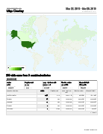
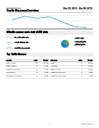
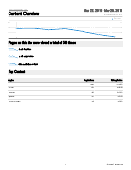
Using Campus Radio to Promote Student Wellness
GOOGLE Analytics

Slide 37
Using Campus Radio to Promote Student Wellness
Counseling Services Satisfaction Survey
Second semester since adding the questions:
Have you listened to Dr. Bernadette Peters' WNIA radio show “Shrink Rap” that focuses on various mental health and wellness topics?
2. If yes, have you found the show helpful?
Feedback- 1/3 listened, 100% found helpful. “It would be nice if more students called in anonymously and talked about issues they were dealing with. Maybe they can relate to a lot of other students.”

Slide 38
Using Campus Radio to Promote Student Wellness
Personal Feedback
i have connected to a couple of your on air shows and i first wanted to say that its really awesome you are doing a radio show like that. I hope it gets a lot of attention from students and you are getting good reviews.
Because of listening to your show on depression I realized I may have it and have decided to get help.
Cool!
You sounds so professional. You have an excellent radio voice!
You sound like a natural.
My friend who is a priest in Rome listened and really likes the show!

Slide 39
Using Campus Radio to Promote Student Wellness
Quiz Question:
What song(s) would you play when doing the show on Managing your Grief through the Holiday?
What about All about Love?
Summer Luvin?

Slide 40
Using Campus Radio to Promote Student Wellness
Strengths- visibility in commons, internet station, guest speakers
Limitations- time slot, internet station, callers
Growth Edges- technology, advertisements

Slide 41
Using Campus Radio to Promote Student Wellness
Additional Advertisements/Outreach
Interviewed by campus newspaper, The Index
Trying to set up time to be interviewed by NU Alumni Newsletter, The Eagle
Webinar through EducationDynamics- almost
Word of mouth

Slide 42
Using Campus Radio to Promote Student Wellness
LESSONS LEARNED:
Remember to turn mikes “on”
Remember to turn mikes “off”
Remember to turn mikes back “on”
Always be prepared
Remember to record show- @ the beginning
Remember how “talk over” function works
Remind guests to not get personal
Utilize the students! They know what they are doing!
VistaPrint is my new best friend ☺
Wear the headphones @ all times

Slide 43
Using Campus Radio to Promote Student Wellness
MORE LESSONS LEARNED:
Don’t schedule a client immediately before
Wear the headphones @ all times
Know where the “kill switch” is
Limit “umm”
Remember ID card
Dress in layers
Close out YouTube webpage when done
Don’t have dead air

Slide 44
Using Campus Radio to Promote Student Wellness
Future Shrink Rap plans:
The show must go on!
Active Minds
Psychology Professor
Certified Yoga Instructor
Martial Arts Master
Person w/ addiction, loss, depression…
Dangers of “Sexting”

Slide 45
Using Campus Radio to Promote Student Wellness
Questions for You:
Co-host or solo?
Unique show ideas?
Songs?
Anyone want to be a guest on Shrink Rap?
Any other feedback/ constructive criticism? I can take it, really ☺

Slide 46
Using Campus Radio to Promote Student Wellness
Questions?
Comments?
Suggestions?
Thank you!

