Slide 1
I DIDN’T KNOW YOU COULD DO THAT!
WAIT, HOW DO YOU DO THAT?
WAYS TITANIUM CAN MAKE YOUR LIFE EASIER
Shelly Lear, PsyD
Director
Hobart & William Smith Colleges

Slide 2
Thanks to:
Norma Jean Brand, Houston Community College, Northwest
Michelle Cooper, Western Carolina University
Melissa Fallon, College at Oneonta, SUNY
Janice K. Fletcher, Lasell College
Joe Hamilton, Truman State University
Dawn LaFrance, Colgate University
Rachel Rose, Cornerstone University
Ariella Soffer, Hunter College
Brian Sullivan, College of Charleston
Tina Yang, Texas A & M University, Commerce

Slide 3
Overview
Not a “how to use Titanium” workshop per se
  Titanium provides excellent training videos for users
  If you want to know how to create a data form, the system admin videos can teach you the basics
  http://www.titaniumschedule.com/Main/Videos/TrainingSystem.aspx
Focus today
  understanding what Titanium can do, and ways to tailor your system for your use
  a few creative tips
  Q & A

Slide 4
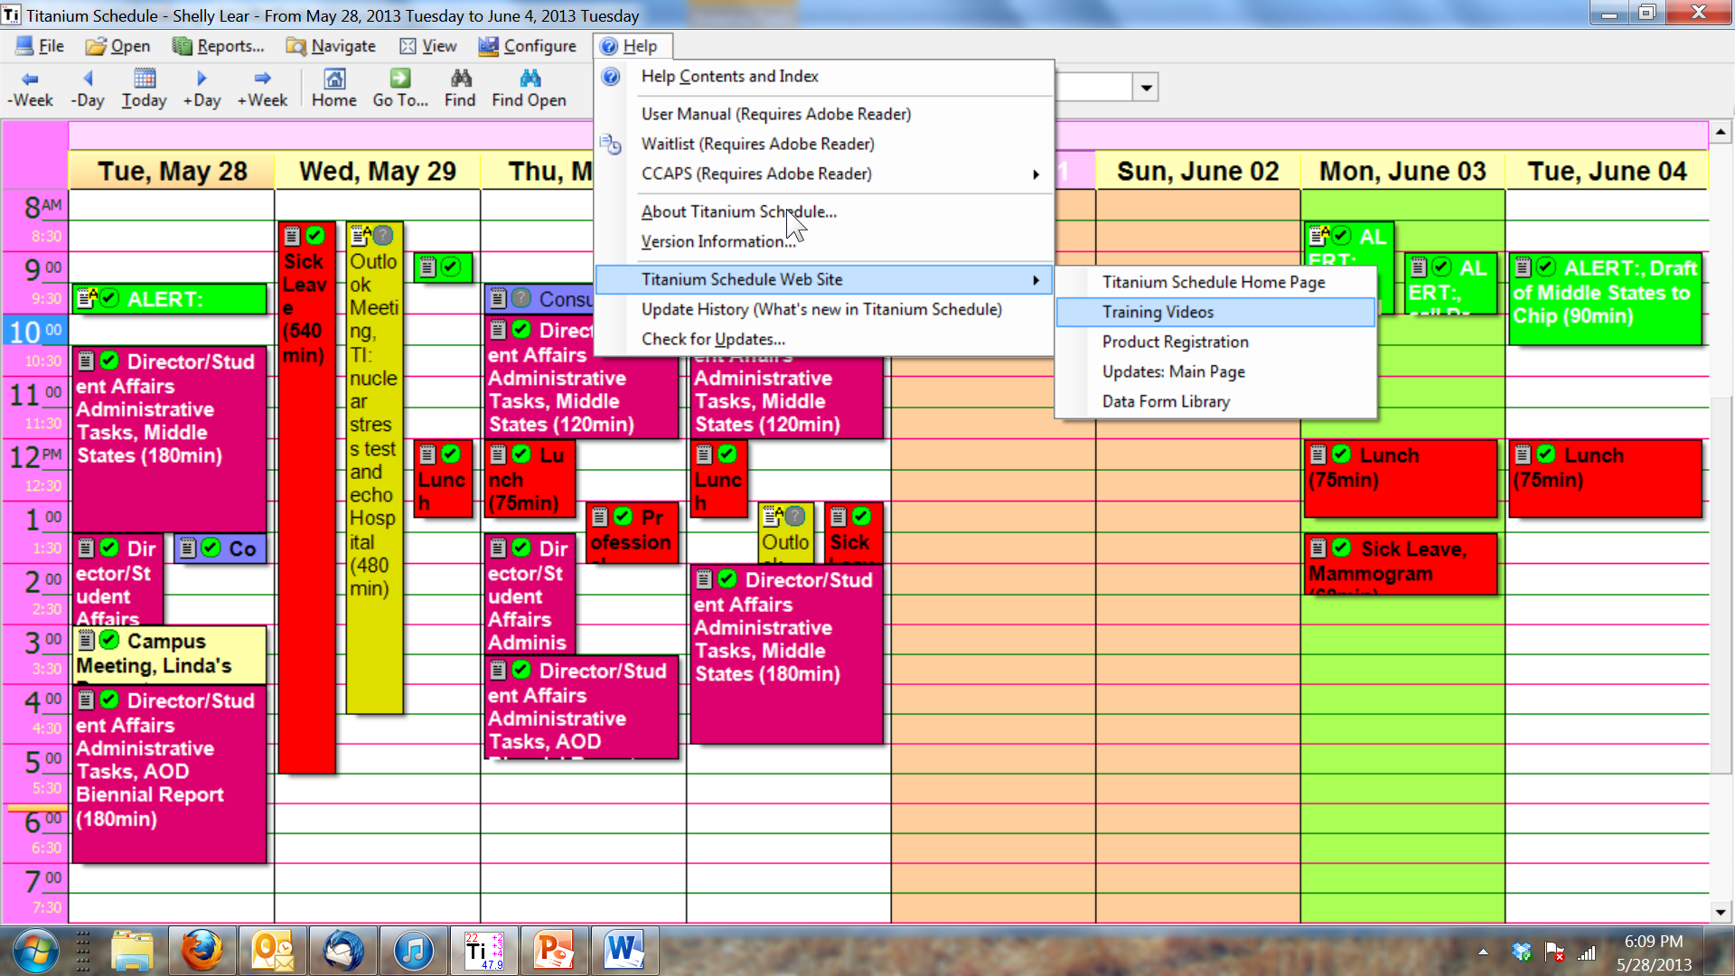
Finding Training Videos

Slide 5
The fundamentals

Slide 6
Think About Your Set Up First
  How you set up your system will determine how helpful it will be when you’re trying to get information later
    The Universal Truth of “GIGO”
  You can’t count it later if you’re not asking about it or inputting it now

Slide 7
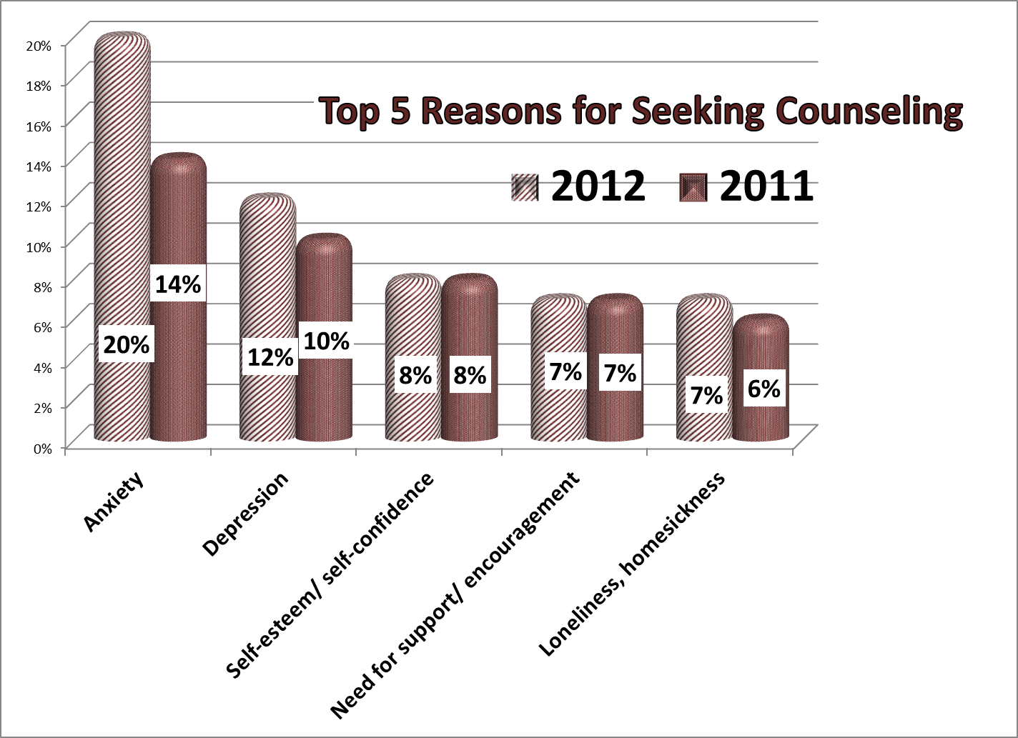
No question, no graph

Slide 8
Exploration, Aka
“How I Spent My Summer 2008”
Before you change anything, see what’s already built in:
  Time up front learning what the reports already do and what they can’t do will be well spent
  What do they tell you? Where do they draw from?
  Are there any variations you can run?
  Figure out what data isn’t there that you’d like to have; or ask whether there’s a way to get it. Do you need a data form?

Slide 9
Where Reports Get Their Data:
Building Blocks
Appointment counts
  From individual and group sessions – kept, no show, canceled
  Outreach
  Other
Note types and counts
Data Forms you create or import
  Titanium 10 – import and export
  Data form library through Titanium Help menu
Mixing and matching through appointment counts, note types and data forms as needed

Slide 10
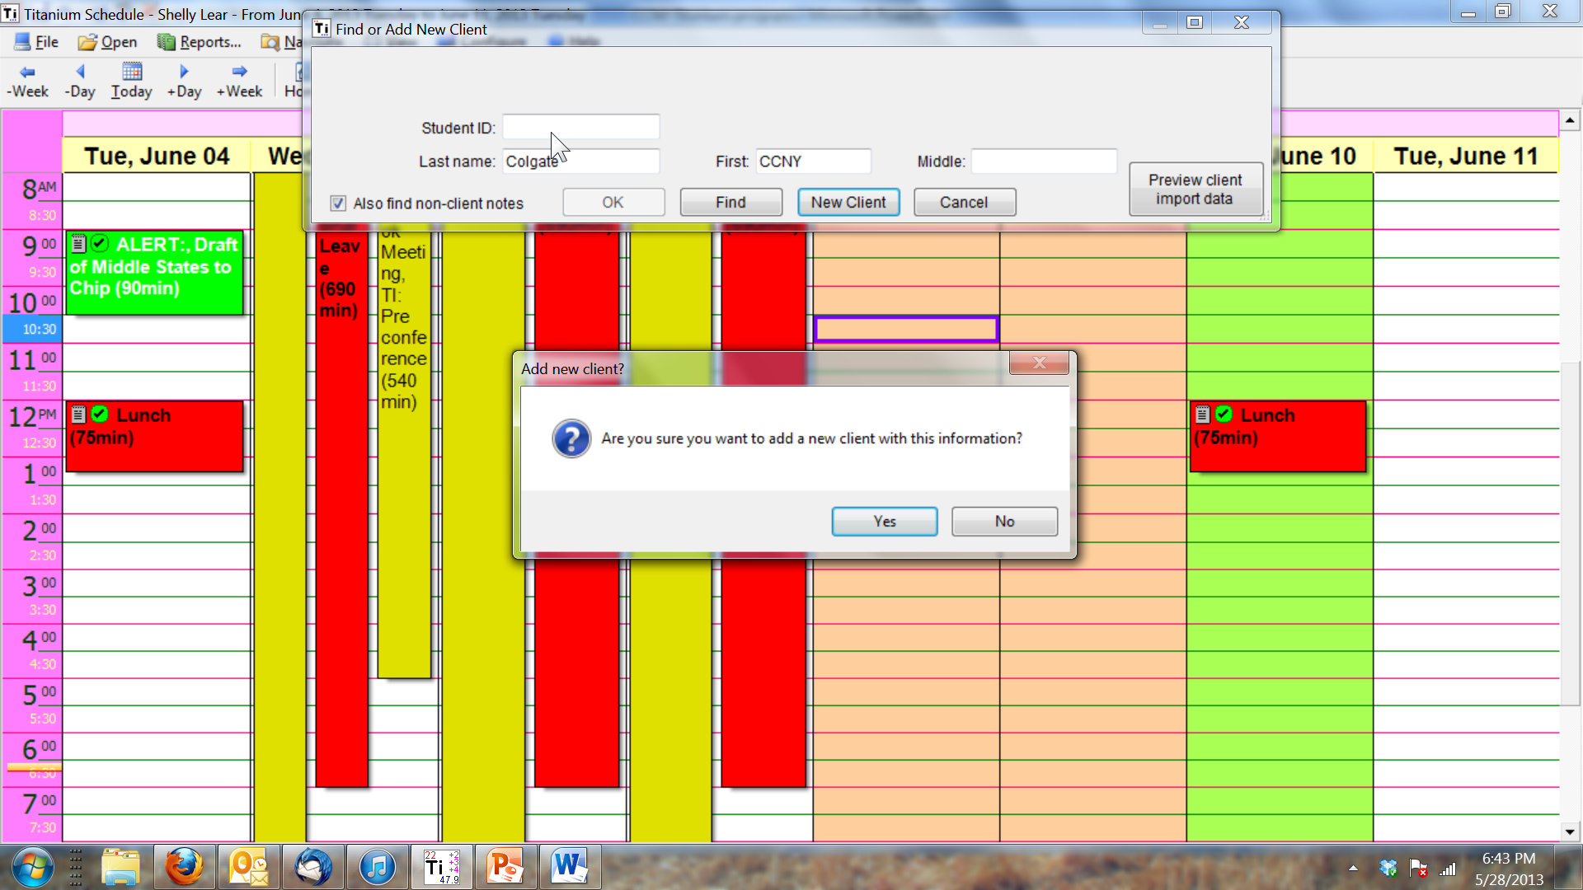
Where the data comes from
Notes:
Client vs. nonclient notes; individual type of appt vs. other type of appt for a consultation

Slide 11
Where reports get their data, continued
Appointment counts
  From individual and group sessions
    Anything where a client is present (phone or otherwise)
    Easy way to add up your clinical time
  Outreach
    Anything coded as other and set up for outreach categories
    Can set up consultations here or as just an “other” appointment
    Easy way to count your service to the campus and various constituencies
  Other
    Hours spent at particular activities that are important to your counts – what do you want to brag/complain about?
      Case management without the client: phone calls, leaving messages, etc.
      Administrative/assessment work for division
      Particular populations you’re trying to target this year
      Constituencies served – e.g., parent phone calls

Slide 12
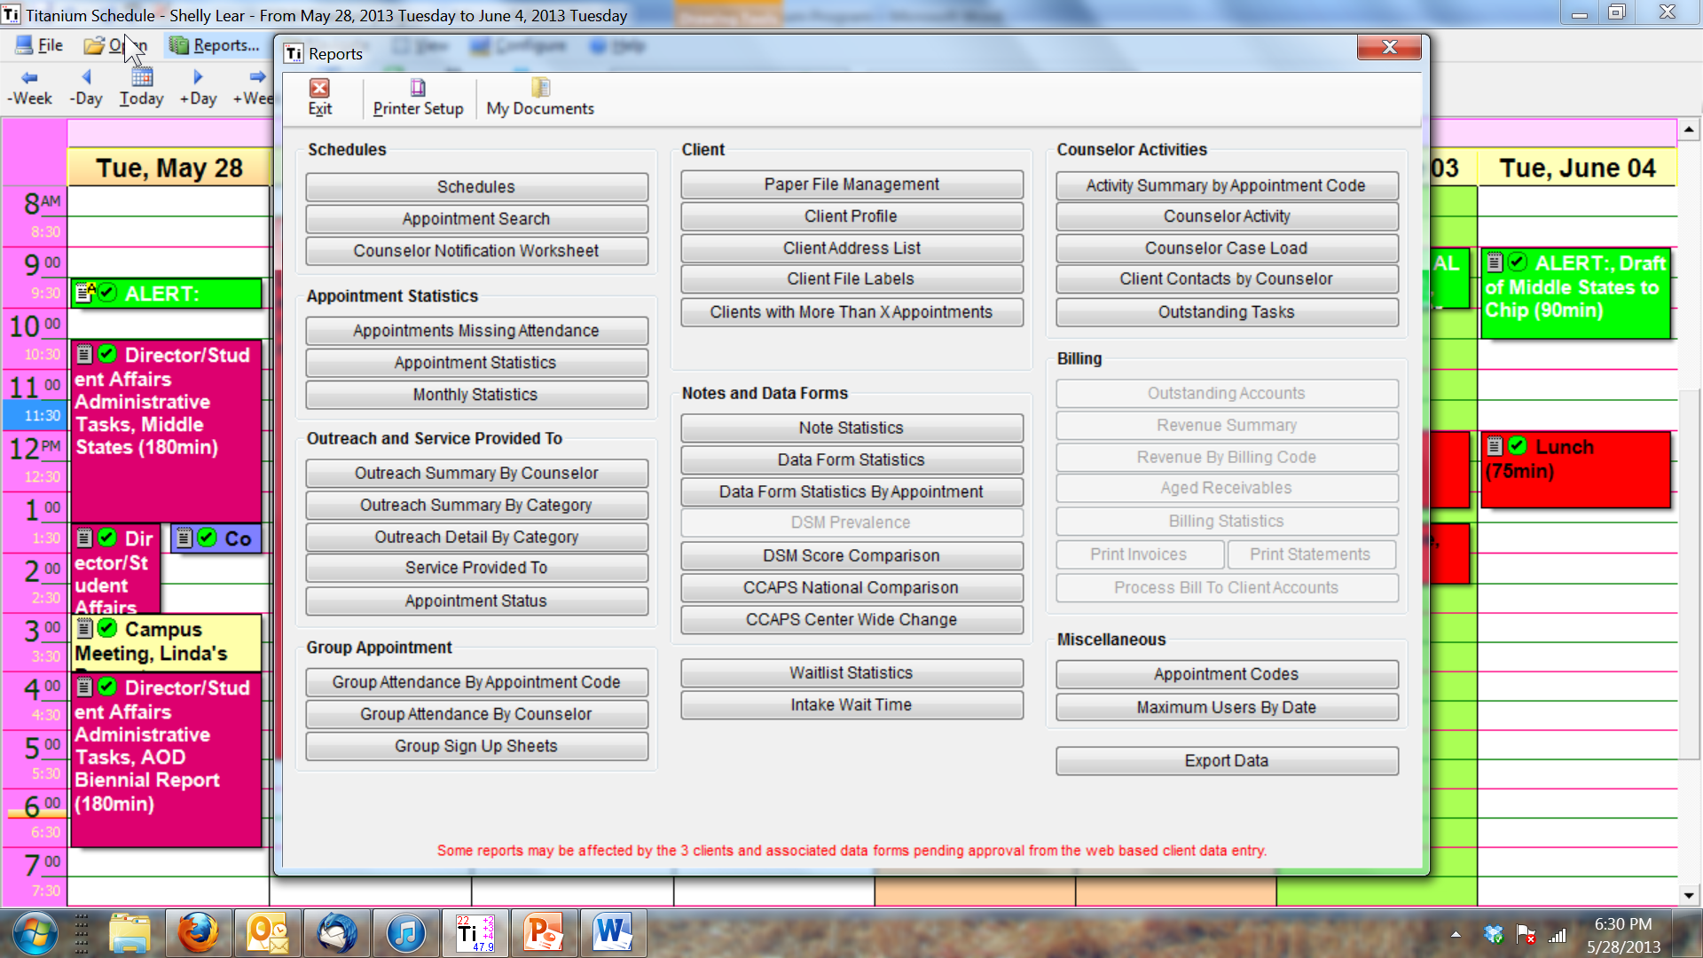
Monthly Appointment Statistics Report

Slide 13
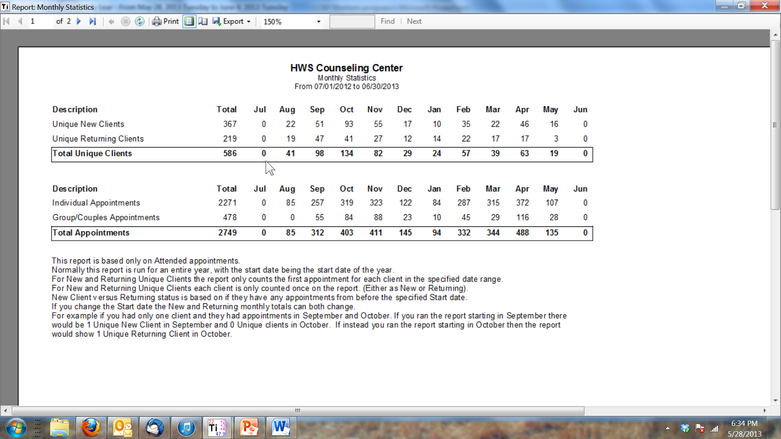
What you get

Slide 14
How to get the most out of your reports
Appointment Types
  Ways to count how your time is used
  What has to be counted, groups of appointment types
    Clinical v AOD v total
  Reports: no-show/cancellation rates; average # appointments per students; time to first visit (wait time);
Note Types
  How to standardize your case notes, your consultation notes, etc.
  Reports: anything where a particular note type indicates something you’re interested in counting separately – e.g., terminations, or intakes or crisis notes ONLY
  Nonclient notes – why you might want them
Data Forms
  Ways to count things that aren’t counted elsewhere
  Way to count things you’re really interested in
  Ways to make documentation of some things easier and faster
  Reports: anything that’s in a data form except a large text box answer can be found, counted, averaged, etc. and/or exported to a spreadsheet

Slide 15
Data form reports
Simple counts and percentages
Cross tabs types of reports for particular student identifiers or questions on any data form, e.g. the CCMH SDS (client information form)
Exporting data for Excel or SPSS or other software
  With identifying information
  Without identifying information

Slide 16
Guiding principles

Slide 17
The Titanium Schedule
“Serenity Prayer Decision-Making Tree”
Things you can change
  How things look
  Web input for students
  Data forms for staff or student use
  CCMH forms – using part, all or none*
  Appointment types
  Note types
  User schedules and groups (e.g. scheduling the group room)
  Deciding what staff/students have to fill out/answer, and what is optional
Things you can’t change
  Built in reports
  Built in categories (for appointments individual, group, other)
  Things that don’t show up in your system configuration screen/tabs
Wisdom
  Creative ideas from others
*IF YOU DON’T ALREADY BELONG TO CCMH, TALK TO ME ABOUT BECOMING A MEMBER!!!!

Slide 18
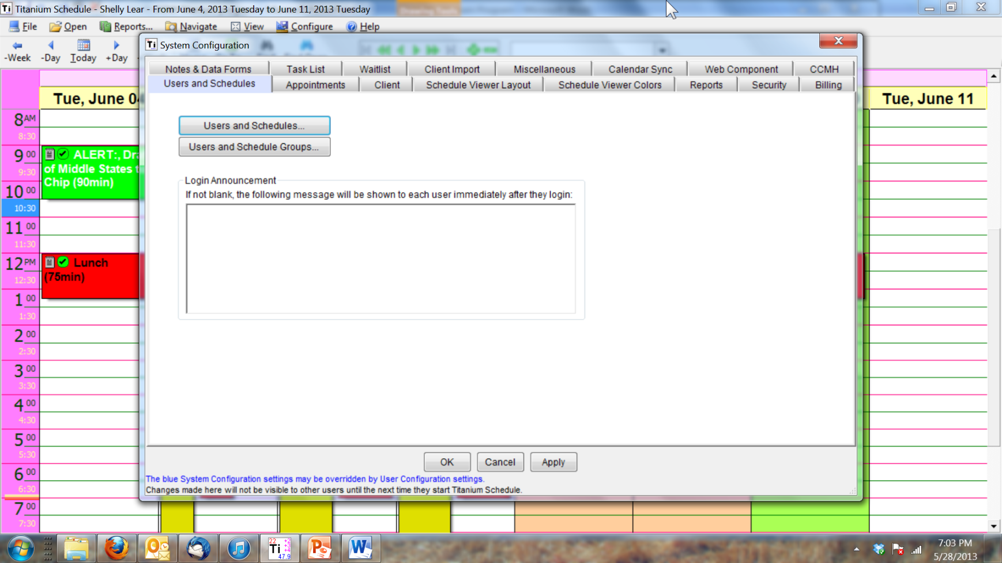
Things you can change

Slide 19
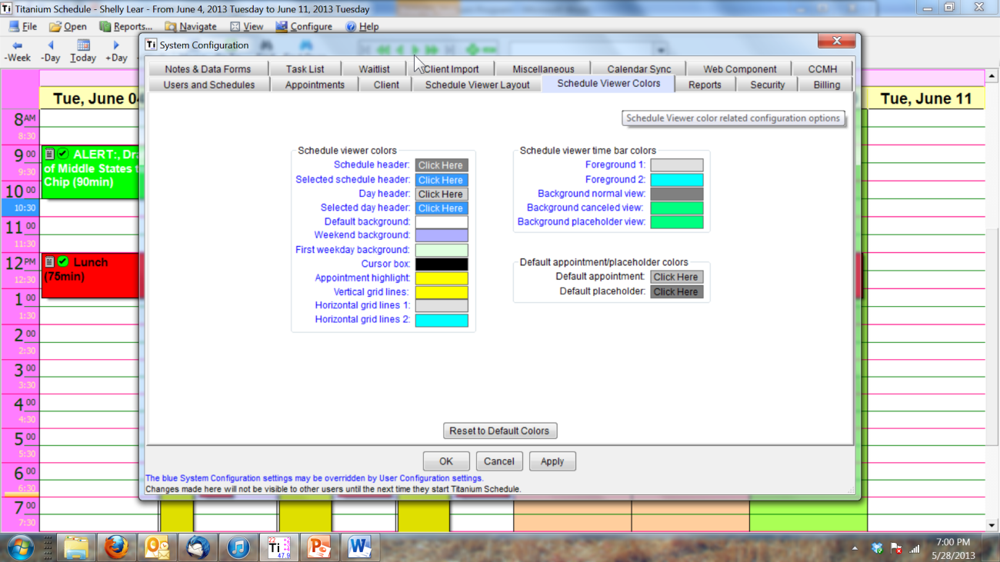
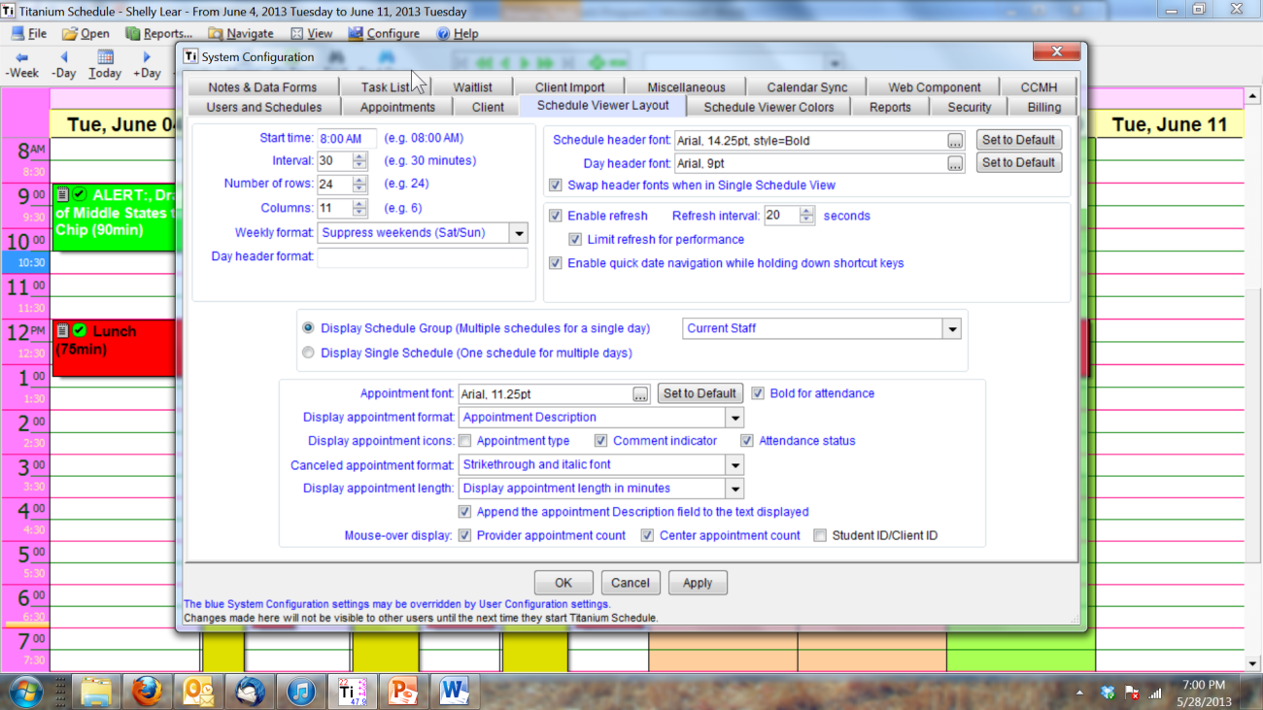
  How things look

Slide 20
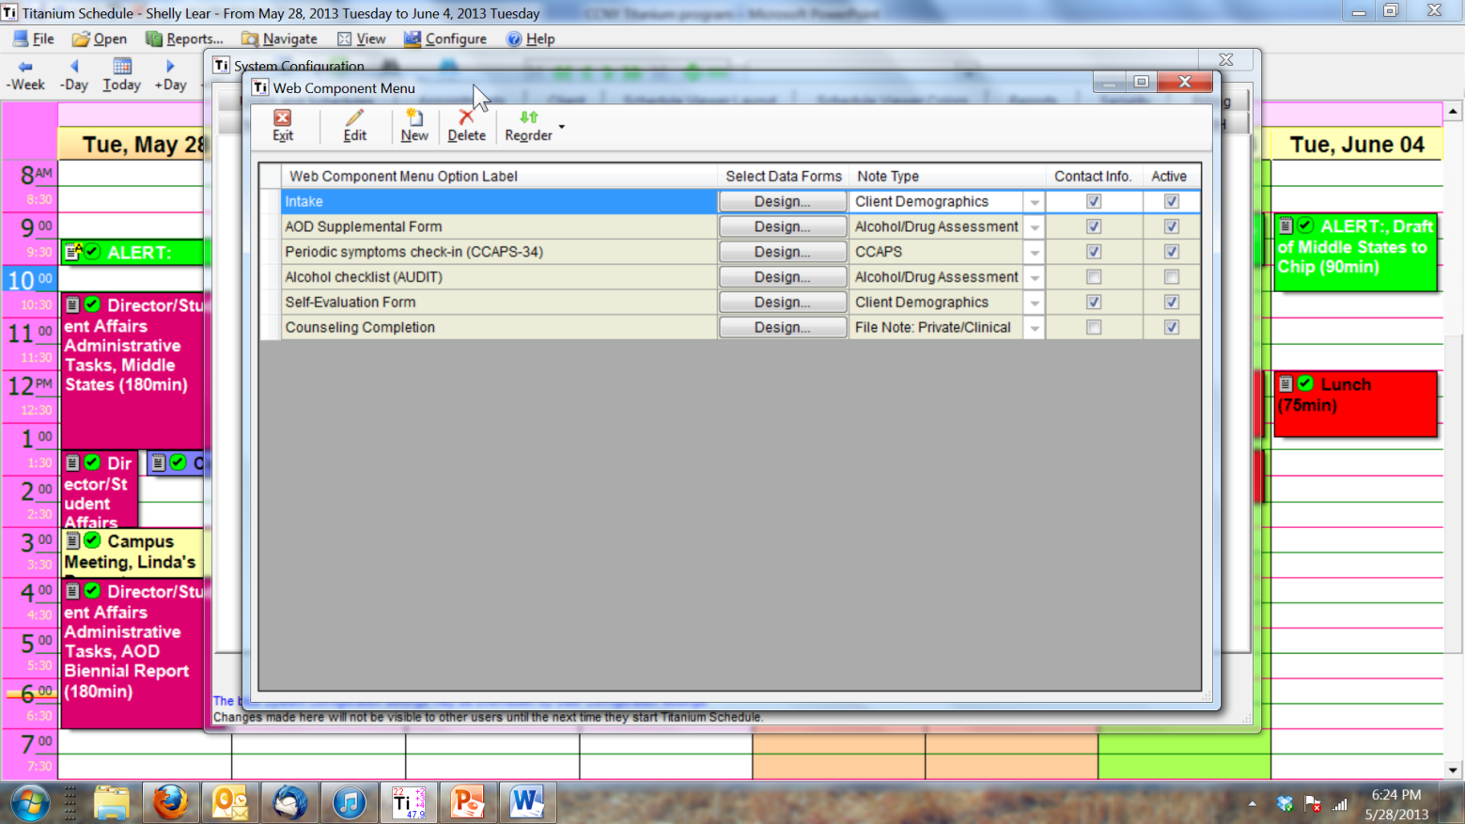
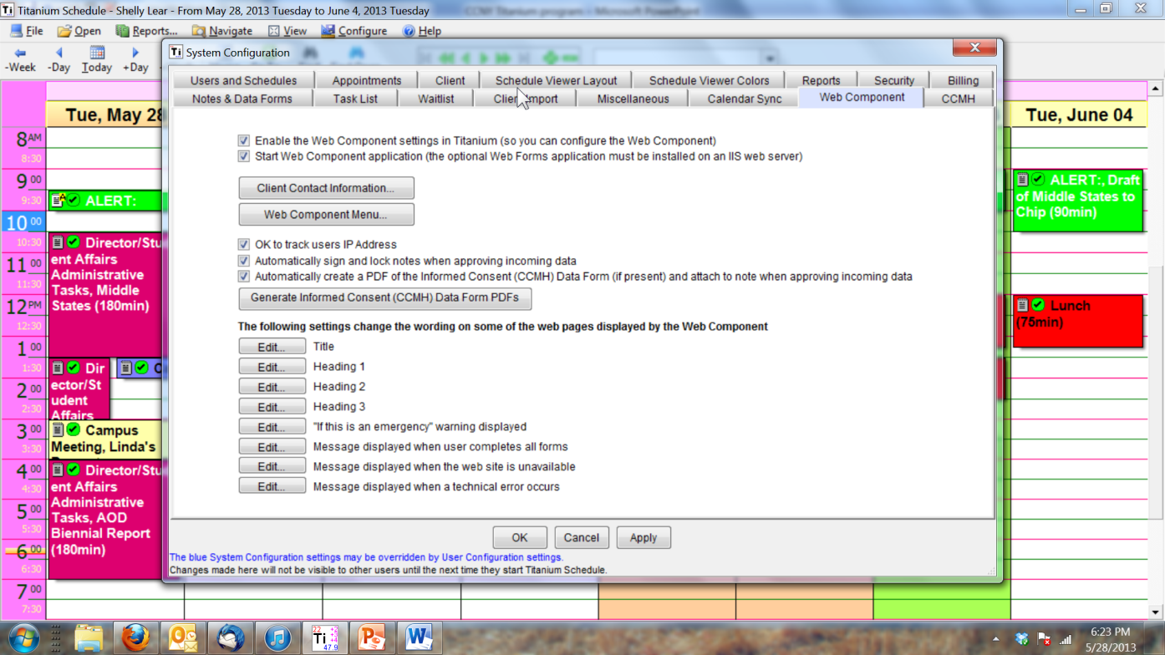
  Web input for students

Slide 21
Data forms
What paper forms are/were you using?
CCMH data collection versus your own Center’s needs - e.g., tailoring the intake data
  If this is why you haven’t joined, there’s good news
What things are you hoping to count easily?
  How would you like to count it?
    Each time it occurs
    By groups of categories, like in surveys (e.g., est. # sessions)
    Integer or other
Is there an easier way to write a report than using an edited narrative template?
  MSE via data form or via template

Slide 22
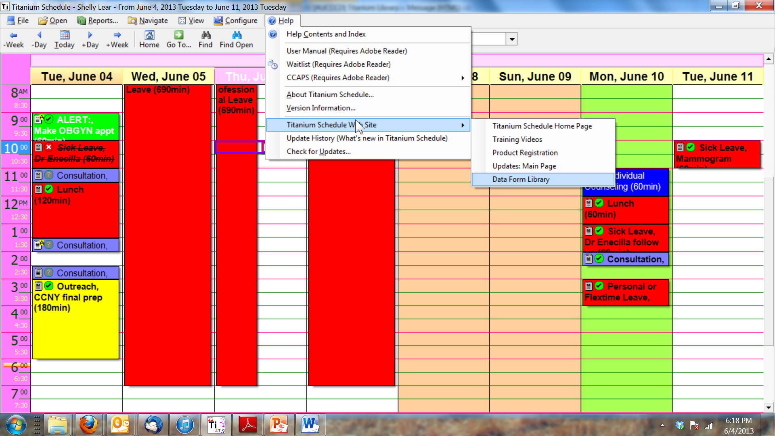

Slide 23
Tips and Questions

Slide 24
Tips from Others
Make everything an appointment and not a placeholder if you need to be able to count it later
If student web data “disappears” after approving incoming data, look for duplicate clients
Checking for releases easily in a paperless system
“flagged” and non-flagged appointments
Two favorite functions: client list and task manager for keeping your life simple
Sending confidential messages for another counselor or leaving phone messages confidentially
Time saver tips from Michelle Cooper at Western Carolina U – staff manual

Slide 25
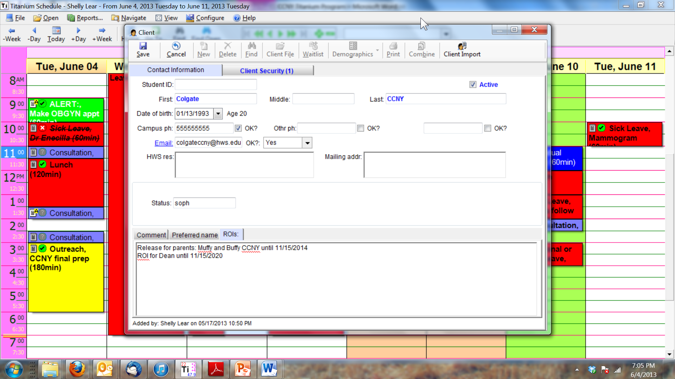

Slide 26
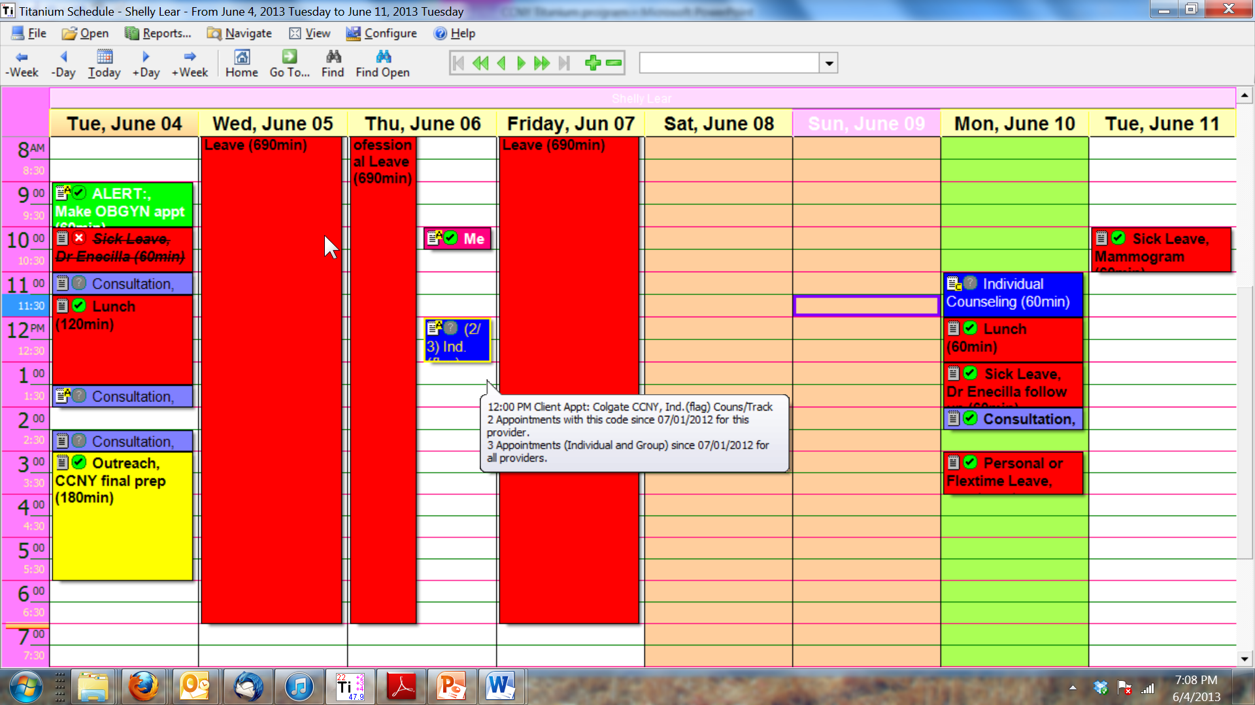

Slide 27
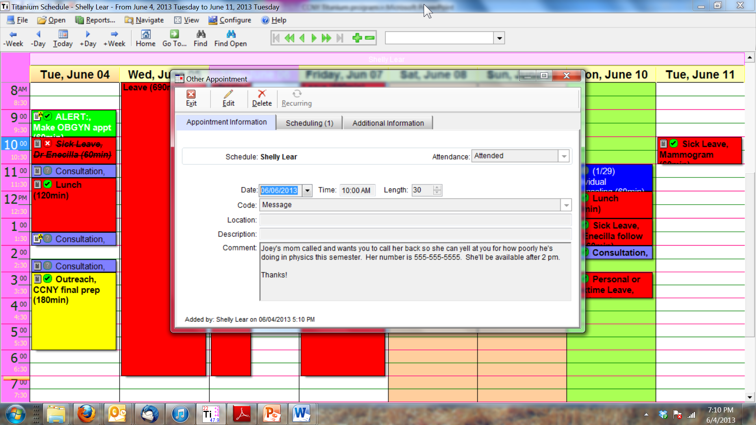

Slide 28
Tips for Titanium
How to make discharge notes show up in your task list
  Add an appointment type called discharge for individual and group
  Make completing a note mandatory
  Make the last appointment discharge ahead of time or after the fact
Color coding placeholders and appointments for ease of scheduling at a glance
Behavioral team assessments via nonclient notes
Using the “right click” menu for shortcuts
Using titanium at follow up and discharge to get a CCAPS associated with a name, but a satisfaction survey that’s anonymous, all at the same time.

Slide 29
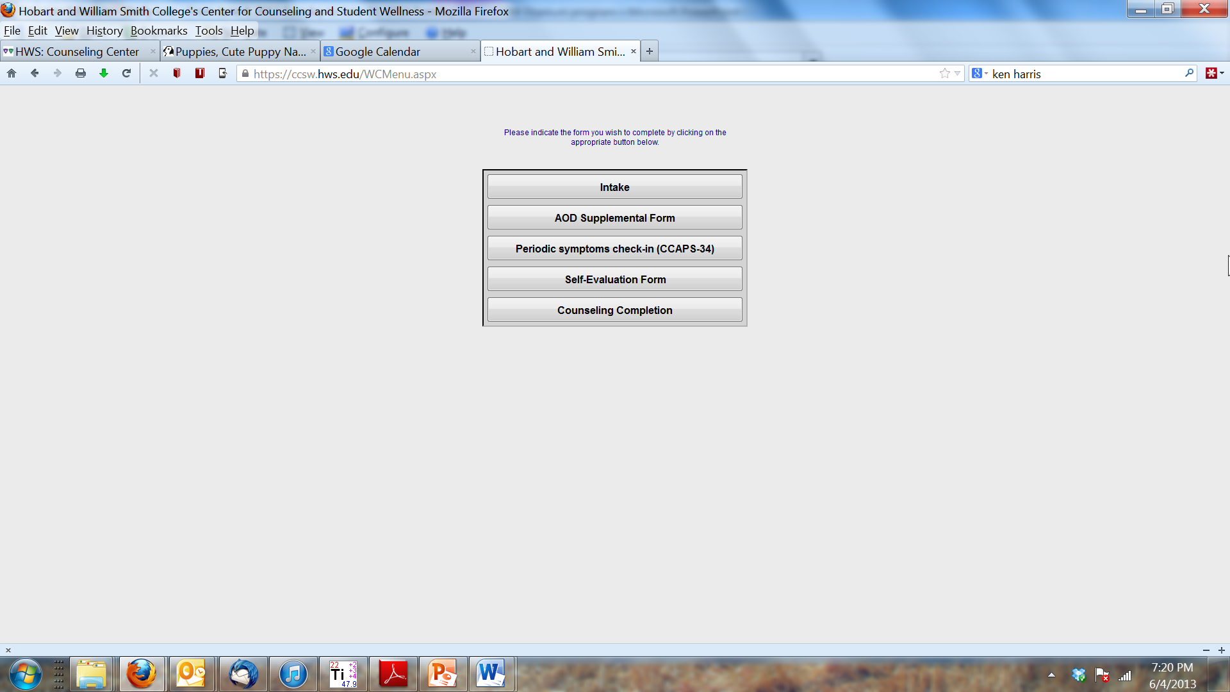

Slide 30
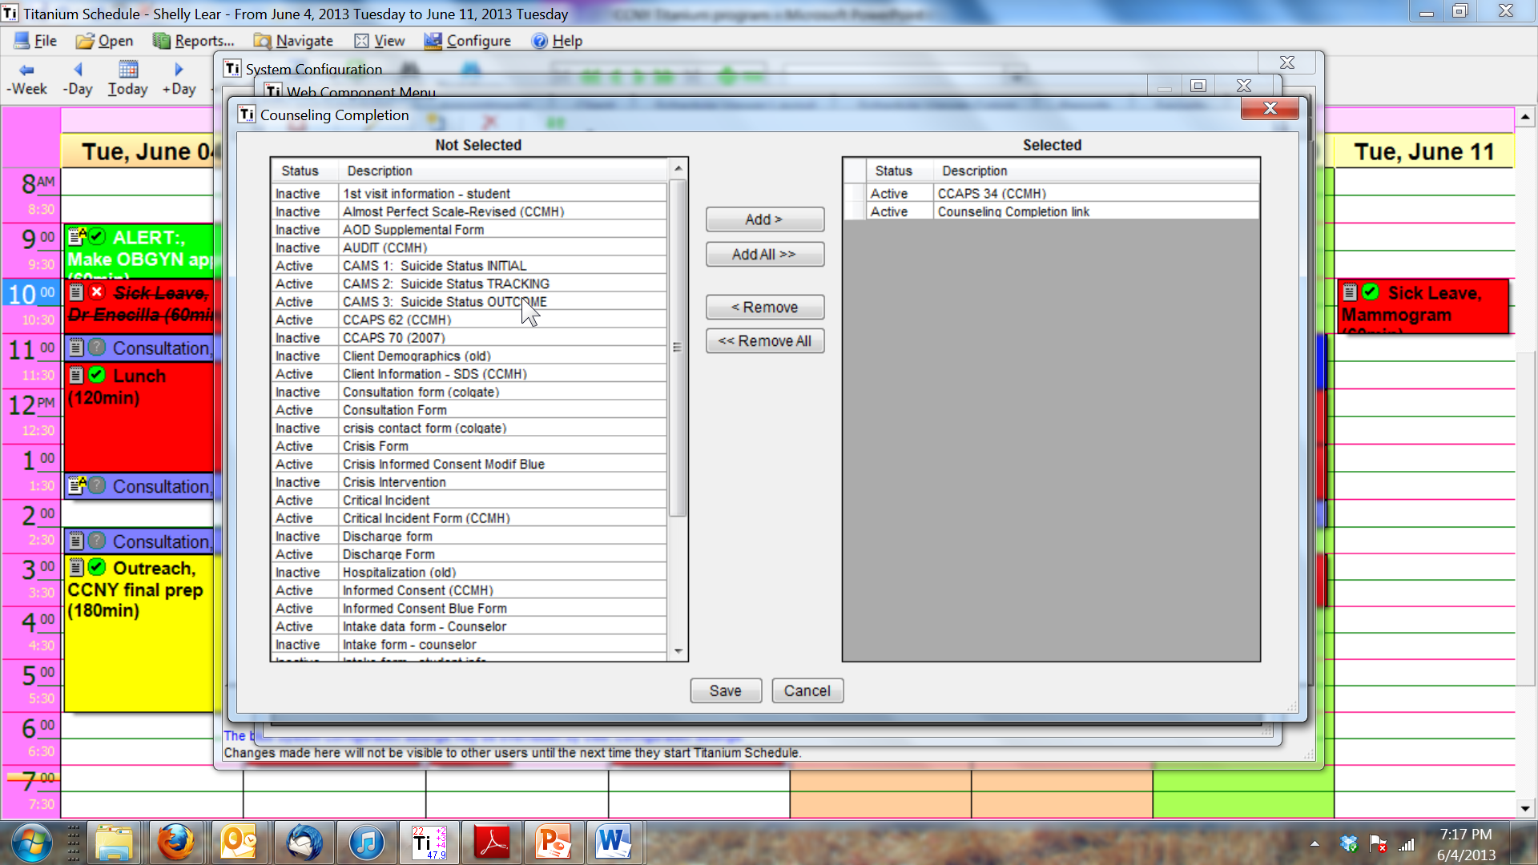

Slide 31
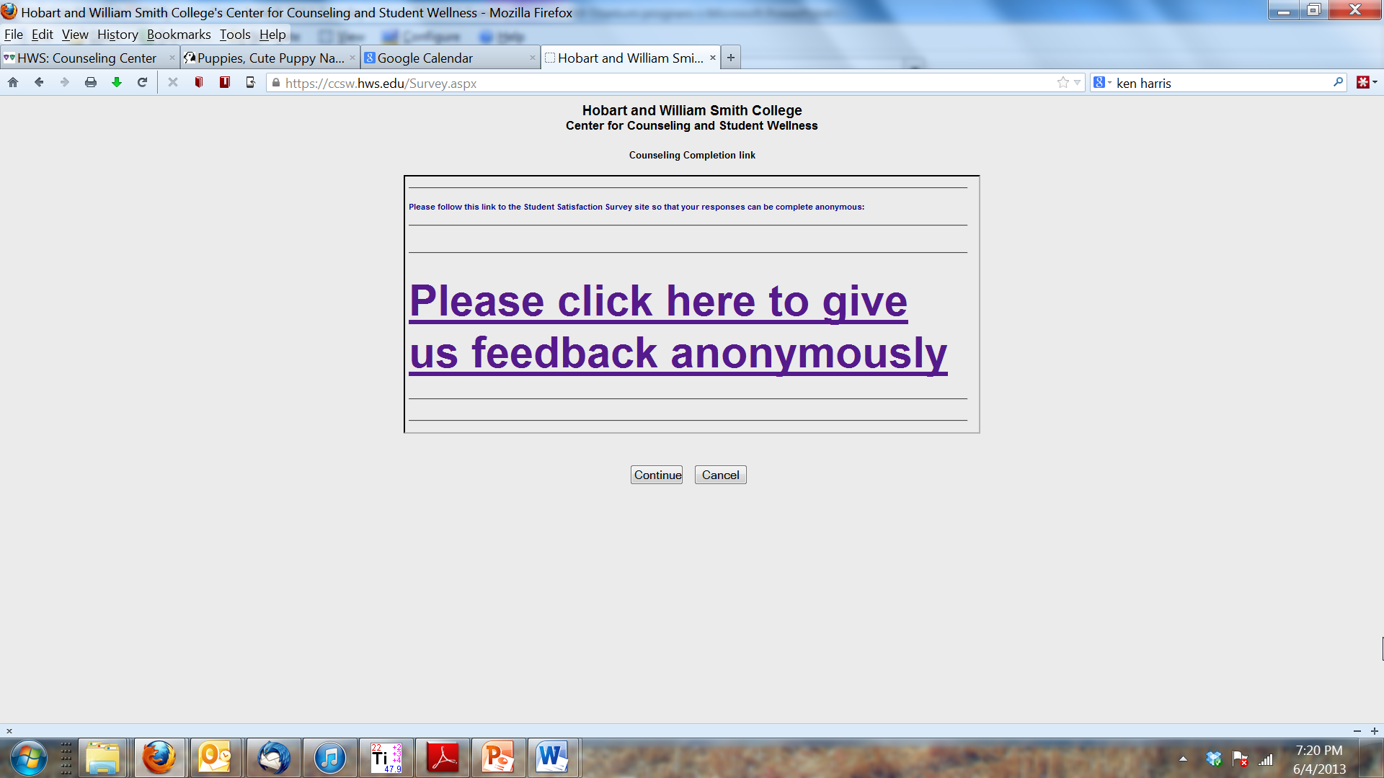

Slide 32
Questions from Others
When do you want to use a data form and when a note template that you build ahead of time?
Qualitative data – text boxes, long and short versions
Taking students off your client list at the end of the year or after they graduate
Using outreach detail categories instead of appointment counts
Reporting on subgroups of students such as college of education, transfers, etc. – exporting data or crosstabs
Calendar synching?
Legal questions about Titanium as a legal record; is everything in it including appointment counts, the legal record?

Slide 33
Other things you’d like to know?

Slide 34
If you’re trying to invent a way to do something
How would you gather the information without Titanium?
Is there a way to export the info from Titanium and look at it with Excel or SPSS?
Can you write a macro/query/formula that will give you the same info each time so you can compare?
Building blocks. Is there a note type, appointment type, appointment group, user/schedule, user group or some other building block that will help?

Slide 35
RESOURCES
Titanium Listserv
  Titanium Schedule L-TITANIUM@lists.psu.edu
Titanium Help/Support menus
Data Form Library
Lear@HWS.edu

