Slide 1
“A time to mourn…” Exploring the mystery of grief
Michael Herzbrun
St. John Fisher College

Slide 2
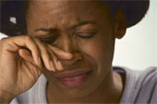
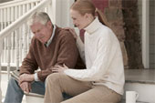
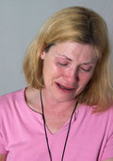
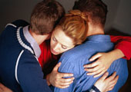
Faces of grief

Slide 3
College students?
93% (male and female) report that they have been spurned by someone whom they have passionately loved.
(Baumeister, Wotman, & Stillwell, 1993)

Slide 4
Grief on the campus (disenfranchised? often not “finite”)
Loss of family… (separation anxiety)
Loss of place… (home ~ country)
Loss of partner… (dating… 93% spurned)
Loss of identity (e.g., as athlete, good student)
Loss of child (abortion, adoption)
Loss of health (std; other illnesses)
Loss of family member/friend (death, divorce, prison, mental illness)
Loss of “parent I never had…”
Loss of trust… belief in meaningful, predictable world

Slide 5
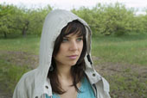
“Most, if not all, people never totally resolve their grief .”
Ziskook, S. & DeVaul R. (1985). Unresolved Grief. American Journal of Psychoanalysis, 45, 370-379.

Slide 6
Workshop agenda:
Personal statements
Models of grief
fMRI studies
Clinical interventions
Future?

Slide 7
“I’ll never get over losing you” (Randy Neman)
http://www.nonesuch.com/media/videos/randy-newman-the-unforgettable-inspiration-behind-losing-you

Slide 8
” These are definitely movies I love to watch over and over. I never can brace myself enough to stop myself from crying. No matter how many times I have seen the movie, I still end up feeling the tears roll down my face! Believe me these are well worth the rental time…”
http://www99.epinions.com/content_1316593796

Slide 9
“How does it work?” (W. Goldstein, 2009)
The “homeostasis” model
The “stage” model
The “evolutionary” model
The “reconstruction” model
The “attachment” model
The “neurological” model

Slide 10
Grief is natural and healing
The ego, confronted as it were with the question whether it shall share this fate [of the lost object], is persuaded by the sum of the narcissistic satisfactions it derives from being alive to sever its attachment to the object that has been abolished (Freud, 1917, “Mourning and Melancholia,” p. 255).

Slide 11
Grief is psychiatric distress (Lindemann, “Symptomatology…,” 1944)
Somatic distress +
Psychiatric distress
Hallucinations
Guilt
Hostility
Restlessness
Assumed traits of deceased (?)

Slide 12
Complicated Grief Disorder (Dillen, et al., 2008)
Normal
Complicated
Yearning
Sometimes misses deceased
Painful to recall memories
Hiding tears
Cannot avoid thinking about deceased
Need to cry at times
Yearning
Intrusive thoughts
Severe distress
Feelings of emptiness
Extreme bitterness
Numbness
Lack of trust
Life is empty, meaningless

Slide 13
Depression or (just) “Complicated Grief”?
 |  | Depression | Grief
Nortriptyline | Reynolds, et al (1999)
< ACC & DL-PFC | Najib, et al (2004)
> Nucleus accumbens | O’Connor, et al (2008)
Yearning | Prigerson, et al (1996)
Dopamine | Fisher, et al (2005)
Self-dislike (Beck II) | Prigerson, et al (1995)

Slide 14
Depression v Grief (Hogan, Worden & Schmidt, 2003-4)
Depression Grief
Factor analysis: 45% shared variance

Slide 15
“Prolonged Grief Disorder”: DSM-V? (Prigerson, Vanderwerker, Maciejewski, 2008)
“Yearning” + 5 symptoms after 6 months:
Avoidance of reminders
Disbelief or trouble accepting the death
Perception that life is meaningless or empty without the deceased
Feelings of bitterness or anger
Numbness
Feeling stunned, dazed, or shocked
Feeling that part of oneself has died
Difficulty trusting others
Difficulty “moving on”

Slide 16
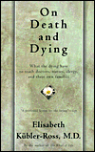
On Death and Dying (Kübler-Ross, 1969)
Denial
Anger
Bargaining
Depression
Acceptance

Slide 17
Questionnaire items Stage theory of Grief (Maciejewski, et al, JAMA, 2007)
I feel I cannot accept…
I feel myself longing…
I can’t help feeling angry…
I feel disbelief…
I feel that life is empty

Slide 18
Stage theory of Grief (Maciejewski, et al, JAMA, 2007)

Slide 19
Stage theory of Grief (Maciejewski, et al, JAMA, 2007)

Slide 20
“Analytical rumination” hypothesis (Andrews and Thompson, 2009)

Slide 21
Does grief facilitate detachment or reunion? (Freed and Mann, 2007)
Loss grief pain reunion
Loss grief despair detachment

Slide 22
Meaning-making: reconstructing the self (Gillies and Neimeyer, 2006)

Slide 23
Stages of reaction to separation (John Bowlby, ,1980)
Childhood stages (1960)
Protest
Despair
Detachment
Adult Stages (1980)
Numbing
Yearning/searching
Disorganization/despair
Reorganization

Slide 24
Attachment
The prolonged deprivation of a young child of maternal care may have grave and far reaching effects on his character and so on the whole of his future life. (Bowlby, Care and the growth of love, 1953)

Slide 25
Attachment and Grief (Johnson, et al., 2007)
High
Parental
Control
Low
p < 0.0001
Complicated Grief
Low High

Slide 26
Attachment and Grief (Vanderwerker, et al., 2006)
High
Childhood
Separation
Anxiety
Low
p < 0.05
Complicated Grief
Low High

Slide 27
Attachment and Grief (Silverman, et al., 2001)
High
Parental
abuse/
Death of
parent
Low
parental abuse: p < 0.0001 death of parent: p < .01
Traumatic Grief
Low High

Slide 28
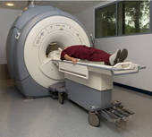
“fMRI”: functional Magnetic Resonance Imaging
Image: blood flow to local blood vessels during neural brain activity
marker: change in level of deoxyhemoglobin (purple-blue, iron-containing hemoglobin without oxygen)
BOLD (blood-oxygenation dependent level): image intensity that varies with the deoxyhemoglobin content in blood
Functional connectivity: the assumed relationship between remote brain regions activated during a mental event

Slide 29
Brain imaging and grief (Gundel, et al., 2003) (O’Connor, 2005)
fMRI:
60 Photos (15 x 4):
~ Deceased / Stranger
~ Grief word / Neutral word
Posterior Cingulate Cortex, ACC, Insula

Slide 30
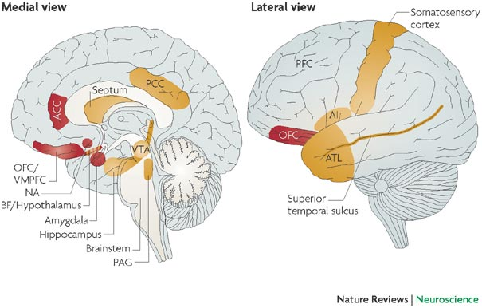
ACC, PCC, Amygdala, PAG

Slide 31
Insula (brown) ACC (yellow)

Slide 32
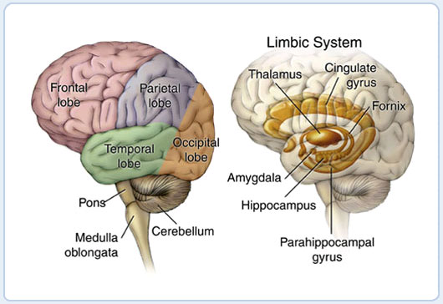
Limbic System
Pons Cerebellum Amygdala

Slide 33
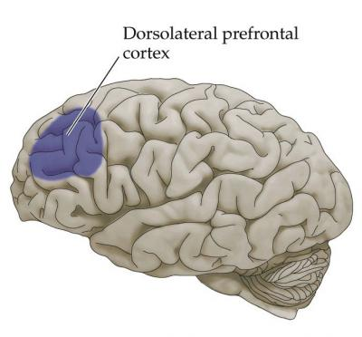

Slide 34
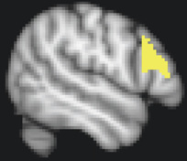
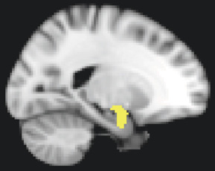
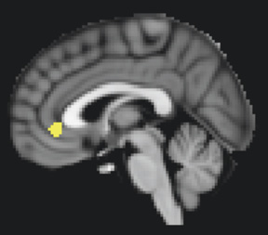
Functional connectivity in grief (Freed et al., 2009)
DL-PFC Amygdala rACC
DLPFC mediates amygdala distress
(attention to grief words)
rACC mediates amygdala distress
(emotion in grief memories)

Slide 35
Social exclusion activates PAG and Dorsal ACC (Panksepp, 1998) (Eisenberger, et al., 2003)
Hi
Feeling
distressed
Low
Social Acceptance

Slide 36
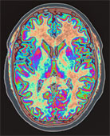
Periaqueductal Gray (PAG)
Section through superior colliculus showing path of oculomotor nerve (midbrain)

Slide 37
A reward factor with grief? (O’Connor, et al., 2008)
High
Nucl.
Accumb.
activity
Low
Grief

Slide 38
Reward Pathways
Cerebral cortex -> VTA ->
dopmine -> nucelus accumbens

Slide 39
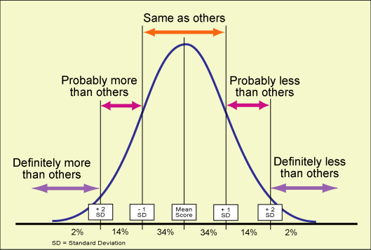
“Normalizing”
“This is probably not depression; you are grieving!”

Slide 40
“…working through…”

Slide 41
Journaling: bereaved HIV partners (Pennebaker et al., 1997)
High
Low
low adjustment high
Cognitive change
Emotional expression

Slide 42
Existential reconstruction: Frankl’s (1962) “tragic optimism” (Gillies and Neimeyer, 2006; Stark, 1994; Edmonds and Hooker, 1992)

Slide 43
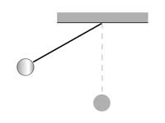
Dual Process Model of Grieving (Stroebe & Schut, 1999)
“Oscillation”
Confrontation Avoidance

Slide 44
Other approaches ???
Medication
Dopamine
Nortriptyline
Meditation
Yoga
Relaxation training

Slide 45
Honoring the grief…
Lasting connections

Slide 46
Tears of sadness/joy?
http://www.youtube.com/watch_popup?v=hkGzqpGx1KU

Slide 47
Grief that doesn’t go away

