Slide 1
Wellness and Well-Being
Sarah F. Spiegelhoff, M.A., Ed.S., NCC
sfspiege@syr.edu

Slide 2
Wellness and Well-Being
What is wellness?
Wellness models
Wheel of Wellness & The Indivisible Self
Six Dimensions of Wellness Model
Illness/Wellness Continuum & Iceberg Model
Well-Being
Hedonic & Eudaimonic
Subjective & Psychological
Flourish-Well-being Theory

Slide 3
Wellness and Well-Being
Wellness & Well-Being in college counseling
Final thoughts, Q&A

Slide 4
What is wellness?
A way of life oriented toward optimal health and well-being in which body, mind, and spirit are integrated by the individual to live more fully within the human and natural community.
Myers, J. E., Sweeney, T. J., & Witmer, J. M. (2000)

Slide 5
Wellness Models
Wheel of Wellness
Sweeney & Witmer
Move away from physical health
Interdisciplinary: health, quality of life, longevity
Adlerian Psychology as organizing principle

Slide 6
Wellness Models
Spirituality—most important characteristic of well-being
12 spokes direct self as person responds to Adlerian life tasks of work and leisure, friendship, and love
Components of wellness are interactive

Slide 7
Wellness Models
Indivisible Self
Empirical research not supporting Wheel of Wellness→Led to creation of Indivisible Self
Statistical analyses on Wellness Evaluation Lifestyle (WEL)
Adlerian theory to create five factors

Slide 8
Wellness Models
Essential Self
Spirituality, self-care, gender identity, & cultural identity
Creative Self
Thinking, emotions, control, positive humor, & work
Coping Self
Realistic beliefs, stress management, self-worth, & leisure
Social Self
Friendship & love
Physical Self
Exercise & nutrition

Slide 9
Wellness Models
Indivisible Self both affected by and effect on surrounding world
Local context
Global context
Institutional context
Chronometrical context
Can this model be considered ecological?

Slide 10
Wellness Models
Myers & Sweeney claim—only empirical models based on counseling literature/theory
Where/Are there other similar models in existence, and what are counseling centers using?

Slide 11
Wellness Models
Hettler’s Six Dimensions of Wellness Model (SDWM)
Father of modern wellness movement
Wellness is an active process through which people become aware of, and make choices toward a more successful existence

Slide 12
Wellness Models
Criticism by Myers and Sweeney
In practical use, primarily focused on physical health
Incongruence?
6 dimensions: social, occupational, spiritual, physical, intellectual, emotional

Slide 13
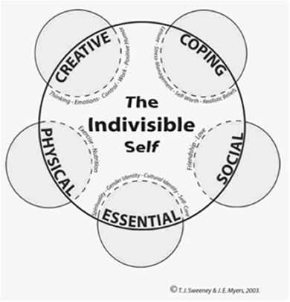
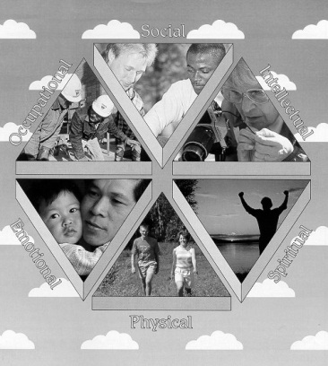
Wellness Model
Indivisible Self
Hettler’s SDWM

Slide 14
Wellness Models
Travis’ Iceberg Model
Varying degrees of wellness and illness
Wellness is not static
High wellness is: giving good care to your physical self, using your mind constructively, expressing your emotions effectively, being creatively involved with those around you, and being concerned about your physical, psychological and spiritual environments

Slide 15
Wellness Models
Travis’ Iceberg Model
Like the structure of an iceberg, wellness and illness is what is seen; whereas other facets of wellness (e.g., lifestyle, culture, spirit, motivation, etc.) must be explored below the surface

Slide 16
Wellness Models
Travis
Energy System: life is a process and an individual’s wellness is dependent upon how s/he manages her/his energy
12 dimensions of wellness: self-responsibility and love, breathing, sensing, eating, moving, feeling, thinking, playing and working, communicating, sex, finding meaning, transcending

Slide 17
Well-Being
Well-being is:
…a complex construct that concerns optimal experience and functioning.
Ryan, R. M., & Deci, E. L.

Slide 18
Well-Being
Hedonic (psychology)
Eudaimonic
Concerned with pleasure or happiness
Balance between positive and negative affect
Quest to actualize human potential
Realize one’s true nature
Focus on doing and thinking, rather than feeling

Slide 19
Well-Being
Subjective well-being (SWB)
Research conducted within hedonic tradition
3 distinct components: life satisfaction, positive affect, (absence of) negative affect
Life satisfaction—global cognitive evaluation of life
Major proponents Ed Diener and Daniel Kahneman
Hedonics as a basic building block of positive psychology (c. 2000)

Slide 20
Well-Being
Psychological well-being (PWB)
Carol Ryff—argues SWB little theoretical grounding
Striving for perfection that represents the realization of one’s true potential
Draws on mental health, clinical, and life span developmental theories
6 ideals: autonomy, personal growth, self-acceptance, purpose in life, environmental mastery, positive relations with others

Slide 21
Well-Being
Hedonic (SWB) in counseling
Client initial help seeking behavior
Heightened negative affect related to life domain or life event
Eudaimonic (PWB) in counseling
Existential concerns

Slide 22
Well-Being
Culture and well-being
Critique
PWB shaped by Western individualistic moral visions
SWB assumes individuals are well when happy
SWB refrains from claims about good life and good person
Collectivist cultures different views on well-being→family and friends over individual
Collectivist cultures more likely to use external cues

Slide 23
Well-Being
Well-Being Theory (Seligman)
Happiness is overused and meaningless → dissolve happiness into more workable terms
Happiness more than cheerful or merry
Original goal of Authentic Happiness Theory (positive psychology) → increase life satisfaction

Slide 24
Well-Being
Well-Being Theory
Topic of positive psychology → well-being
Elements of well-being: positive emotion, engagement, meaning, accomplishment, and positive relationships
No one element defines well-being, but contribute to it and can be measured through self-report (subjectively) and objectively

Slide 25
Well-Being
Flourishing as the goal of positive psychology in Well-Being Theory
To flourish an individual must have all of the core features and three of the six additional features¹
¹Huppert, F. A., & So, T. as cited in Seligman (2011)
Core features: positive emotions, engagement, interest, meaning, purpose
Additional features: self-esteem, optimism, resilience, vitality, self-determination, positive relationships

Slide 26
Wellness and Well-Being
Do college students who adhere to a wellness model have a greater sense of well-being? (Herman & Hazler, 1999)
Measurements: WEL, Memorial University of Newfoundland Scale of Happiness (MUNSH)
MUNSH measures state (affective) and trait (quality of life) aspects of well-being
Significant relationship between wellness measure and state/trait well-being

Slide 27
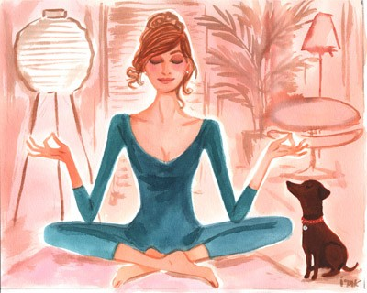
Counseling Centers
How can this critical understanding of wellness and well-being be implemented in our counseling with clients?
Further thoughts?

Slide 28
References
Christopher, J. C., (1999). Situating psychological well-being: Exploring the cultural roots of its
theory and research. Journal of Counseling & Development, 77, 141-152.
Diener, E. (2000). Subjective well-being: The science of happiness and a proposal for a national
index. American Psychologist, 55(1), 34-43. doi: 10.1037//0003-066X.55.1.34
Hattie, J. A., Myers, J. E., & Sweeney, T. J. (2004). A factor structure of wellness: Theory,
assessment, analysis, and practice. Journal of Counseling & Development, 82, 354-364.
Hermon, D. A., & Hazler, R. J. (1999). Adherence to a wellness model and perceptions of
psychological well-being. Journal of Counseling & Development, 77, 339-343.
Hettler, B. (1976). The six dimensions of wellness model. Retrieved from http://www.nationalwellness.org/pdf/SixDimensionsFactSheet.pdf.
Hettler, B. (1980). Wellness promotion on a university campus. Journal of Health Promotion
and Maintenance, 3, 77-95.
Hettler, B. (1984). Wellness: Encouraging a lifetime pursuit of excellence. Health Values, 8(4),
13-17.

Slide 29
References
Kahneman, D., Diener, E., Schwarz, N. (1999). Well-being: The foundations of hedonic
psychology. New York, NY: Russell Sage Foundation.
Myers, J. E., & Sweeney, T. J. (2004a). The indivisible self: An evidence-based model of wellness. Journal of Individual Psychology, 60(3), 234-244.
Myers, J. E., & Sweeney, T. J. (2008). Wellness counseling: The evidence base for practice.
Journal of Counseling & Development, 86, 482-493.
Myers, J. E., Sweeney, T. J., & Witmer, J. M. (2000). The wheel of wellness counseling for
wellness: A holistic model for treatment planning. Journal of Counseling & Development, 78, 251-266.
Ryan, R. M., Deci, E. L. (2001). On happiness and human potentials: A review of research on
hedonic and eudaimonic well-being. Annual Review of Psychology, 52, 141-166.
Ryff, C. D. (1989). Happiness is everything, or is it? Explorations on the meaning of psychological well- being. Journal of Personality and Social Psychology, 57(6), 1069-1081.

Slide 30
References
Seligman, M. E. P. (2011). Flourish: A visionary new understanding of happiness and well-being. New York, NY: Free Press.
Seligman, M. E. P., & Csikszentmihaly, M. (2000). Positive psychology: An introduction.
American Psychologist, 55(1), 5-14. doi:10.1037//003-066X.55.1.5
Sweeney, T. J., & Witmer, J. M. (1991). Beyond social interest: Striving toward optimum health
and wellness. Individual Psychology, 47(4), 527-540.
Travis, J. W. (1981). The Wellness Inventory (3rd Edition). Mill Valley, CA: Wellness Associates.
Travis, J. W. (1997). Wellness Workbook for Health Professionals. Mill Valley, CA: Wellness
Resource Center.
Witmer, J. M., & Sweeney, T. J. (1992). A holistic model of wellness and prevention over the
life span. Journal of Counseling & Development, 71, 140-148.

