Slide 1

Doing More With Less:
Evolving Evaluation and
Intervention Protocols
Beth Cholette, Ph.D.
Clinical Director for Counseling Services
Melinda DuBois, LMSW
Administrative Director of Student Health & Counseling
SUNY Geneseo

Slide 2
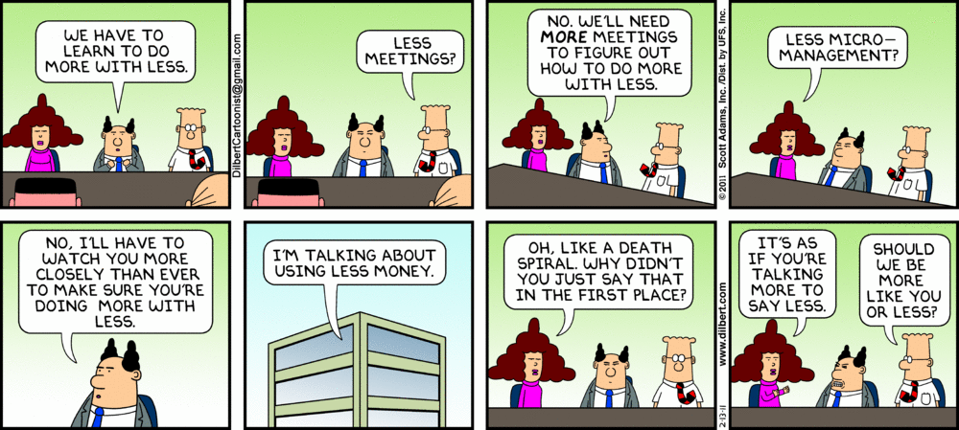

Slide 3
History: The Necessity of Evolution
Counseling Services Pre-2008:
Geneseo ≈ 5000 undergraduates
3 full-time psychologists plus Director of Health & Counseling providing additional Clinical hours (approximately .3 FTE)
Counselor to Student Ratio ≈ 1 to 1515 (slightly above IACS recommendation of 1 to 1500)

Slide 4
History: The Necessity of Evolution, cont.
Years of Transition: 2008-2010
Director departed in June 2008, leaving 3 FTE in Counseling Services only; new Counselor to Student Ratio ≈ 1 to 1600
Temp Counselor hired for 2008-09 and part of 2009-10 provided some assistance
Despite this, wait time for initial Intake appointments during Fall 2009 was more than 3 weeks at times

Slide 5
Deciding to Make a Change
Additional Contributing Factors:
Began limited use of triage-type appointments to manage increased demands for services during 2008-09
Hired new Administrative Director of Health & Counseling (Melinda), August 2009
Collected information from other colleges on using triage-based assessment models throughout 2009-10

Slide 6
Deciding to Make a Change, cont.
Our students report significant distress! Based on the 2011 NCHA II, 1,258 Geneseo student respondents reported the following within the previous 12-month period:
91% felt overwhelmed by all they had to do
34% felt so depressed that it was difficult to function
48% felt that things were hopeless
8.5% seriously considered suicide
1.5% attempted suicide
6.5% engaged in self-harm behaviors

Slide 7
Goals of Change
Decrease wait times for initial appointments
Use first contacts with students more efficiently given that a high number of students seen for only one appointment (based on prior utilization rates)
Offer an alternate tract for students needing only brief intervention
Re-commit to our short-term treatment model and refer off-campus when appropriate
Build in more psycho-educational opportunities

Slide 8
The Change: The MEETing Appointment
MEETing = Meet, Evaluate, Educate, Treat
All first-time appointments are now MEETings rather than Intakes
How MEETings differ from Intakes:
Students complete less paperwork
Overall appointment time is shorter
Focus of the appointment is on problem-solving and specific disposition
Counselor writes only brief report

Slide 9
The Change: The MEETing Appointment, cont.
Possible outcomes of MEETing appointment (may be more than one):
Single-Session Contact
Refer to Psycho-Educational Resources
Refer for Brief Contracted Counseling
Refer to Intake
Refer for Psychiatric Treatment
Refer for Off-Campus Treatment

Slide 10
The Change: Psycho-Educational Resources
Stressbusters Program
Weekly workshop series focused on different skills-based topics
Offered Fridays, 3-4 p.m.
During Fall, programs offered weekly from mid-September through end of semester
In Spring, offered two evening programs in February and then weekly programs on Fridays starting after Spring Break

Slide 11
Evaluating the New Model
What Has Worked
Stressbusters program provides a great option for students mainly needing coping skills
Students definitely being seen more quickly for initial appointments, usually one week or less (input)
Students report lower waiting times for initial appointments and increased satisfaction with initial appointment wait times as compared to previous academic year
What Needs Work
Stressbusters sessions not always well-attended (varied between approximately 0-13 students) despite apparent student interest and plenty of advertising
Counselors having trouble scheduling students for ongoing counseling appointments (throughput)
When we do see students for ongoing therapy, we are generally only able to accommodate biweekly sessions

Slide 12

Evaluating the New Model, cont.
What Has Worked
We can accommodate more students wanting to be seen initially (increase in quantity)
Brief Contracted Counseling provides a good option for providing services while also moving students through our system more quickly
MEETing/BCC appointments were especially helpful at the end of the academic year, when we were unable to pick up students for more ongoing therapy
What Needs Work
Counselors sometimes feel that students are just being processed—i.e., that we have traded quality for quantity
Difficult to handle students with longer-term needs who have few options (e.g., no health insurance, car, etc.)
Some students complained on their Satisfaction Surveys about not liking having session limits, BCC restrictions, etc.
Ideally, we need more therapists but are not likely to get them—i.e., we will have to continue “Doing More With Less!”

Slide 13
Looking to the Future: Evolving Evaluation
Adoption of EMR (Point-N-Click) in April 2011:
Increased reporting capabilities
Increased ability to perform statistical analyses/evaluate services
Anticipated Changes for 2011-12:
A Drug/Alcohol Program Coordinator will be hired as part of the Counseling Staff (search underway)
The Stressbusters workshop series is being re-evaluated and a time change is being considered
Open to Other Suggestions! ☺

