Slide 1
Understanding Grief Dr. Jim Guinee UCA Counseling Center October 20, 2008 APEN Conference
f

Slide 2

Planning a trip?

Slide 3
Obstacles to planning
Pervasiveness of denial
Denial leads to living in the “here and now”
What plans do you have for the hereafter?
[e.g., living will, life insurance, burial plot]

Slide 4
Explaining Death
Study of death (and dying) is called “thanatology”
Death is inevitable
“The statistics on grieving are impressive: one out of every one person dies” [George Bernard Shaw]
Death is clearly a biological event
Physical Locus
Religious / spiritual issues come up a LOT with respect to death and dying

Slide 5
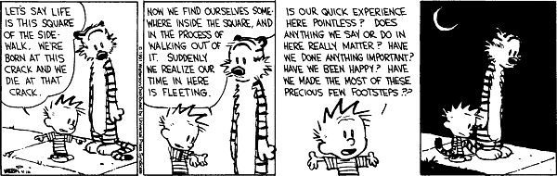
Timetables do push us forward

Slide 6
My childhood’s home I see again,
And sadden with the view;
And still, as memory crowds my brain,
There’s pleasure in it too.
Near twenty years have passed away
Since here I bid farewell
To woods and fields, and scenes of play,
And playmates loved so well.
Where many were, but few remain
Of old familiar things
But seeing them, to mind again
The lost and absent brings.
The friends I left that parting day,
How changed, as time has sped!
Young childhood grown, strong manhood gray,
And half of all are dead.

Slide 7
Historical Changes
Death more visible
Death more common
Mourning period more obvious and culturally defined [“custom of seclusion”]
Shorter Life Span

Slide 8
Studying grief reactions
A. Everyone has the painful experience of loss
B. Our culture poorly understands, poorly responds to grieving individuals
C. The psychological responses to grieving are fairly common across a wide range of individuals, providing a kind of model by which we can analyze another’s grieving
D. Understanding the pattern of these psychological responses, this pattern can be applied to other “little deaths” (e.g., death of a relationship, job loss)

Slide 9
Complicated Bereavement
Anniversary Reactions
Frozen Grief / Ambiguous Loss
Mistreatment of the Deceased
Mummification
Bereavement Overload

Slide 10
Basis for “normal” grieving
A. Some general comments
-What is normal differs over time (should it?)
-What is normal differs from culture to culture
(e.g., Asian denial of death)
B. Common cognitive and behavioral reactions to grief
-Preservation of person’s personal things [e.g., “shrines”]
-Attachment to physical reminders (especially important with children, who are concrete operational rather than abstract)
-Dreams of the deceased

Slide 11
Stages to Recovery
-People experience a wide range of emotions, especially early on in grief process
-People go through a discrete set of stages,
though not necessarily in linear fashion
-Stages can be applied to other LOSSES
-Stages can reveal where bereaved is STUCK

Slide 12
Theorized Stages
1. Shock/Denial
2. Fear
3. Longing
4. Anger
5. Depression
6. and finally…Acceptance

Slide 13
Grief process affected by…
Intensity of relationship
Mental health (e.g., independence, security)
Length of relationship
Age of deceased
Uniqueness of relationship
Circumstances of death
[e.g., preventability of death]
[e.g.,“anticipatory grief” vs. “sudden death”]
“Perceived” closeness
Religious beliefs
Age of bereaved

Slide 14
Children and Death
A. Some Thoughts
Children’s initial exposure often result of a pet dying
Children have a very hard time understanding death
Children: ages 0-5 death equated with departure, seen as temporary (i.e., sleep)
ages 5-9 death can be undone; might not be permanent
B. Development of children’s understanding of death:
Death is permanent, universal, nonfunctional

Slide 15
Children and Death (cont’d)
C. Typical questions children ask
1. Why do people die? (why did X die?)
2. Are they being punished?
3. Where do they go?
4. When will they return?
5. Will YOU die?
D. Suggestions:
-Do not use euphemisms [“Grandma is in God’s house”]
-It is not necessarily bad to take child to funeral service
-Be open and honest with children
-Plan on revisiting the issue (again and again)
-Remember the stages if grief, because you will see them
evidenced in your children
-LISTEN LISTEN LISTEN

Slide 16
Helping yourself and others respond to grief
1. It is ok to not want to let go right away
2. You will never completely let go
3. How bad you feel should not be confused with how much you loved them
4. It is good to talk to others and let others talk to you [“Dear God”]
5. Don’t be surprised if others react differently to this person’s death than you do

Slide 17
Help (cont’d)
6. Be patient with yourselves and others
7. Do not be surprised that a death will affect
many areas of your life
8. What is “normal” and “abnormal” is more
HOW LONG rather than WHAT
9. Plant seeds of hope
10. Start within and work out as far as possible

Slide 18
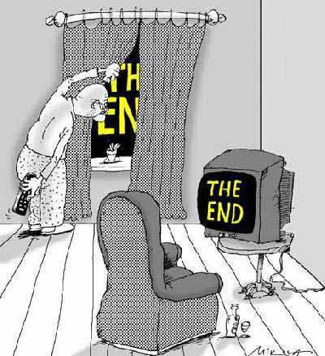
The End?

