Slide 1
Turning away Wrath
Dr Jim Guinee
UCA Counseling Center
October 20, 2008
APEN Conference

Slide 2
Anger Management 101
http://www.youtube.com/watch?v=KcHejBlWtyA&feature=email

Slide 3
Common themes
A. Anger is a futile business
B. Anger has negative consequences
C. True control comes from managing your
anger, not venting/exploding
D. Become aware of own reactions to anger, hostility – a “solvable problem”

Slide 4
Nature and Frequency of Anger
A. Example: Married couples
B. The key is that there is a clear difference between feeling angry
acting angry
C. Do religious groups, teachings prohibit the expression of anger?

Slide 5
Bible Verses about Anger
Ephesians 4:26 “Do not let the sun go down on your anger”
Ephesians 6:4 “Do not provoke your child to anger”
Proverbs 29:11 A fool gives full vent to his anger
James 1:19 Be slow to speak and slow to become angry
Proverbs 14:29 He who is slow to anger has great understanding
Proverbs 15:1 A gentle answer turns away wrath, but a harsh word stirs up anger

Slide 6
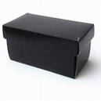
The Black Box

Slide 7
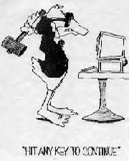
Angry people don’t realize
A. They choose to be angry

Slide 8
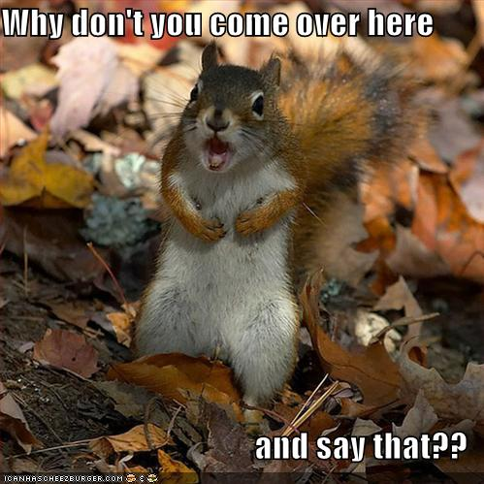

Slide 9

B. They become conditioned to react angrily

Slide 10
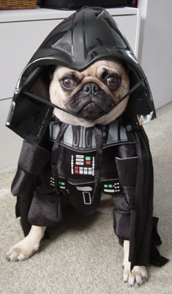
Luke…I am your father’s dog!!

Slide 11

Rewinding the video tape

Slide 12
Benefits of analysis
1. See negative outcome
2. Access chain of thoughts
3. Revise the situation
4. Model the “right” behavior

Slide 13
Helpful strategies
A. It isn’t always about YOU
The problem with personalizing
B. Don’t judge outsides with your insides
The fundamental attribution error
C. The Principle of Least Intervention
Smallest amount as early as possible

Slide 14
Helpful strategies (cont’d)
D. Self-talk is Good Medicine
Examples: “My therapist says this is not about me, this is about you.”
“You’re going to wear yourself out being that nasty.”
“Thank you for sharing your anger, I’m not allowed to accept gifts.”

Slide 15
Helpful strategies (cont’d)
E. Owning your problems
Solve the problem vs. Win argument
Decrease defensiveness, increase receptivity
FORMULA: "I have a problem. When you ______ (specific behavior), then _____ (specific consequences) happens, and I feel ___. And I don’t like that.“

Slide 16
Helpful strategies (cont’d)
F. Don’t assume the level of concern until
you control the degree of knowledge
NOT KNOWING and/or NOT CARING
G. Spiritual Solutions
H. Don’t forget counseling

Slide 17
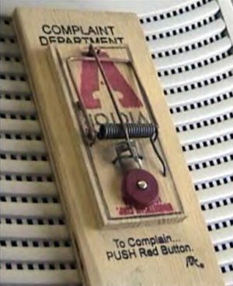
I. Sense of Humor

Slide 18
I tried it, it didn’t work ☹
When faced with an immoveable obstacle (i.e., the other person):
Deal with it
Leave the relationship, leave the environment

Slide 19
Change your attitude
Change your behavior
Is this fair? No.
But who said life was fair?

Slide 20

Final Comments

